Slide 1


Optimization of Co addition amount to enhance thermoelectric properties of β-FeSi₂
Sopheap Sam¹,*, Genki Kashikawa¹, Hiroshi Nakatsugawa¹, Yoichi Okamoto²
Yokohama National University, Japan
National Defense Academy, Japan
* E-mail: sam-sopheap-fh@ynu.jp
2022-March-24

Slide 2
Outline
Introduction
- Crystal and band structure FeSi_{2.}
- Phase transition of FeSi_{2.}
- Review of previous researches.
- Strategy to improve TE performance of β-FeSi₂.
2. Experimental method
- Fabrication and measurement.
3. Results and discussions
- Phase transition of FeSi₂ and crystal structure.
- Thermoelectric properties (Seebeck coefficient, electrical resistivity, thermal conductivity, and ZT).
4. Conclusions

Slide 3
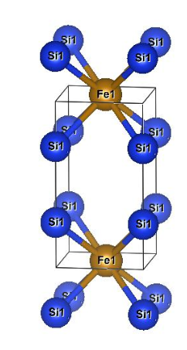
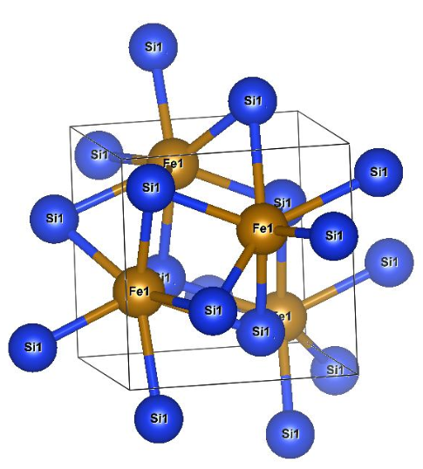
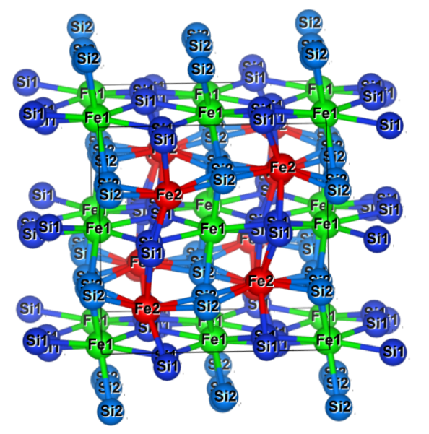
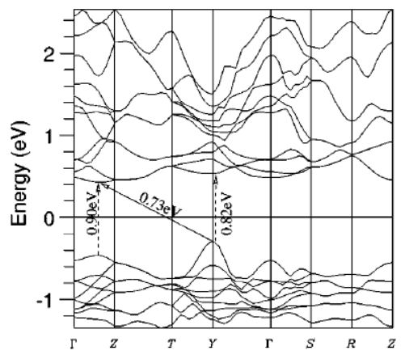
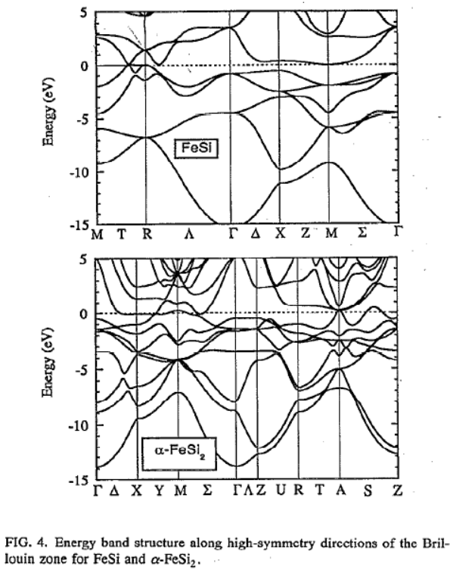
Crystal and band structure of each phase FeSi₂
Orthorhombic β-phase
Tetragonal α-phase
Cubic ε-phase
Si2
Fe1
Si1
Fe2
Space group: Cmca
Space group: P4mmm
Space group: P2₁3
S. J. Clark et al., Physical review B., 58,16 (1998)
R. Girlanda et al., J. Appl. Phys. 76, 2837 (1994)

Slide 4
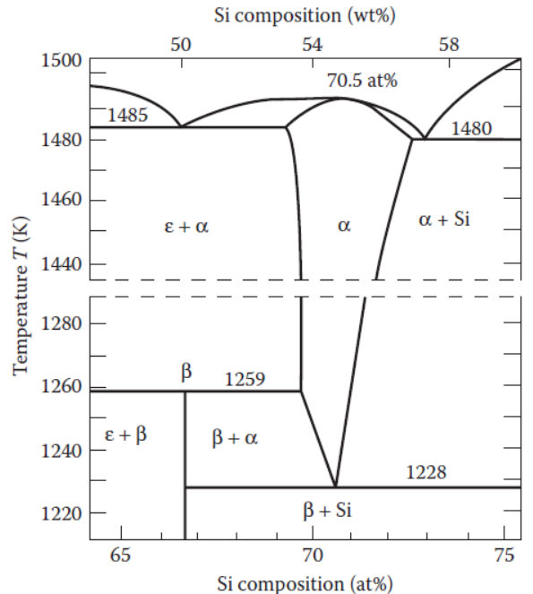
Phase transition diagram of FeSi₂
The β-FeSi₂ based material is a promising candidate for thermoelectric (TE) application working at high temperatures up to 900 ºC due to:
Environmental friendliness
Good thermal stability
Strong oxidation resistance
Low cost.
[X. L. Du et al., Acs Applied Materials & Interfaces, 12, 12901-12909 (2020)]
The equilibrium phase diagram for the system Fe–Si by Piton and Fay. α-phase:FeSi2, β-phase:FeSi2, ε-phase:FeSi.

Slide 5
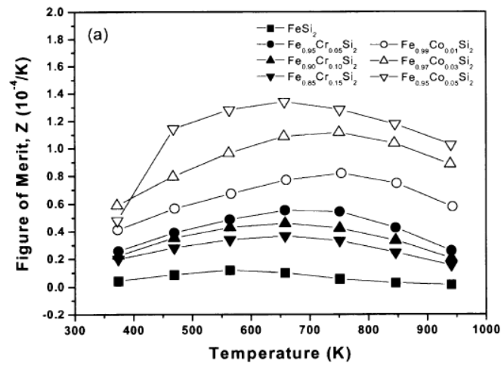
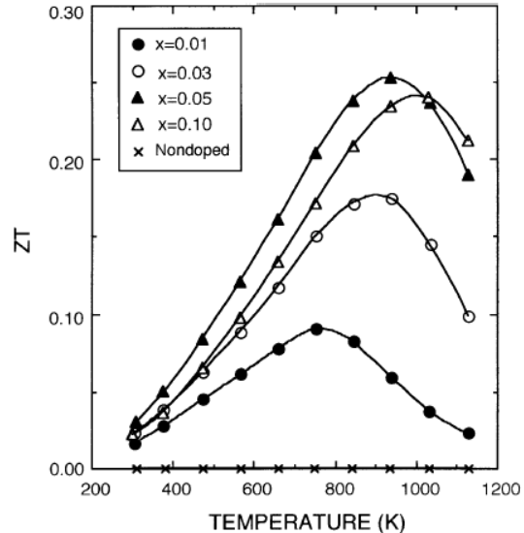
Review of previous researches
ZT_{max} = 0.085 at 657 K of Fe_{0.95}Co_{0.05}Si₂ by pressure sintering method.
ZT_{max} = 0.25 at 940 K of Fe_{0.95}Co_{0.05}Si₂ by spark plasma sintering method.
[S. W. Kim et al., Intermetallics, 11, 399-405 (2003)]
[J. Tani and H. Kido, Japanese Journal of Applied Physics, 40, 3236-3239 (2001)]
S: Seebeck coefficient [V/K]
ρ: resistivity [Ω.m]
κ: thermal conductivity[W/m.K]

Slide 6
Strategy to improve TE performance of β-FeSi₂ by Co doping
Resistivity (ρ) can be decreased by the increase in carrier density (n_{H}) by Co-doing due to the larger valence electron.
mobility
Seebeck coefficient (S) :
large m_{e}*
In β-FeSi₂ (x=0), the Seebeck coefficient |S| decreases with increasing temperature because of the bipolar effect.
By Co doping, Hall mobility μ_{H} decreases and |S| increases because of the majority carrier for electrons.
small m_{h}*
However, with increasing x, as decreasing the ρ, the Seebeck coefficient |S| also decreases. Therefore, we need to find the optimum Co doping and carrier density in β-Fe_{1-x}Co_{x}Si₂ .

Slide 7
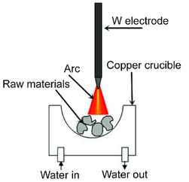
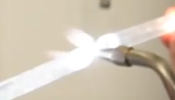
Experimental method
Fabrication :
Measurement :
Arc-melting (20g)
NC wire cut
7x7x1.5mm
Vacuum sealing in quartz tube
Heat treatment 1150 ºC, 3h
Annealing
840 ºC, 20h
XRD by Smart Lab, Rigaku
Rietveld analysis by RIETEN-FP
Thermal conductivity by power efficiency measurement (PEM-2)
ZT calculated by above parameters
Carrier concentration and mobility at RT by ResiTest 8300
Resistivity and Seebeck coefficient by ResiTest 8300 and homemade apparatus
7x7x1.5mm
Furnace 1150 ºC, 3h.
Furnace 840 ºC, 20 h.

Slide 8
X-ray diffraction patterns of Fe_{1-x}Co_{x}Si₂ (0 ≤ x ≤ 0.10) at room temperature
(202)
(202)
(422)
(422)
β-phase
β-phase
(331)
x=0.00
(331)
x=0.05
Phase transition
(242)
(515)
(242)
(312)
(024)
(533)
(221)
(024)
(602)
(312)
(602)
(533)
(515)
(221)
(112)
(112)
The α phase (metallic phase) is grown from x=0.07 sample. This phase is not good for TE application.
β-phase
β-phase
x=0.005
x=0.06
Intensity /arb.unit
Intensity / arb.unit
β-phase
x=0.01
α, (312)
α+β-phase
β-phase
x=0.07
x=0.015
β-phase
α, (312)
α+β-phase
x=0.02
x=0.08
β-phase
α, (312)
α+β-phase
x=0.03
x=0.09
∆V is low in metallic phase.
β-phase
α+β-phase
x=0.04
α, (312)
x=0.10
Diffraction angle, 2θ / degree
Diffraction angle, 2θ / degree

Slide 9
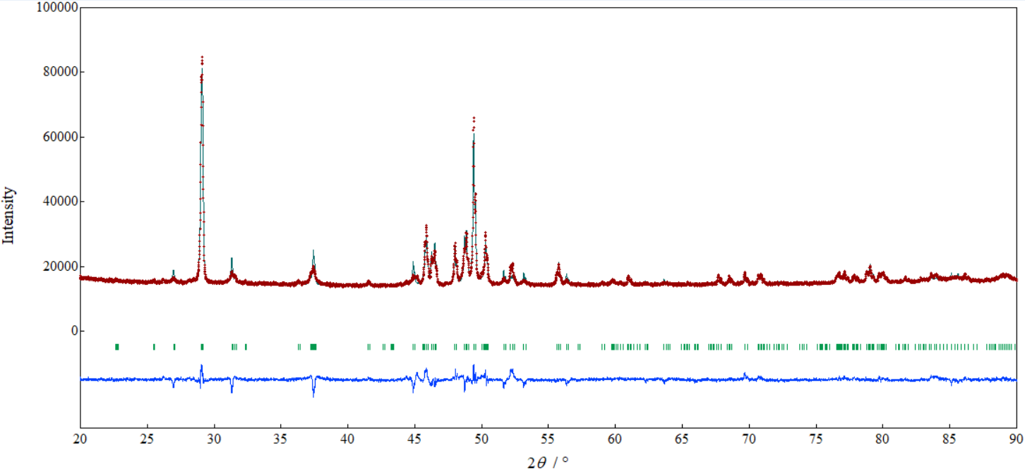
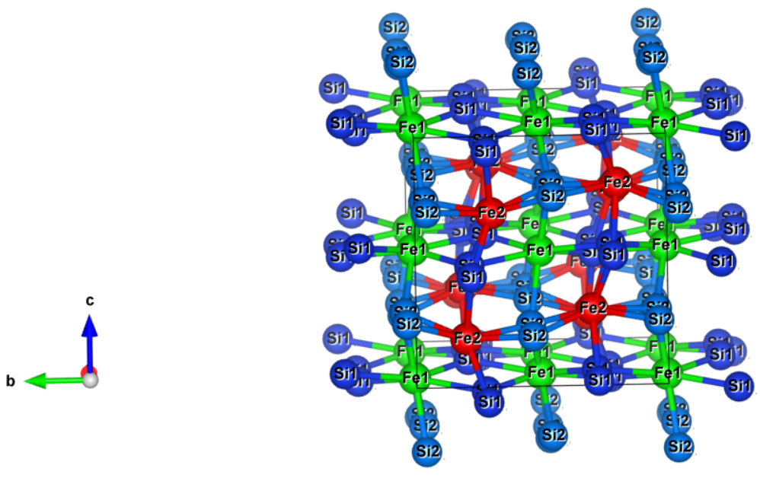
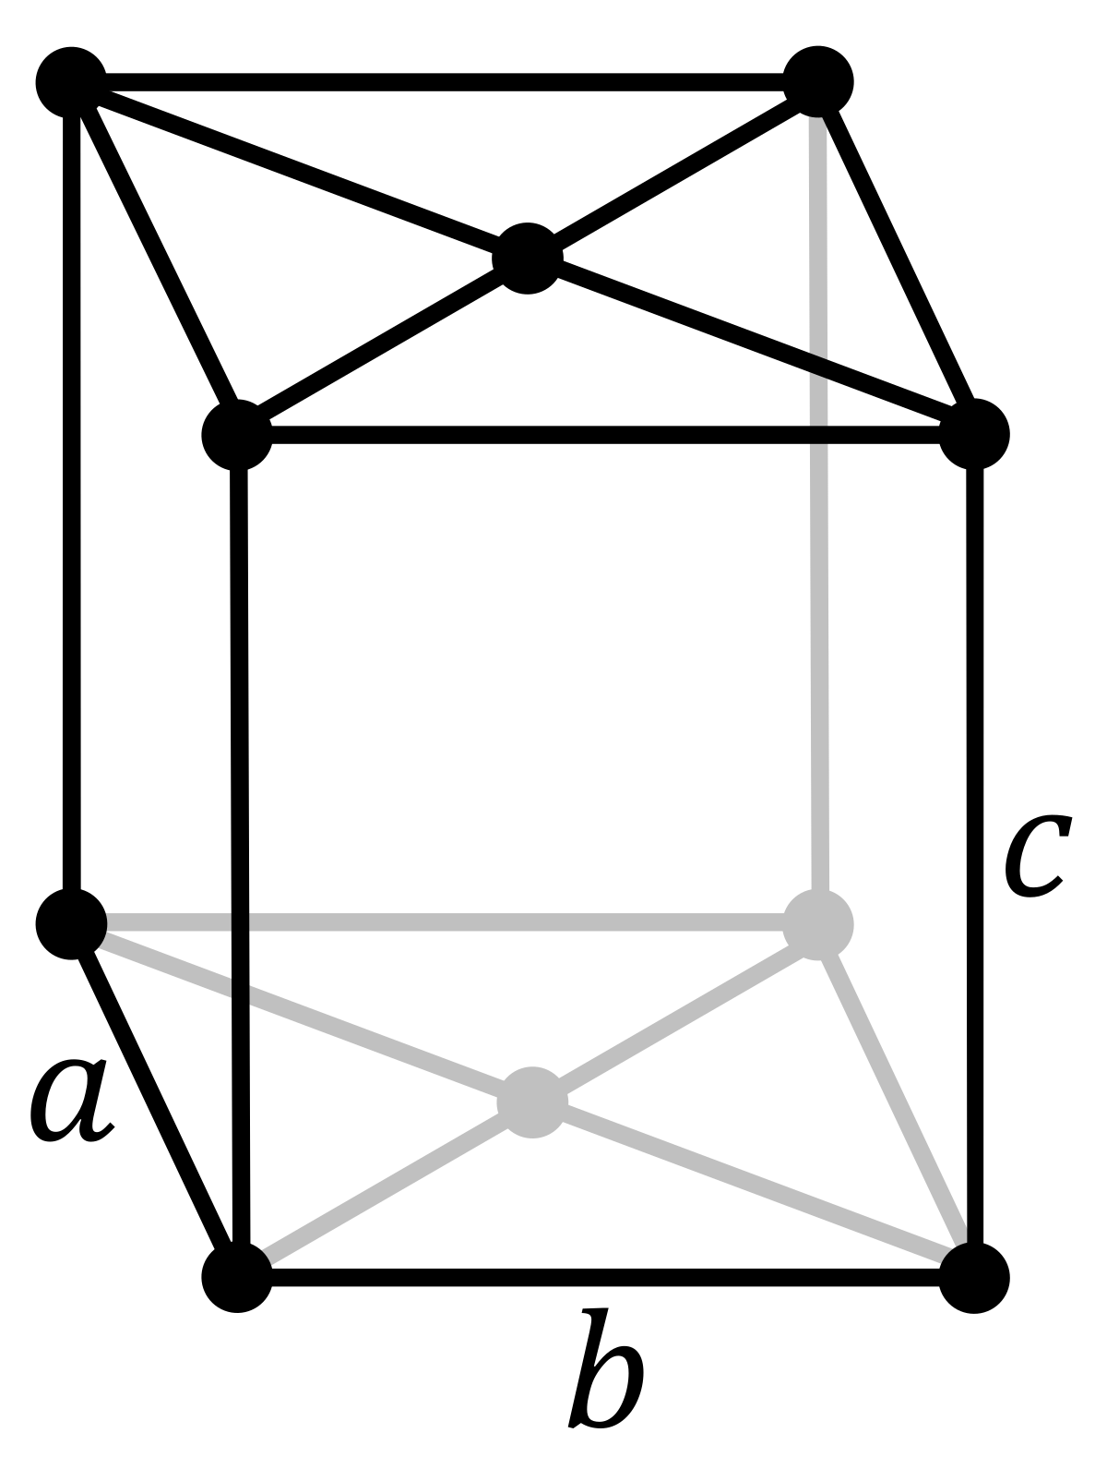
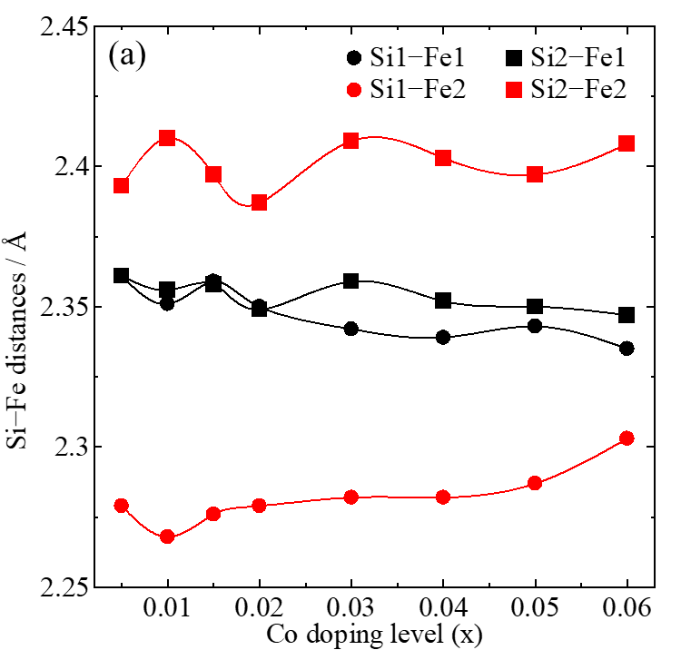
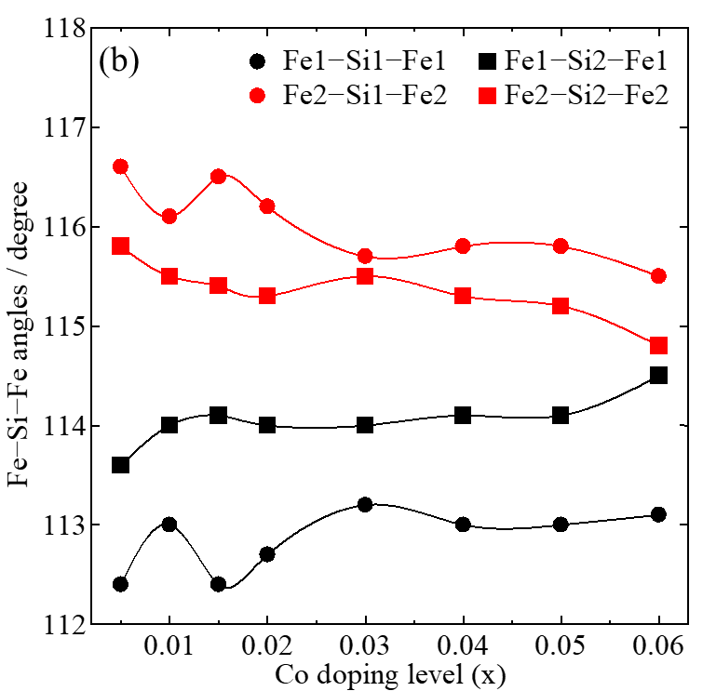
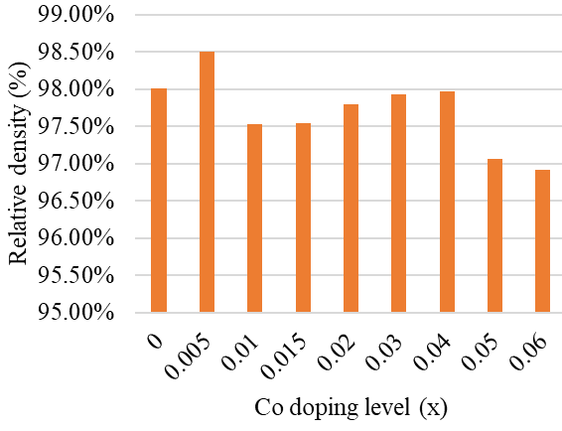
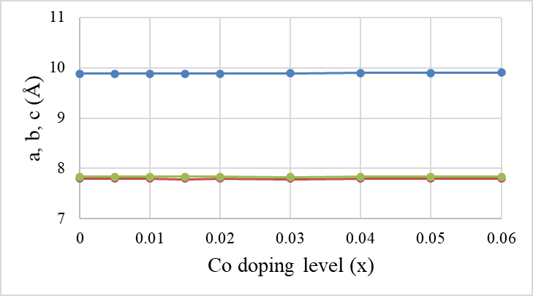
Crystal structure identification by Rietveld analysis
By using Rietveld Analysis with the measured data of XRD, all samples were grown in single beta β phase crystal structure with Cmca space group (base-centered orthorhombic) after heat treatment 1150 ºC 3 h and annealing 840 ºC 20 h.
FeSi₂
Si2
(202)
β-FeSi₂
Fe1
(422)
Si1
(331)
Fe2
(112)
(312)
(024)
(221)
(242)
(533)
(515)
(602)
a
b & c

Slide 10
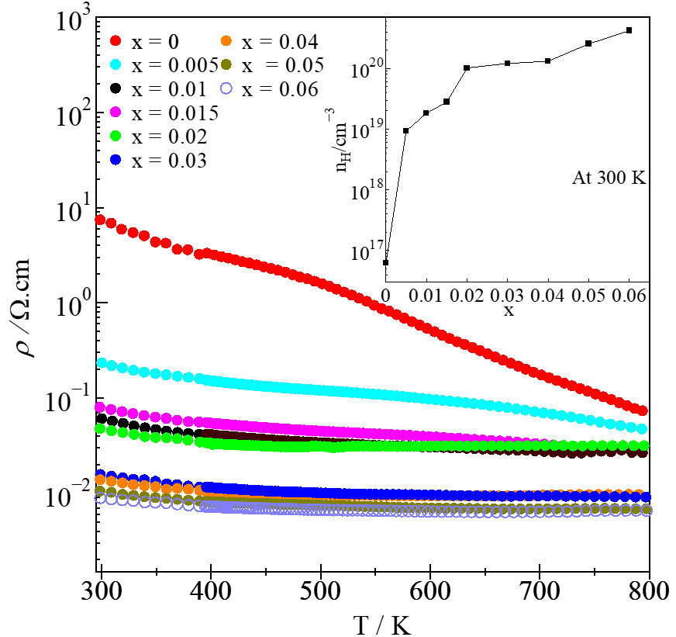
Electrical resistivity (ρ) and Seebeck coefficient (S) of β-Fe_{1-x}Co_{x}Si₂
Bipolar effect deteriorates S due to narrow band gap.
As Co addition increases, the ρ significantly decreases due to high n_{H}.
At 300K, the |S| of 0.005 ≤ x ≤ 0.06 samples are in range 371-145 μV/K which is higher than 127 μV/K of x = 0 .

Slide 11
Thermal conductivity (κ) of β-Fe_{1-x}Co_{x}Si₂
The high values of κ are found in x=0.005, while the minimum values of that are obtained in x=0.04. The κ slightly decreases with Co addition.

Slide 12
Thermoelectric performance (ZT) of β-Fe_{1-x}Co_{x}Si₂
The highest ZT of non-doped β-FeSi₂ is only about 2.6 × 10⁻⁴ at 450K.
ZT_{max} = 0.099 at 720-800 K is obtained in x=0.03 with the optimum n_{H} =1.2(4) × 10²⁰ cm⁻³ and μ_{H}= 3.5(6) cm².V⁻¹.s⁻¹.
ZT_{max}
The improvement of ZT in Co-doped samples is due to the significant enhancement in PF and also the slight reduction in κ.

Slide 13
Conclusions
The thermoelectric (TE) materials β-Fe_{1-x}Co_{x}Si₂ (0 ≤ x ≤ 0.06) have been successfully fabricated and TE properties were measured.
The |S| of all Co doping samples is higher than that of non-doping sample due to the absence of bipolar effect with the lower electrons mobility.
The |S| and ρ simultaneously decrease with increasing Co addition due to the increase in n_{H}.
The highest ZT = 0.099 at 720-800 K is obtained in optimum point x = 0.03 with the n_{H} around 1.2(4) × 10²⁰ cm⁻³.
Authors | ZT_{max} | x | Temperature [K] | Fabrication method
J. Tani and H. Kido | 0.25 (higher S) | 0.05 | 940 | Spark plasma sintering
S. W. Kim et al. | 0.085 (lower S) | 0.05 | 657 | Pressure sintering
This study | 0.099 | 0.03 | 720-800 | Arc melting

Slide 14
Thank you for your attention!

Slide 15
TE properties at RT
x | L_{𝚶} [V²/K²] | r | n_{H} [1/cm³] | μ_{H} [cm²/V.s ] | |S| [μV/K] | ρ [Ω.cm] | κ [W/mK]
0 | 1.792×10⁻⁸ | -1/2 | 6.3(9)×10¹⁶ | 14(2) | 127 | 7.23(7) | 7.16
0.005 | 1.625×10⁻⁸ | -1/2 | 9.3(0)×10¹⁸ | 6.1(3) | 371 | 0.108(0) | 8.97
0.01 | 1.625×10⁻⁸ | -1/2 | 1.8(0)×10¹⁹ | 5.4(2) | 357 | 0.063(0) | 6.72
0.015 | 1.627×10⁻⁸ | -1/2 | 2.8(4)×10¹⁹ | 5.2(8) | 299 | 0.043(0) | 6.82
0.02 | 1.628×10⁻⁸ | -1/2 | 1.0(8)×10²⁰ | 4(2) | 287 | 0.027(1) | 6.30
0.03 | 1.644×10⁻⁸ | -1/2 | 1.2(4)×10²⁰ | 3.5(6) | 213 | 0.015(0) | 6.33
0.04 | 1.671×10⁻⁸ | -1/2 | 1.3(0)×10²⁰ | 2.4(0) | 179 | 0.019(0) | 5.14
0.05 | 1.688×10⁻⁸ | -1/2 | 2.5(3)×10²⁰ | 2.4(4) | 167 | 0.010(0) | 5.18
0.06 | 1.735×10⁻⁸ | -1/2 | 4.2(8)×10²⁰ | 1.9(4) | 145 | 0.008(0) | 5.26

Slide 16
Power factor (PF) of β-Fe_{1-x}Co_{x}Si₂
The highest PF value of non-doped sample is only around 3.4 μW.m⁻¹. K⁻² at 450K.
By doping with Co, the PF was significantly enhanced.
The optimum doping x=0.03 with the maximum value of around 900 μW.m⁻¹. K⁻² at 720-800K
PF_{max}

Slide 17
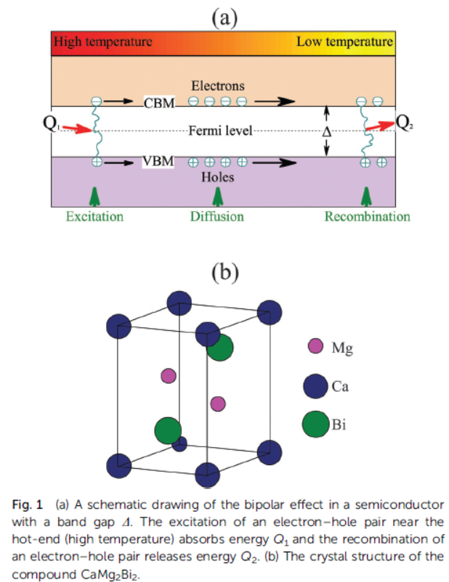
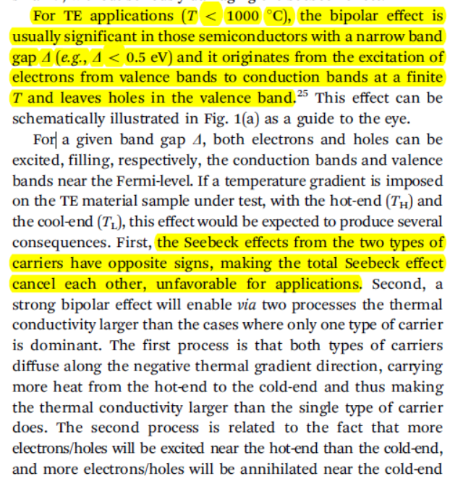
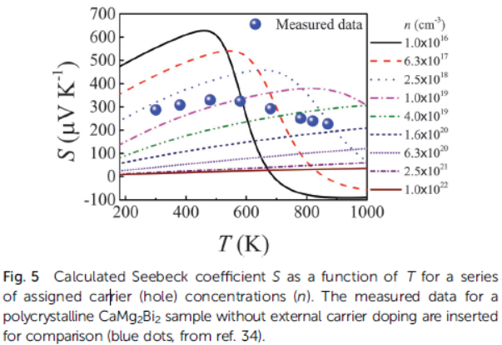
Bipolar
Bipolar effect remarkably dominate at low n_{H} .
J. J. Gong et al., Physical Chemistry Chemical Physics,18, 16566-16574 (2016).

