Slide 1
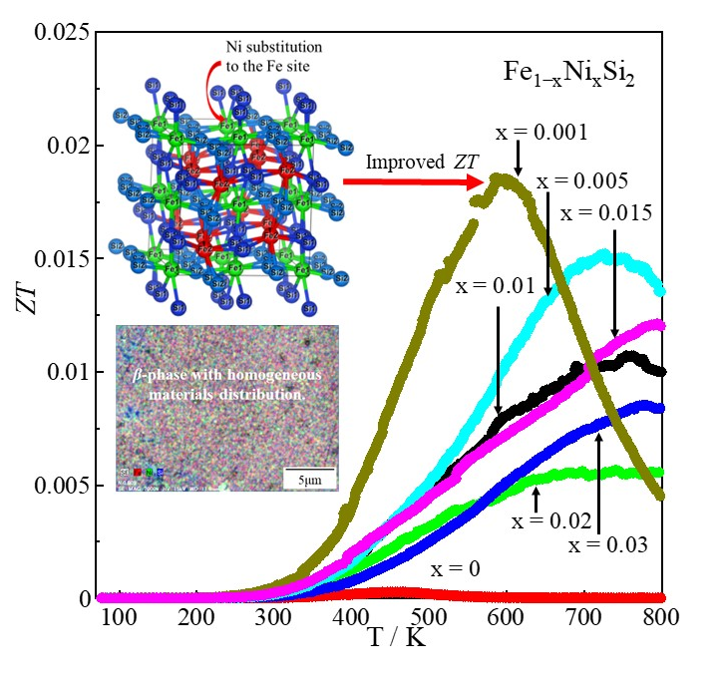
Thermoelectric properties of bulk Ni-doped 𝛃-FeSi₂
Sopheap Sam^{1,} *, Soma Odagawa¹, Hiroshi Nakatsugawa¹, Yoichi Okamoto²
Yokohama National University, Japan
National Defense Academy, Japan
* E-mail: sam-sopheap-fh@ynu.jp
2023-March-16th

Slide 2
Content
Introduction
- Crystal and band structure FeSi_{2.}
- Phase transition of FeSi_{2.}
- Review of previous research.
- Improve thermoelectric(TE) performance of β-FeSi₂ by Ni substitution.
2. Experimental method
- Fabrication and measurement.
3. Results and discussion
- Crystal structure and phase identification.
- TE properties (Seebeck coefficient, electrical resistivity, thermal conductivity, and ZT).
4. Conclusions

Slide 3
1. Introduction

Slide 4
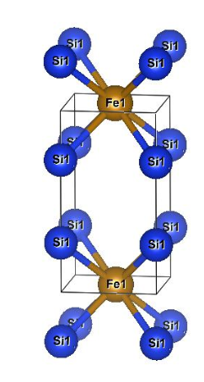
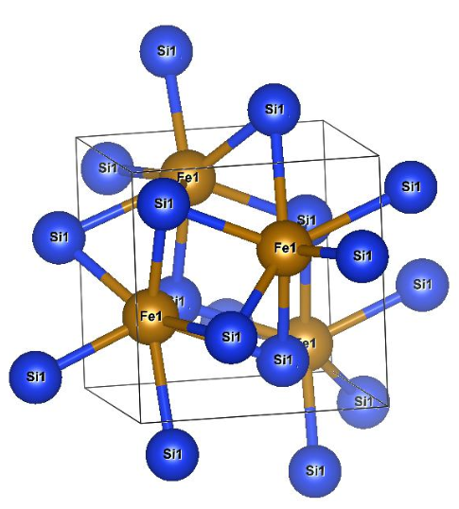
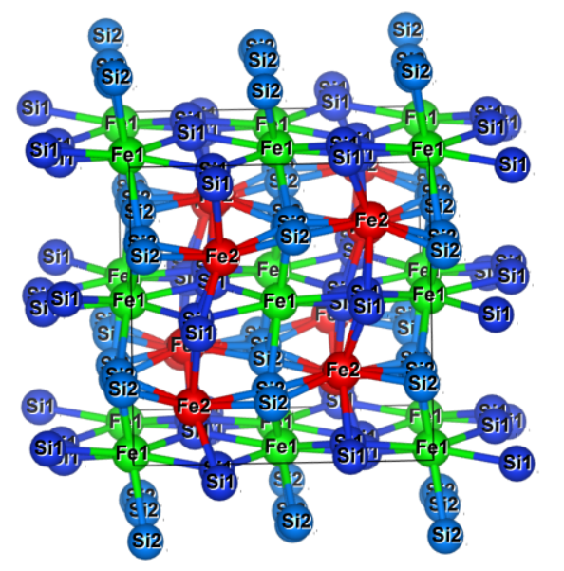
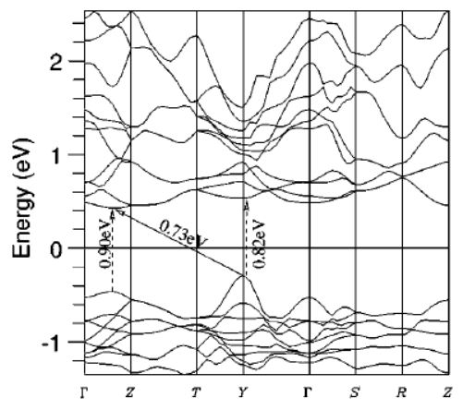
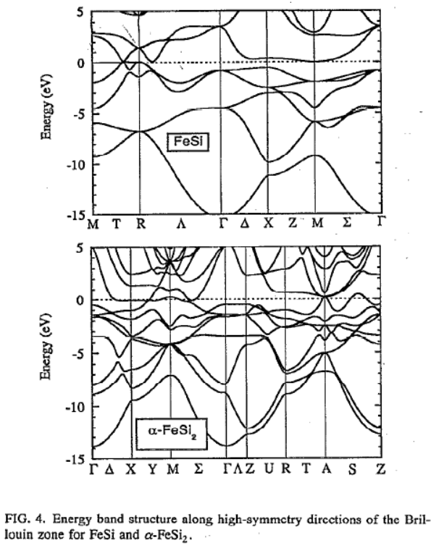
Crystal Structure of each phase FeSi₂
Orthorhombic β-phase
Tetragonal α-phase
Cubic ε-phase
Space group: Cmce
Space group: P4mmm
Space group: P2₁3
S. J. Clark et al., Phys. Rev. B., 58,16 (1998)
R. Girlanda et al., J. Appl. Phys. 76, 2837 (1994)

Slide 5
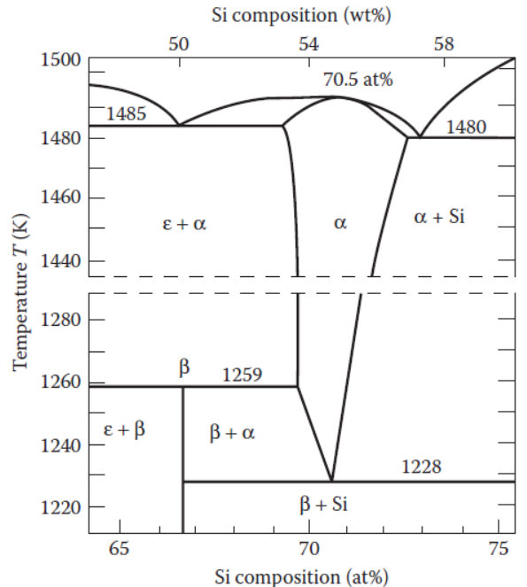
Phase transition diagram of FeSi₂
The β-FeSi₂ based material is a promising candidate for thermoelectric (TE) application working at high temperatures due to:
Environmental friendliness
Good thermal stability
Strong oxidation resistance
Low cost.
X. L. Du et al., Acs Appl. Mater. Interfaces, 12, 12901-12909 (2020).
The equilibrium phase diagram for the system Fe–Si by Piton and Fay. α-phase:FeSi2, β-phase:FeSi2, ε-phase:FeSi.
J. P. Piton and M. F. Fay, C. R. Acad. Sci. (Paris). C266, 514–516 (1968).

Slide 6
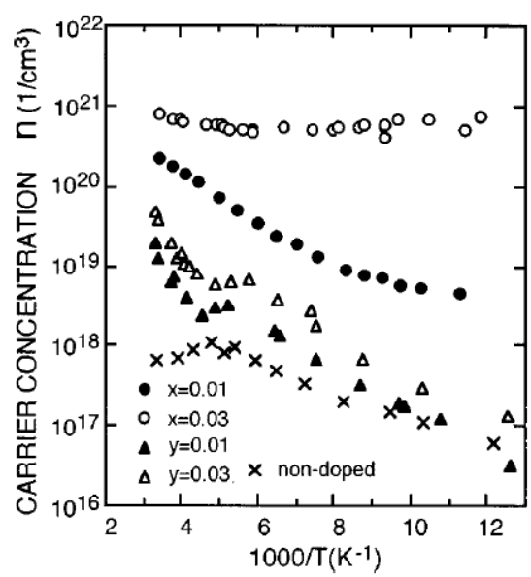
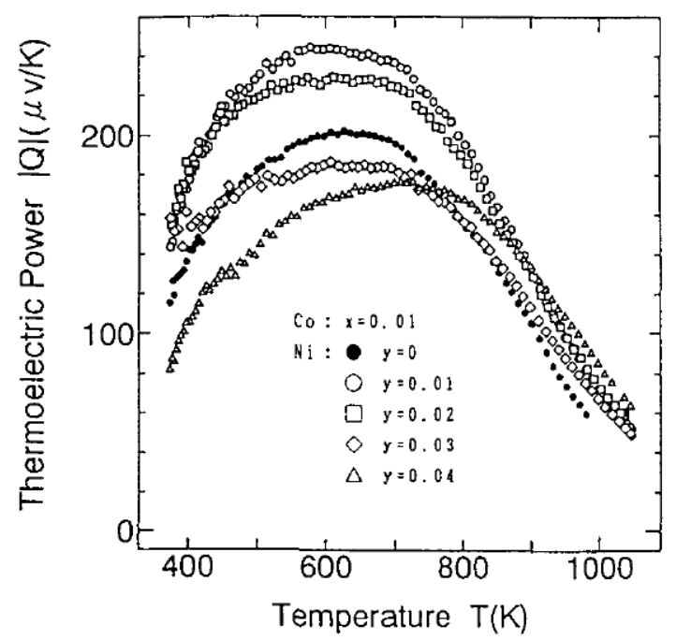
Review of previous research
S_{max} at Ni doping 0.01
β-Fe_{0.99-y}Co_{0.01}Ni_{y}Si₂
β-Fe_{1-y}Ni_{y}Si₂
J. Tani and H. Kido J. Appl. Phys., 84, 1408-1411 (1998).
H. Nagai et. al., J. Jpn. Soc. Powder Powder Metall., 41, 560-564, 1994.
ρ can be reduced due to an increase in carrier concentration.
S can be increased by Ni substitution probably due to a reduction in mobility.
S: Seebeck coefficient [V/K]
ρ: resistivity [Ωm]
κ: thermal conductivity[W/mK]

Slide 7
Improve TE performance of Ni doping Fe_{1-x}Ni_{x}Si₂
Resistivity (ρ):
; Ni valence electron = 2 Fe.
Mobility
Seebeck coefficient (S) :
large m_{e}*
In pure β-FeSi₂ (x=0), the Seebeck coefficient |S| decreases with increasing temperature because of the bipolar effect.
By Ni doping, Hall mobility μ_{H} decreases and |S| increases because of the majority carrier are electrons.
small m_{h}*
Find the optimum Ni doping to improve the performance of β-FeSi₂!

Slide 8
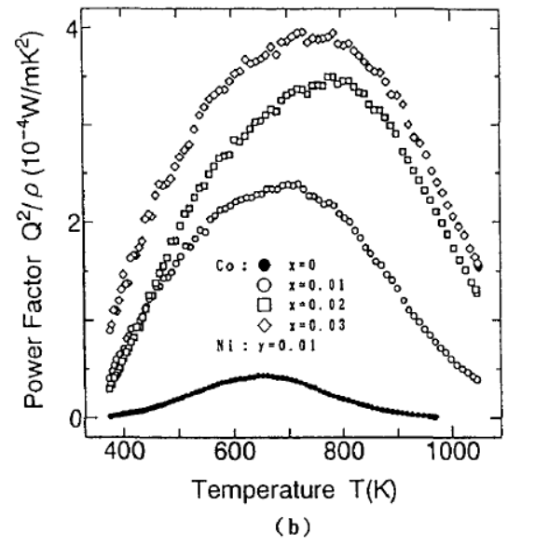
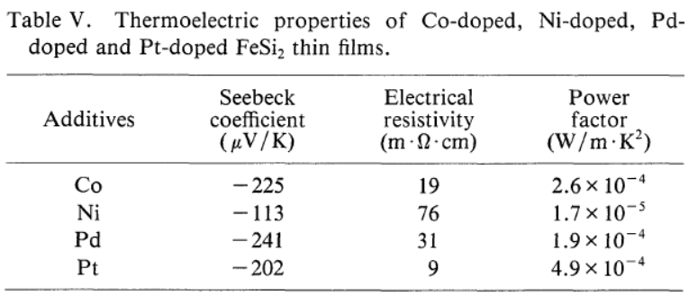
Research purpose:
Investigate the thermoelectric properties of Ni-doped β-FeSi₂ prepared by the direct arc melting method.
Study the effect of Ni on the solid solution limit and phase transition of β-FeSi₂.
Find the optimum doping concentration of Ni substitution to improve thermoelectric properties.
Power factor of Ni-doped β-FeSi₂ of previous research:
Komabayashi et al. Jpn. J. Appl. Phys. ,30, 1906 (1991).
Nagai et al. J. Jpn. Soc. Powder Powder Metall. 41, 560 (1994).

Slide 9
2. Experimental method

Slide 10
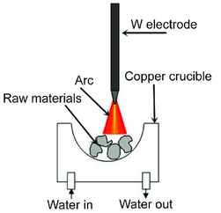
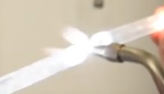
Fabrication :
Measurement :
XRD by Smart Lab, Rigaku
Rietveld analysis by RIETEN-FP
Thermal conductivity by power efficiency measurement (PEM-2)
ZT calculated by above parameters
Carrier concentration and mobility at RT by ResiTest 8300
Resistivity and Seebeck coefficient by ResiTest 8300 and homemade apparatus
3D SEM VE-8800
Arc-melting (20g)
NC wire cut
7x7x1.5mm
Vacuum sealing in quartz tube
Heat treatment 1150 ºC, 3h
Annealing
840 ºC, 20h
7x7x1.5mm
Furnace 1150 ºC, 3h.
Furnace 840 ºC, 20 h.
This annealing condition was optimized by Ohtaki et al., for Cu, Zn, Nb, Ag, and Sb doping.
Ohtaki et al., Chem. Lett. 22, 1067-1070 (1993).

Slide 11
3. Results and discussion

Slide 12
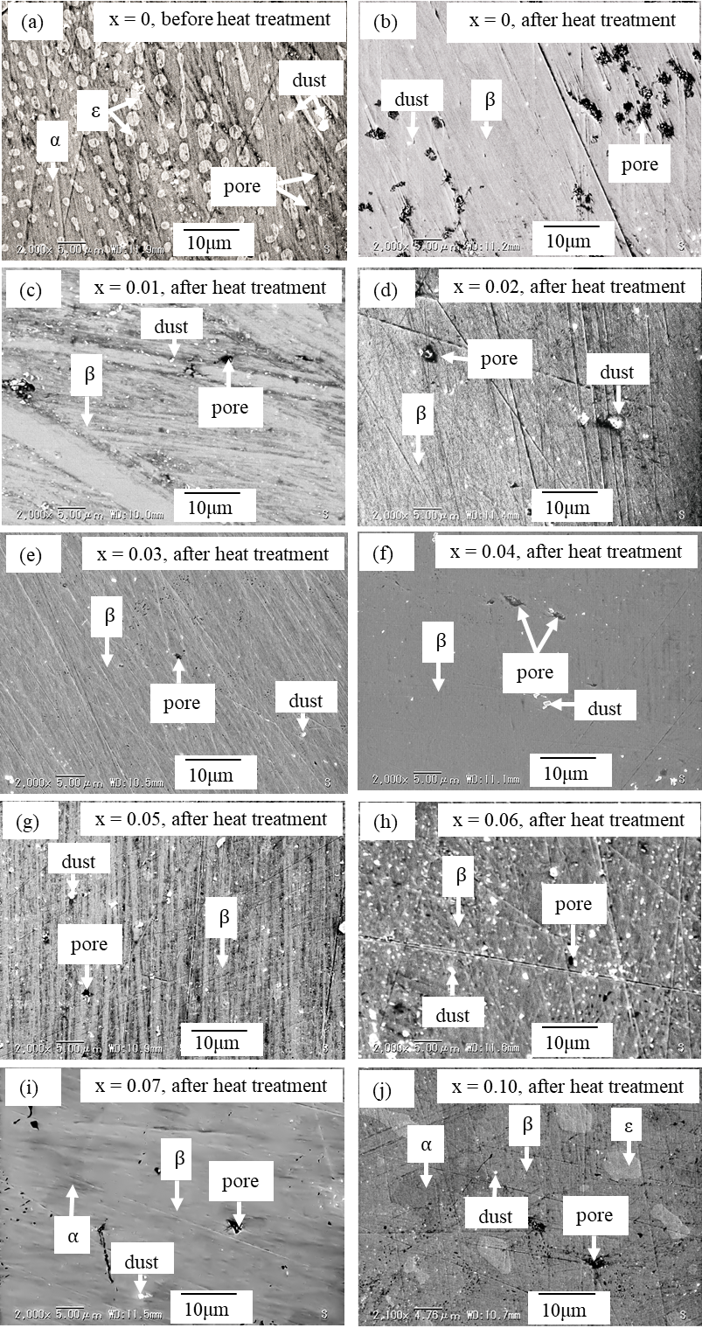
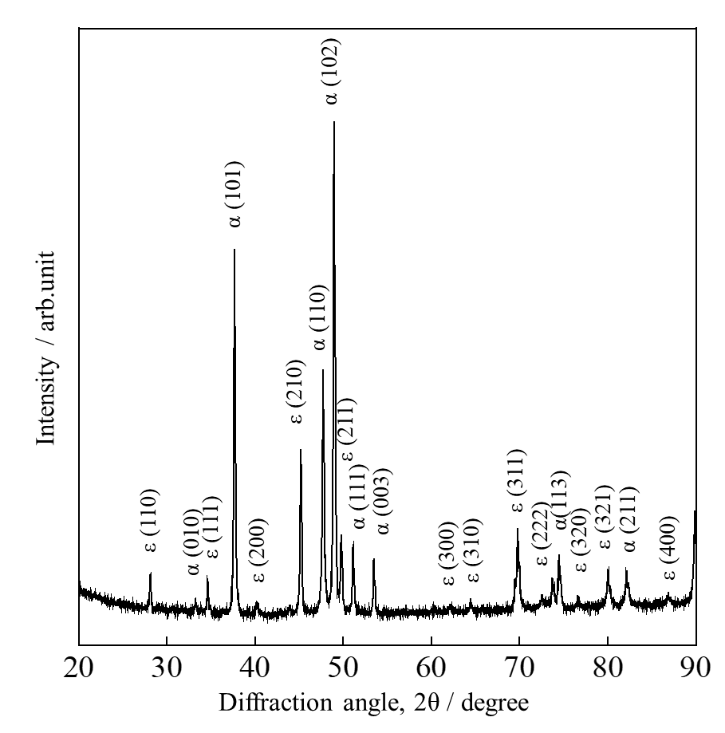
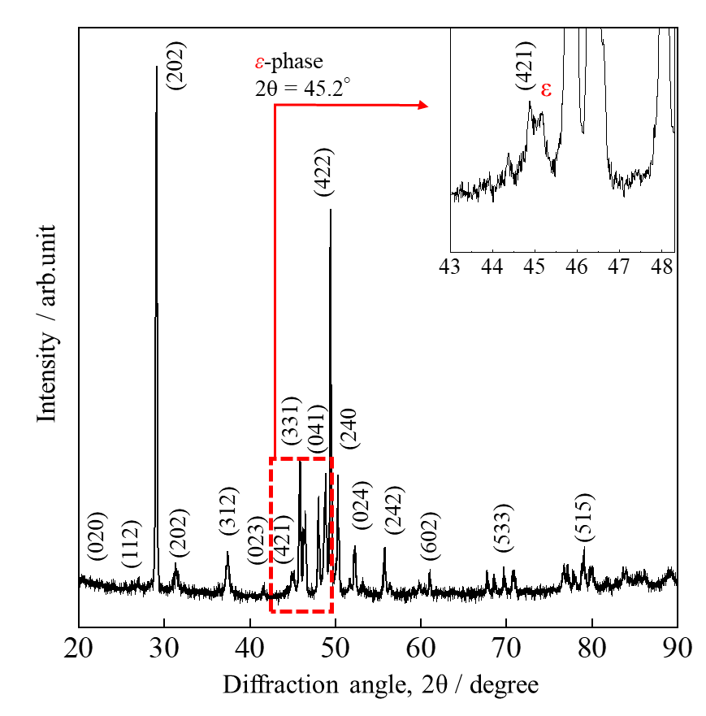
X-ray diffraction patterns and SEM images of non-doped FeSi₂ (x = 0)
Before
After
Heat treatment at:
1150 ºC, 3h
840 ºC, 20h
Before heat treatment
After heat treatment
ε + α phases.
Non-doped, x = 0.
β + ε phases.
Non-doped, x = 0.
Indexed peaks are β-phases

Slide 13
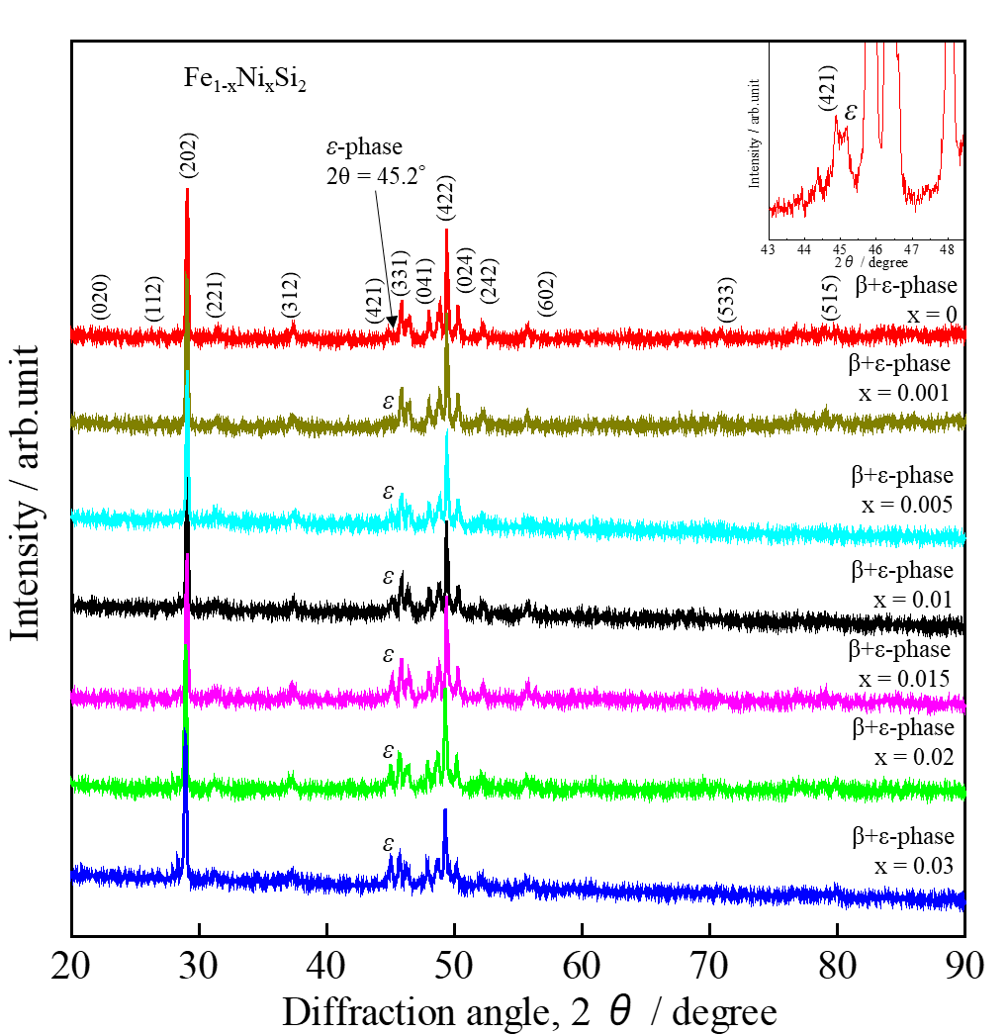
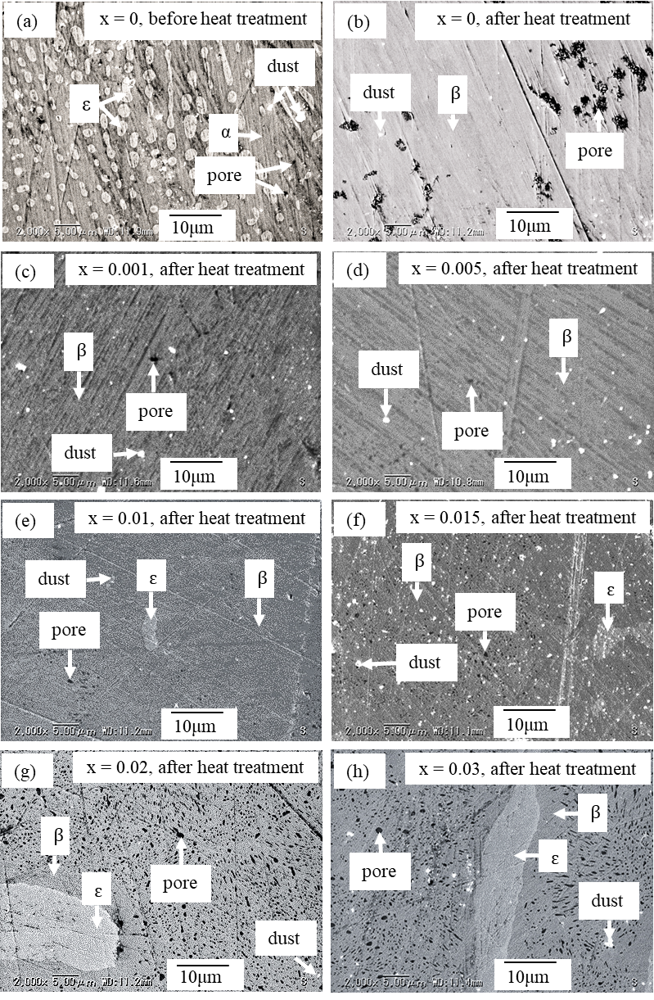
X-ray diffraction patterns and SEM images of Fe_{1-x}Ni_{x}Si₂ at room temperature

Slide 14
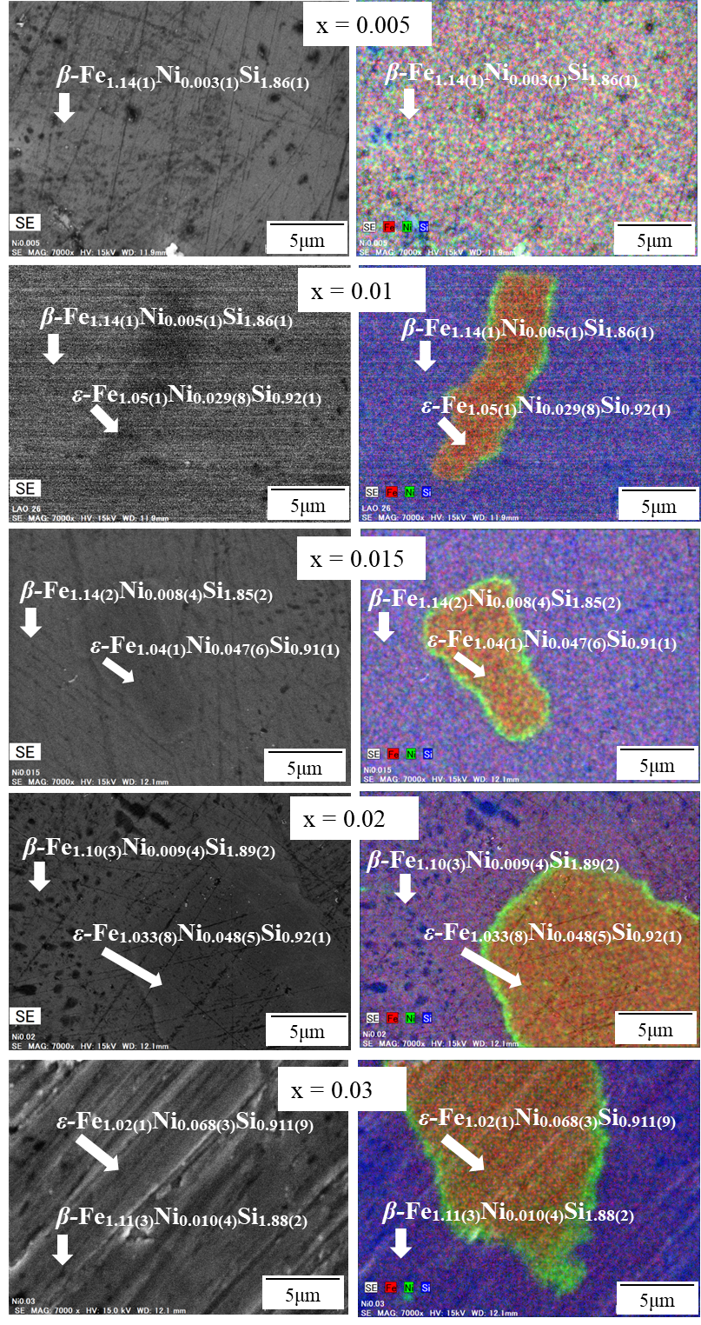
Elemental analysis by SEM-EDS at room temperature
The ε-phase increases with Ni substitution and solid solution limits of Ni in β-FeSi₂ can be lower than 1%.

Slide 15
Electrical resistivity (ρ) of β-Fe_{1-x}Ni_{x}Si₂
x
n_{H}
ρ
μ_{H}
ρ
The increase in n_{H} contributes positively to the decrease in ρ.
The decrease in μ_{H} contributes negatively to the decrease in ρ.

Slide 16
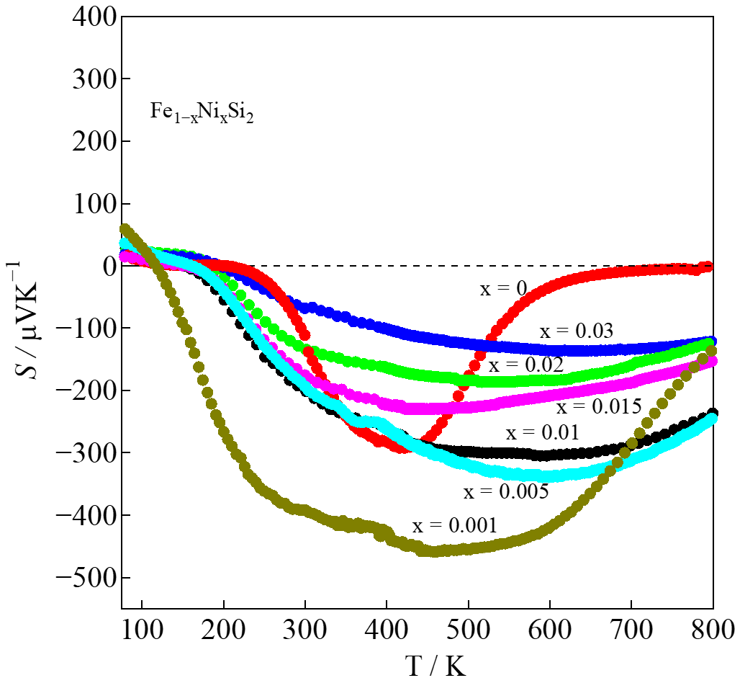
Seebeck coefficient (S) of β-Fe_{1-x}Ni_{x}Si₂
x=0, bipolar effect deteriorates S.
|S|_{max}
x
n_{H}
|S|
The bipolar effect is reduced by Ni substitution

Slide 17
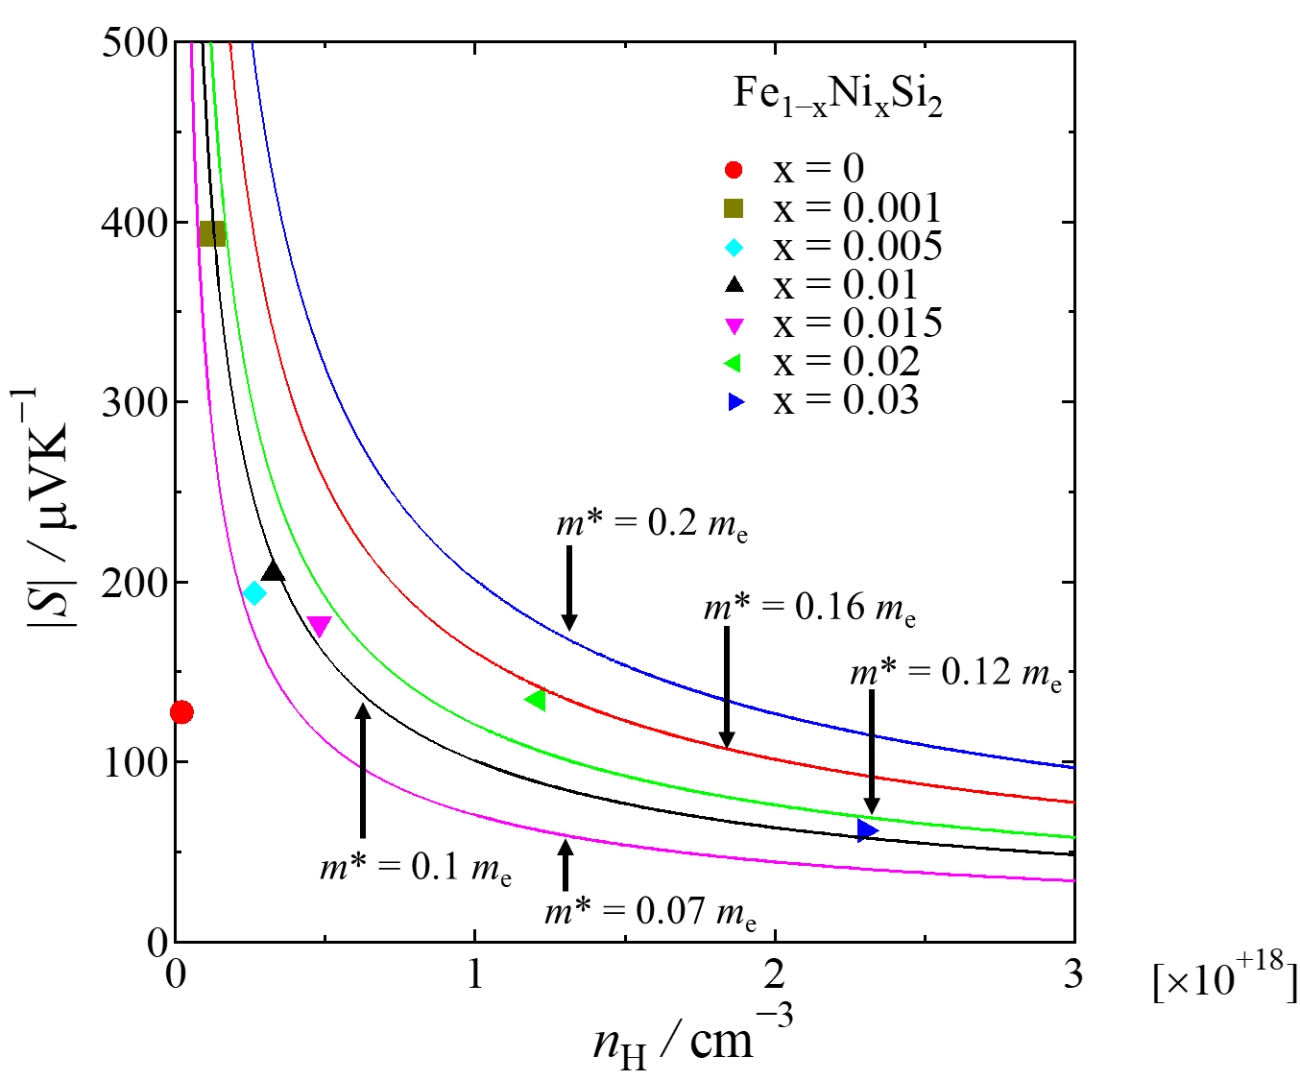
Seebeck coefficient vs carrier density at room temperature
Solid lines are the calculated data at various effective masses (m*) using Mott’s equation:
Various shape plots are the experimental data.
A good fitting condition is obtained at m* = 0.12m_{e}.
The Ni-doped sample has an effective mass of 0.12m_{e}, mobility of about 10 - 40 cm²V⁻¹s⁻¹, and relaxation time of about 0.68 fs - 2.73 fs.

Slide 18
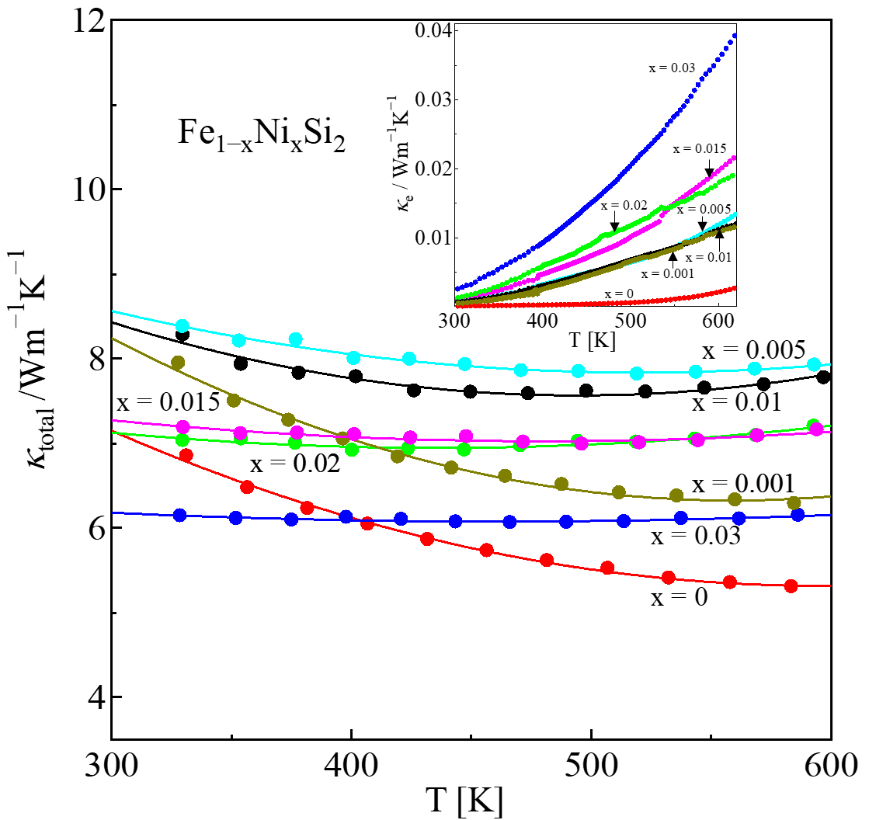
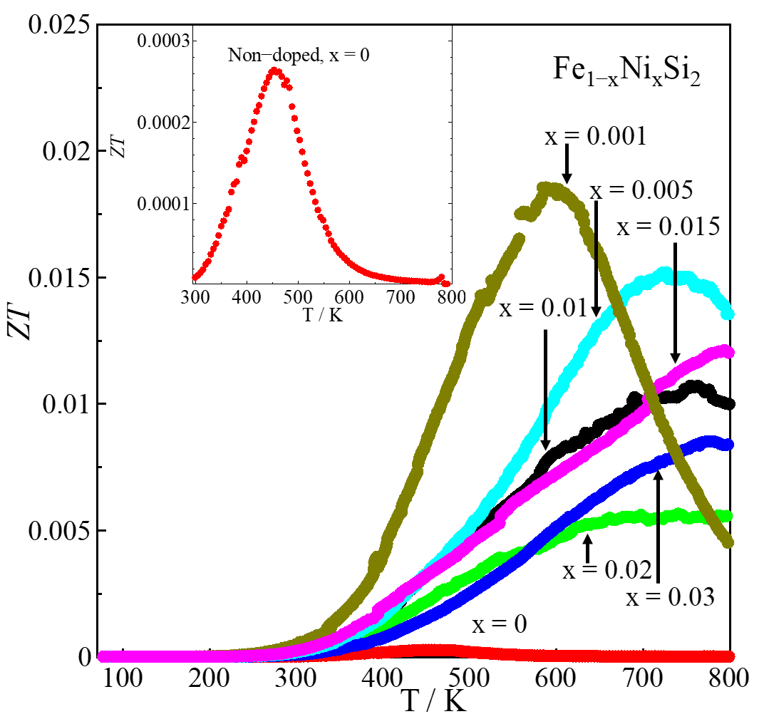
Thermal conductivity (κ) and ZT of β-Fe_{1-x}Ni_{x}Si₂
ZT_{max}
The κ of Ni doping samples is higher than that of non-doped samples probably due to the increase in n_{H}.
The ZT_{max} = 0.019 is obtained in the x = 0.001 sample due to the significant increase of S and also the decrease in resistivity.

Slide 19
4. Conclusion

Slide 20
Conclusions
The electrical resistivity decreases with Ni doping level due to an increase in n_{H}.
The Seebeck coefficient decrease with Ni doping level, where the highest value is obtained in x = 0.001 with the value of 450 μV/K at 450 K. Small doping amount is more effective.
The thermal conductivity slightly increases with Ni doping.
The highest ZT = 0.019 at 600 K is obtained in the x = 0.001 sample due to the significant increase in the Seebeck coefficient and reduction in electrical resistivity.
Authors | x | S [μV/K] | PF [μW/mK²] | Fabrication method
Komabayashi et al. at 300K | 0.06 | -113 | 17 | Thin film by RF sputtering
This study at 300K | 0.001 | -393 | 13 | Bulk by arc melting
Nagai et al. at 650K | 0.01 | -190 | 50 | Bulk by mechanical milling + hot-pressing
This study at 600K | 0.001 | - 450 | 280 | Bulk by arc melting

Slide 21
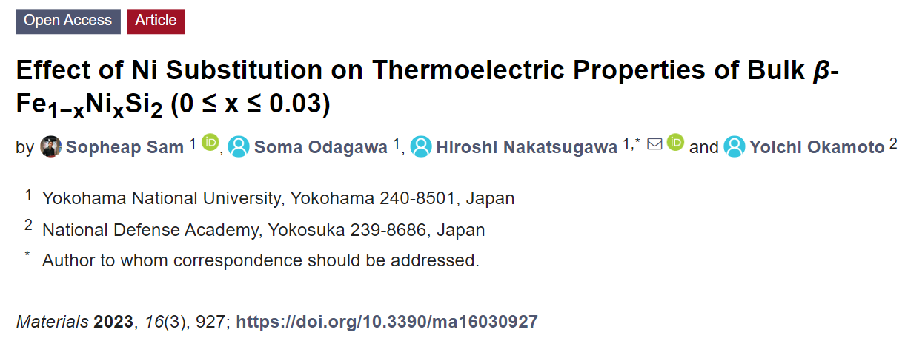
Thank you for your kind attention!
For more details, please refer to the full paper in the Materials journal:

Slide 22
Appendix

Slide 23
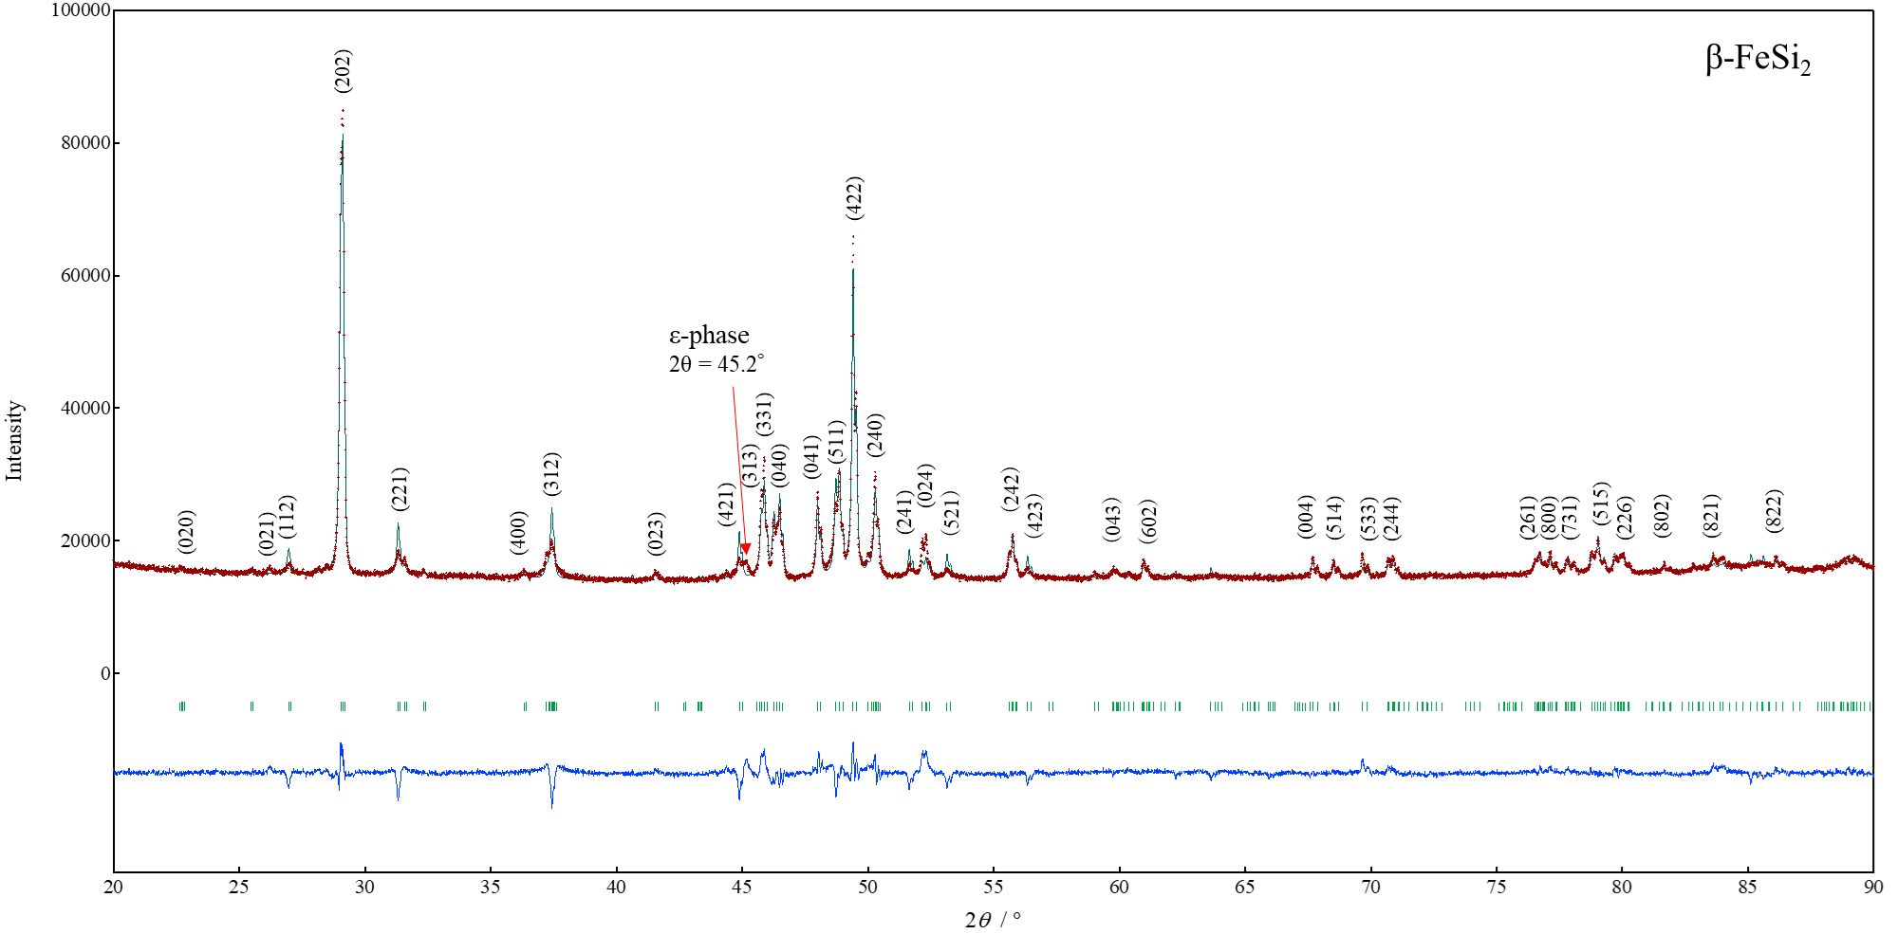
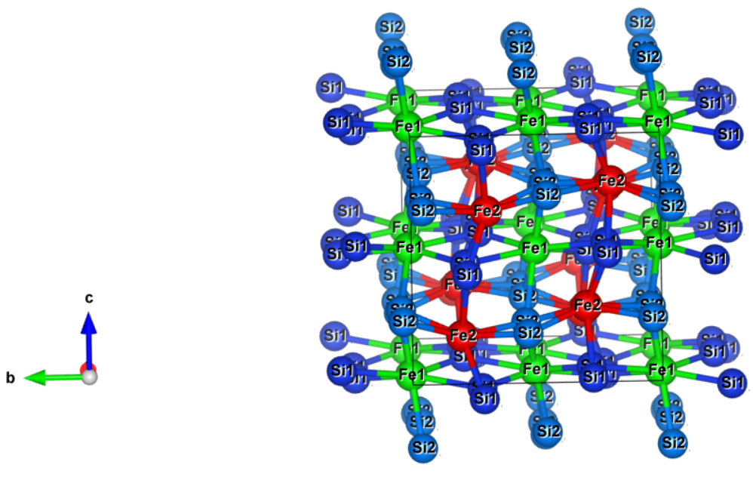
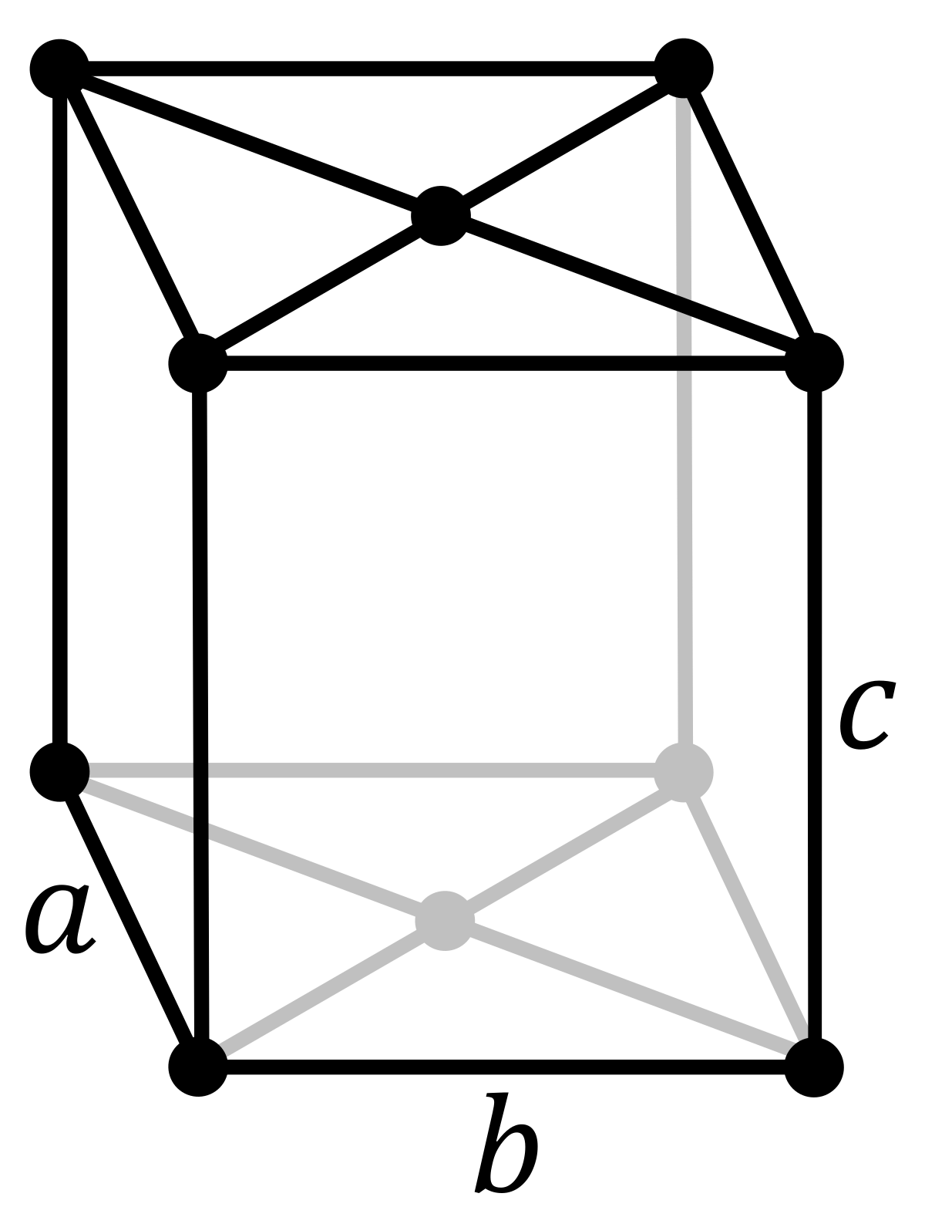
Crystal structure and phase identification by Rietveld analysis
The samples were grown in β-phase crystal structure with Cmce space group (base-centered orthorhombic) after heat treatment 1150 ºC 3 h and annealing 840 ºC 20 h.
Si2
Si1
Fe1
A small amount of ε-phase at 2θ=45.2 deg.
Fe2

Slide 24
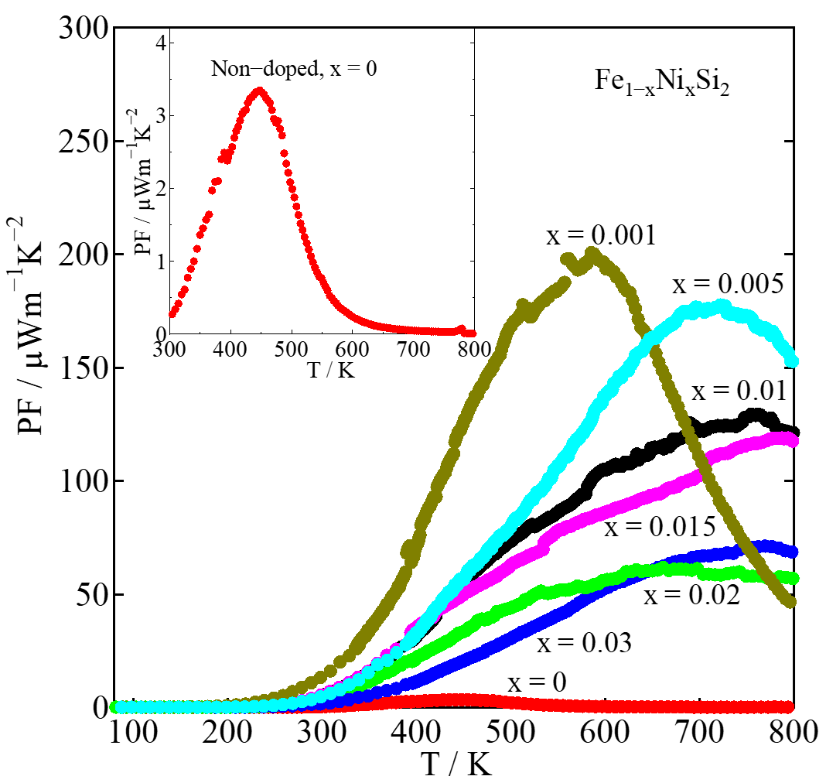
Power factor (PF) of β-Fe_{1-x}Ni_{x}Si₂
PF_{max}
PF of x = 0.001 is about 60 times higher than that of x = 0.

Slide 25
Future research for co-doping of Co+Ni
β-Fe_{1-x}Co_{x}Si₂
β-Fe_{1-x}Ni_{x}Si₂
ρ of Co-doped samples are uniform with temperature.
ρ of Ni-doped samples remarkably decreases at high temperature.
Role of each dopant:
- Co: stabilize small ρ and large S with increasing temperature because of large n_{H} and large m*, respectively.
- Ni: decrease ρ @ high temperature probably due to increase μ_{H} with increasing temperature.
Result: More improved PF.
S of Ni-doped samples are less uniform with temperature.
S of Co-doped samples are more uniform with temperature

Slide 26
TE properties of β-Fe_{1-x}Ni_{x}Si₂ at RT
x | L_{𝚶} [V²/K²] | r | n_{H} [1/cm³] | μ_{H} [cm²/V.s ] | |S| [μV/K] | ρ [Ω.cm] | κ [W/mK] | Relative density [%]
0 | 1.792×10⁻⁸ | -1/2 | 2.3(2)×10¹⁶ | 37(4) | 127 | 7.10 | 7.16 | 98.0(1)
0.001 | 1.624×10⁻⁸ | -1/2 | 1.2(4)×10¹⁷ | 35(7) | 393 | 1.39 | 8.25 | 98.3(1)
0.005 | 1.656×10⁻⁸ | -1/2 | 2.6(2) ×10¹⁷ | 34(3) | 194 | 0.69 | 8.57 | 96.24(8)
0.010 | 1.648×10⁻⁸ | -1/2 | 3.2(7) ×10¹⁷ | 27(5) | 205 | 0.69 | 8.44 | 97.5(3)
0.015 | 1.674×10⁻⁸ | -1/2 | 4.8(4) ×10¹⁷ | 20(1) | 176 | 0.63 | 7.27 | 98.7(1)
0.02 | 1.766×10⁻⁸ | -1/2 | 1.2(4) ×10¹⁸ | 11(3) | 135 | 0.45 | 7.12 | 95.6(2)
0.03 | 2.139×10⁻⁸ | -1/2 | 2.3(2) ×10¹⁸ | 10(1) | 62 | 0.26 | 6.18 | 95.6(1)

Slide 27
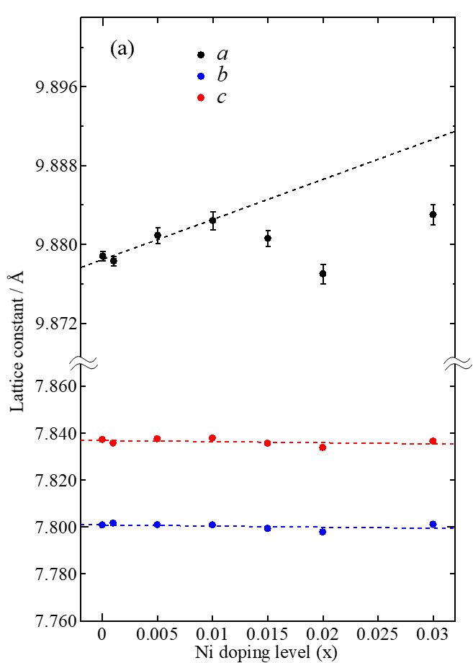
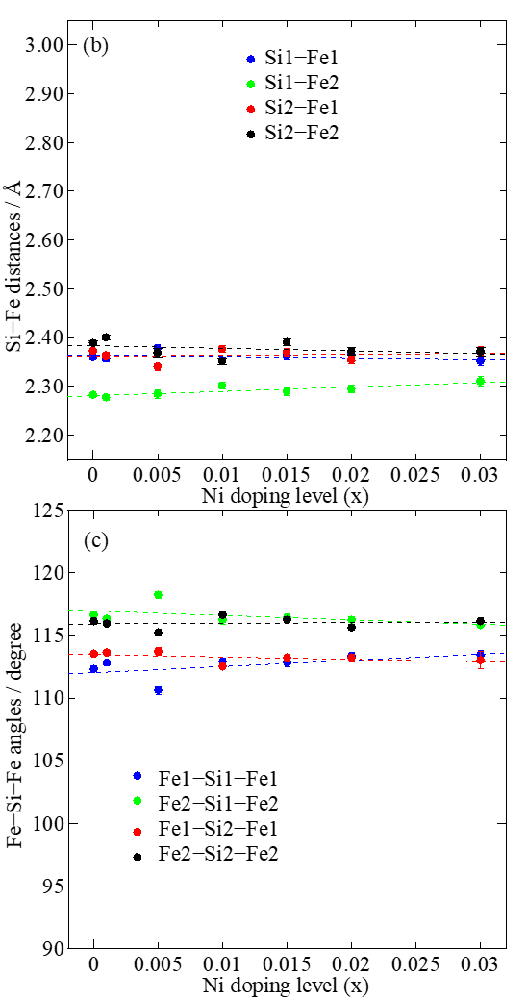
Si2
Si1
Fe1
Fe2

Slide 28
Lattice parameter of β-Fe_{1-x}Ni_{x}Si₂ at RT

Slide 30
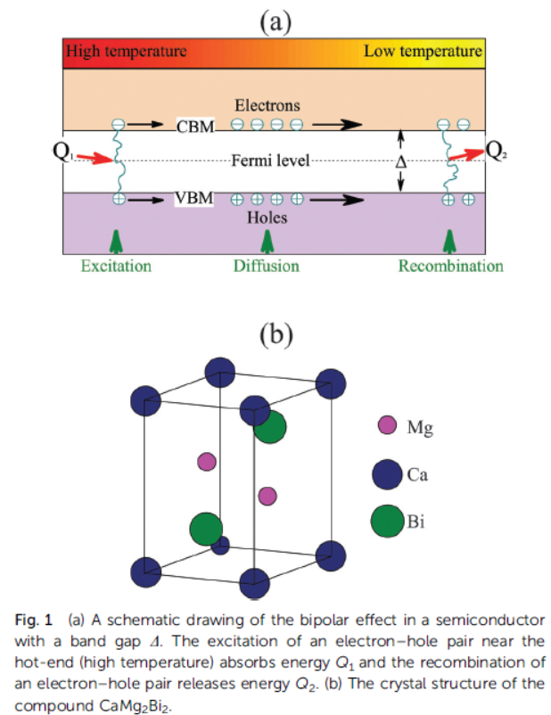
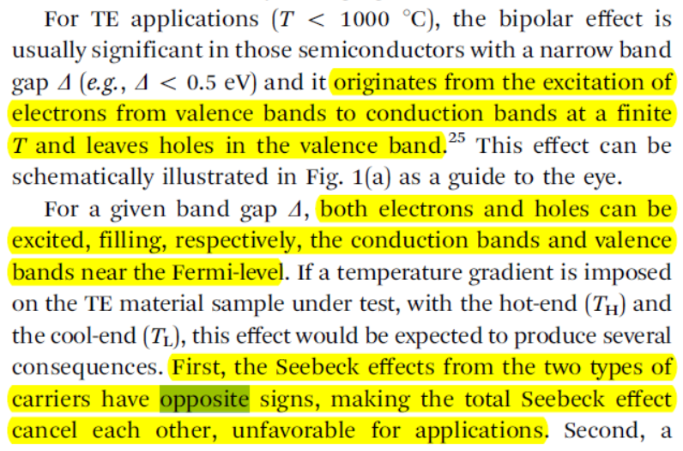
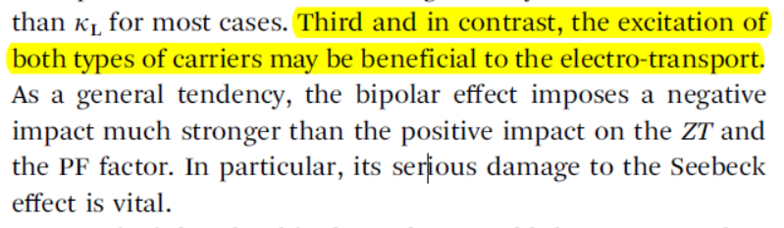
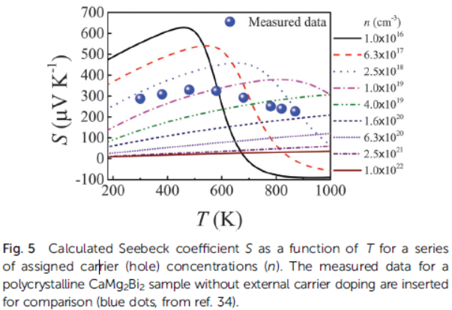
Bipolar
Bipolar effect remarkably dominate at low n_{H} .
J. J. Gong et al., Physical Chemistry Chemical Physics,18, 16566-16574 (2016).

