Slide 1
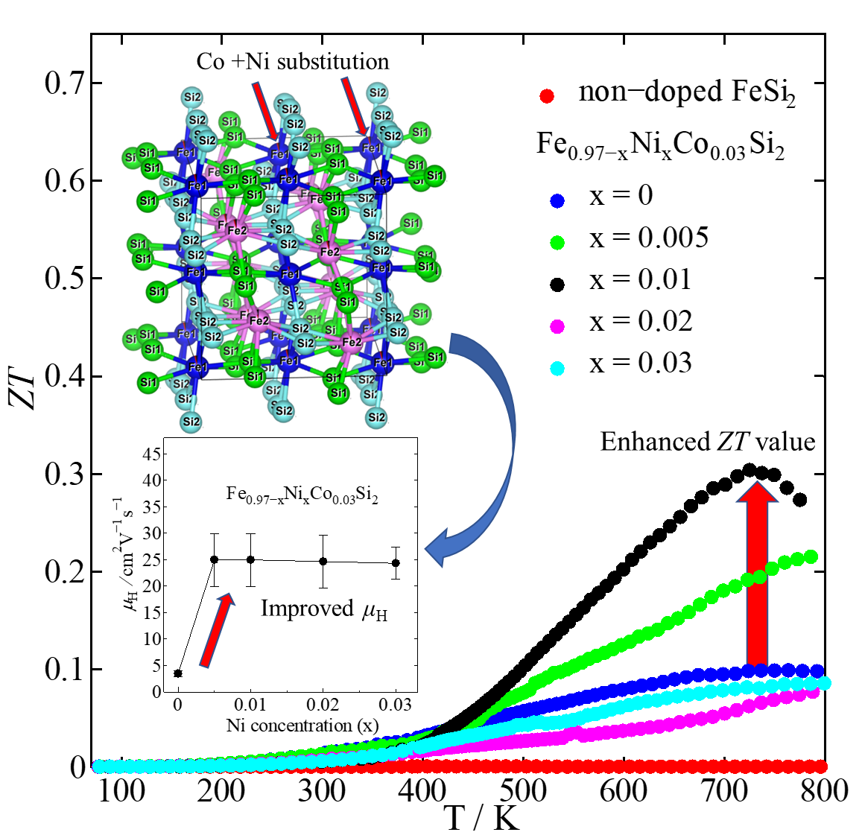
Thermoelectric properties of β-FeSi₂ with Co and Ni addition
Sopheap Sam ¹, Hiroshi Nakatsugawa^{1,} *, Yoichi Okamoto ²
¹ Yokohama National University, ² National Defense Academy
* E-mail : nakatsugawa-hiroshi-dx@ynu.ac.jp
2023/09/22
1

Slide 2
Contents
Introduction
Crystal and band structure FeSi₂
Phase transition of FeSi₂
Review of previous research
Research purpose
Experimental methods
Fabrication
Measurement
Results and discussion
Crystal structure
Microstructure
Electrical properties
Thermoelectric properties
Conclusions
Summary
Future issue

Slide 3
Introduction
3

Slide 4
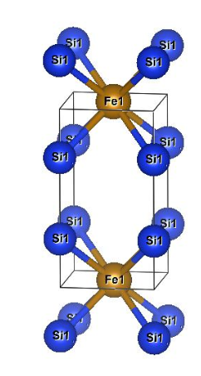
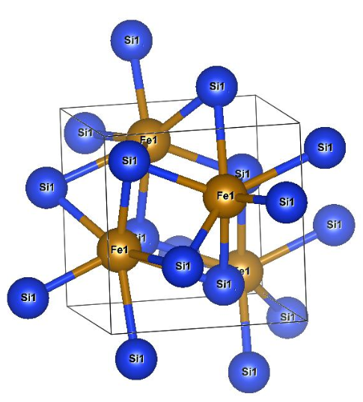
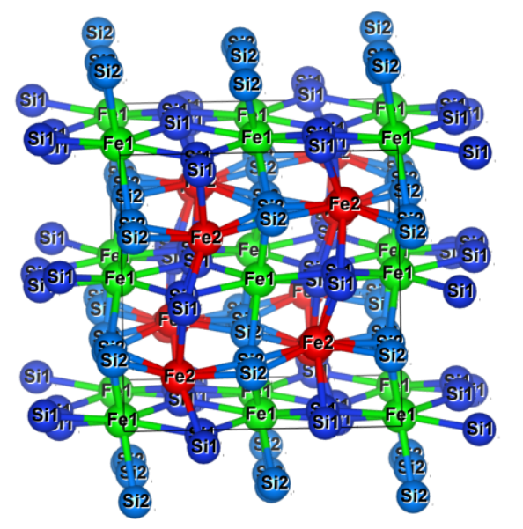
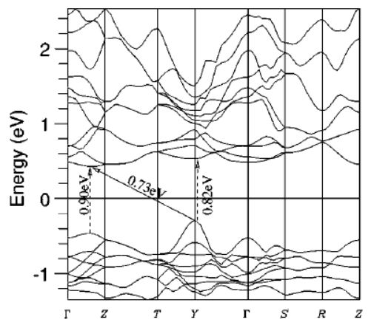
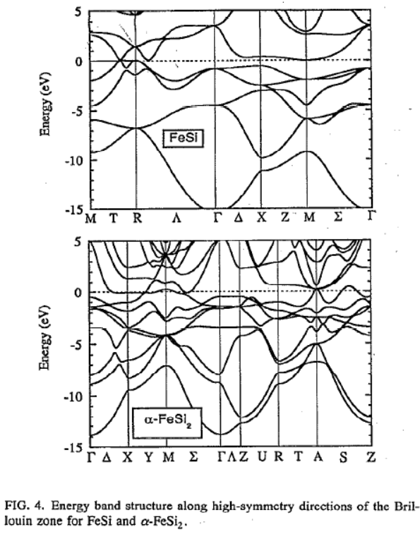
Crystal Structure of each phase FeSi₂
Orthorhombic β-phase
Tetragonal α-phase
Cubic ε-phase
Space group: Cmce
Space group: P/4mmm
Space group: P2₁3
S. J. Clark et al., Phys. Rev. B., 58,16 (1998)
R. Girlanda et al., J. Appl. Phys. 76, 2837 (1994)

Slide 5
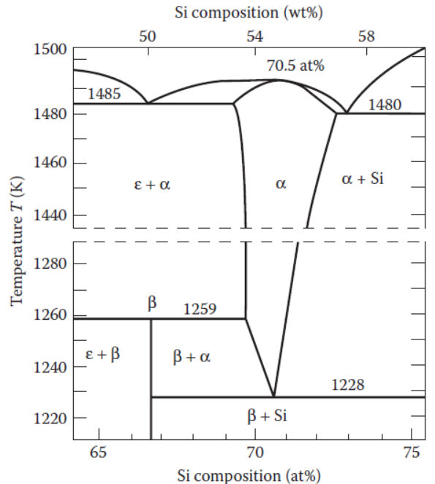
Phase transition diagram of FeSi₂
The β-FeSi₂ based material is a promising candidate for thermoelectric (TE) application working at high temperatures due to:
Environmental friendliness
Good thermal stability
Strong oxidation resistance
Low cost.
X. L. Du et al., Acs Appl. Mater. Interfaces, 12, 12901-12909 (2020).
The equilibrium phase diagram for the system Fe–Si by Piton and Fay. α-phase:FeSi2, β-phase:FeSi2, ε-phase:FeSi.
J. P. Piton and M. F. Fay, C. R. Acad. Sci. (Paris). C266, 514–516 (1968).

Slide 6
β-Fe_{1-x}Co_{x}Si₂
β-Fe_{1-x}Ni_{x}Si₂
Previous studies
m* = 6.0m_{e} ,
μ_{H} = 4 cm²V⁻¹s⁻¹
τ =13.6 fs
m* = 0.12m_{e}
μ_{H} = 10-40 cm²V⁻¹s⁻¹
τ = 0.68 fs - 2.73 fs
- Co: stabilize small ρ and large S with increasing temperature because of large n_{H} and large m*, respectively.
- Ni: decrease ρ at high temperature probably due to increase μ_{H} with increasing temperature.
Co+Ni: More improved PF.
S of Co-doped samples are more uniform with temperature
S of Ni-doped samples are less uniform with temperature.
Sam et al., Jpn. J. Appl. Phys. 61, 111002 (2022)
Sam et al., Materials. 16, 927 (2023)

Slide 7
Objective of research
Study the effects of Co and Ni on the structure and phase transition of β-Fe_{0.97-x}Ni_{x}Co_{0.03}Si₂ prepared by the arc melting method.
Investigate the electrical and thermoelectric properties of Co and Ni-doped β-FeSi₂ prepared by the arc melting method.
Find the optimum doping concentration of Co and Ni substitution to optimize carrier density and mobility for improving electrical and thermoelectric properties.

Slide 8
Experimental methods

Slide 9
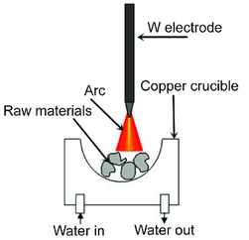
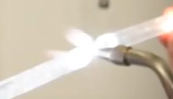
Fabrication :
Measurement :
Arc-melting (20g)
NC wire cut
7x7x1.5mm
Vacuum sealing in quartz tube
Heat treatment 1150 ºC, 3h
Annealing
840 ºC, 20h
XRD by Smart Lab, Rigaku
Rietveld analysis by RIETEN-FP
Thermal conductivity by power efficiency measurement (PEM-2)
ZT calculated by above parameters
Carrier concentration and mobility at RT by ResiTest 8300
Resistivity and Seebeck coefficient by ResiTest 8300 and homemade apparatus
3D SEM-EDS by VE-8800 & SU8010
7x7x1.5mm
Furnace 1150 ºC, 3h.
Furnace 840 ºC, 20 h.
This annealing condition was optimized by Ohtaki et al., for Cu, Zn, Nb, Ag, and Sb doping.
Ohtaki et al., Chem. Lett. 22, 1067-1070 (1993).

Slide 10
Results and discussion

Slide 11
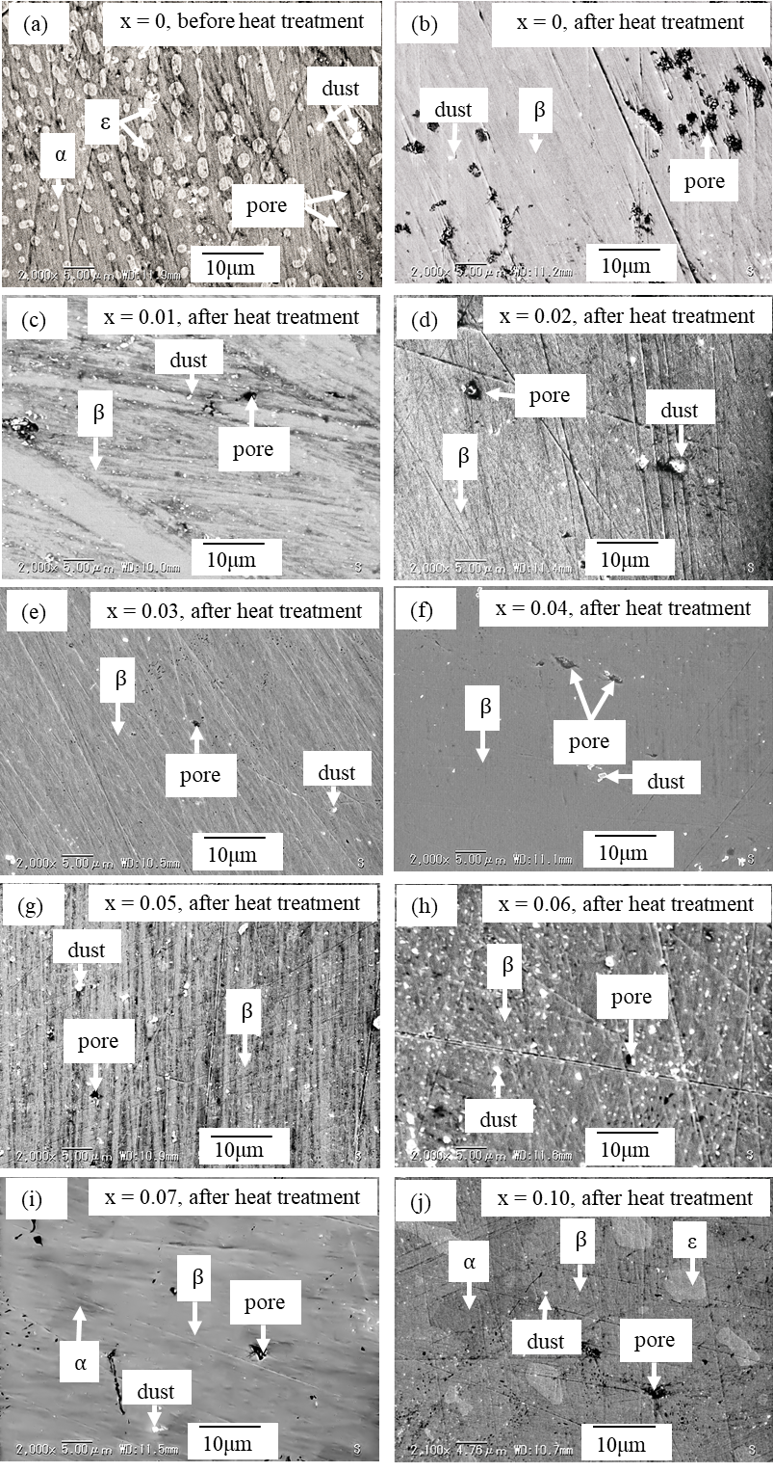
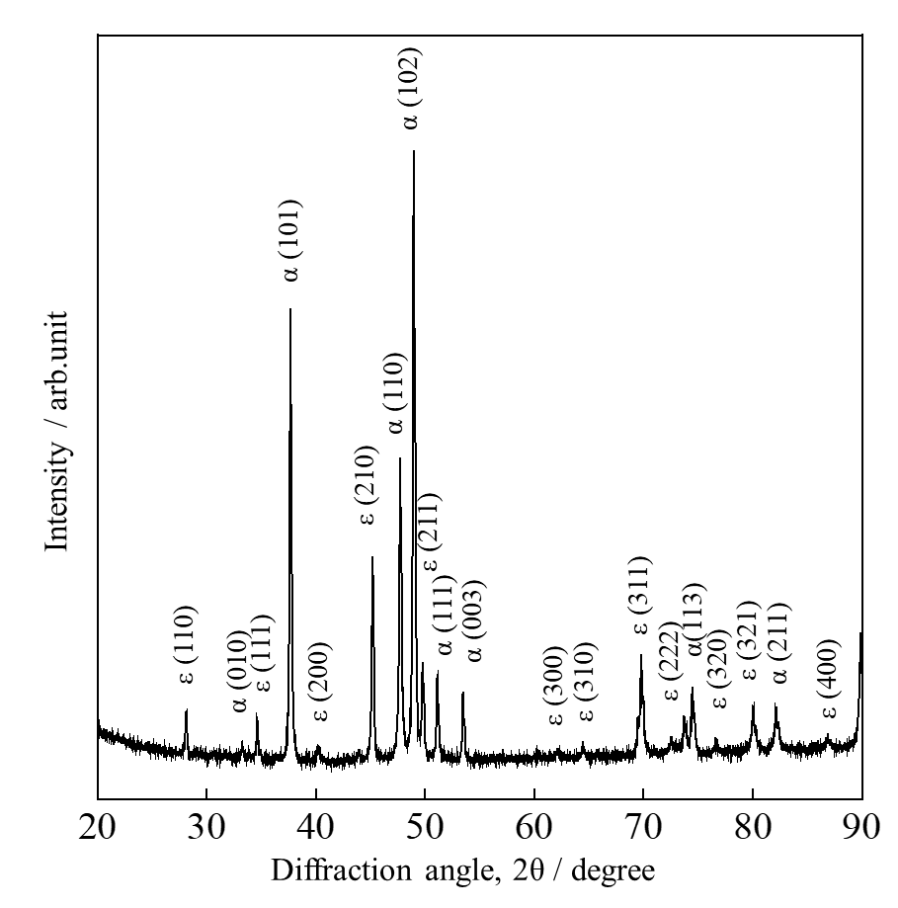
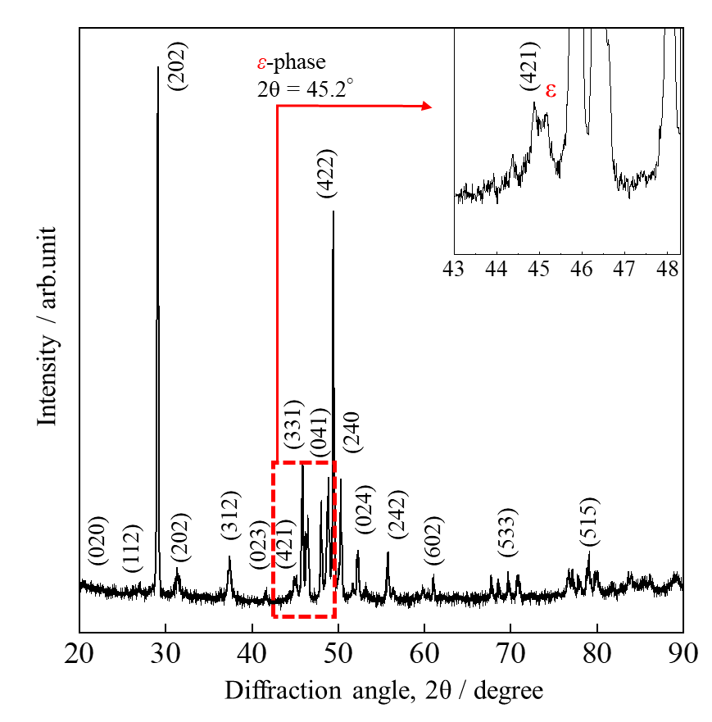
X-ray diffraction patterns and SEM images of non-doped FeSi₂ (x = 0)
Before
After
Heat treatment at:
1150 ºC, 3h
840 ºC, 20h
Before heat treatment
After heat treatment
ε + α phases.
Non-doped, x = 0.
β + ε phases.
Non-doped, x = 0.
Indexed peaks are β-phases

Slide 12
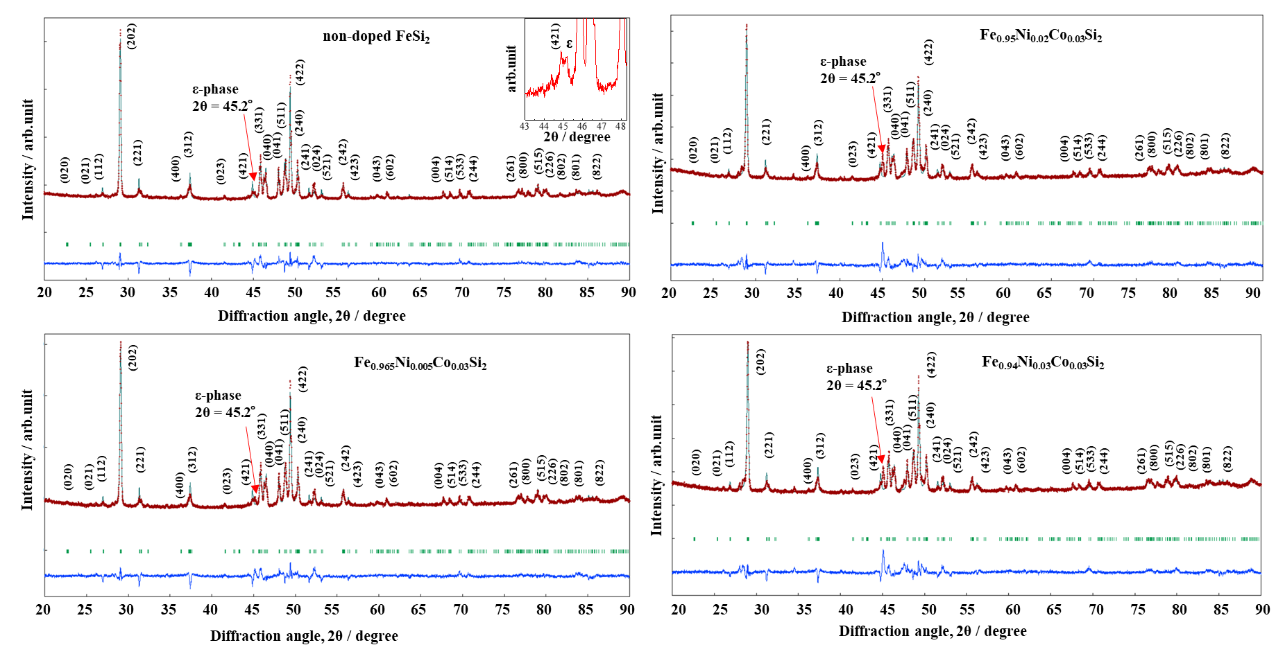
Rietveld analysis of Fe_{0.97-x}Ni_{x}Co_{0.03}Si₂ at room temperature
A trace of the ε-phase is contained in all samples.
The peak of the ε-phase increase with increasing Ni contents.

Slide 13
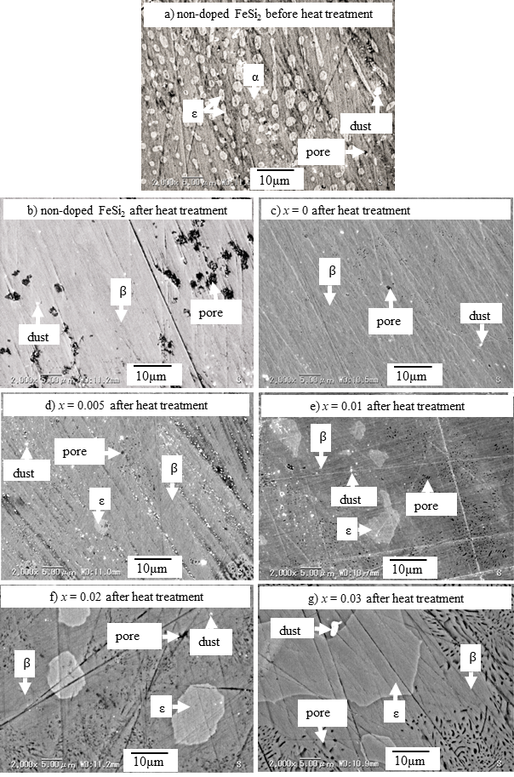
Microstructure and phase fraction of Fe_{0.97-x}Ni_{x}Co_{0.03}Si₂
ε-phase is more dominant than α-phase.
Orthorhombic phase changes to cubic phase.
Because the atomic size of Ni is smaller than Fe.
The grain of the ε-phase increase with Ni.

Slide 14
Elemental analysis by SEM-EDS of Fe_{0.97-x}Ni_{x}Co_{0.03}Si₂ at room temperature
The ε-phase increases with Ni substitution and solid solution limits of Ni in β-FeSi₂ can be lower than 1%.
The Co distribution becomes less homogeneous with increasing Ni content.

Slide 15
Electrical resistivity (ρ) and Seebeck coefficient (S) of β-Fe_{0.97-x}Ni_{x}Co_{0.03}Si₂
Ni decreases the solubility of Co.
Ni has a lighter effective mass (m*).
Increase n_{H}
Increase ε-phase.
Ni has a lighter m*.
Increase μ_{H}

Slide 16
Seebeck coefficient vs carrier density at room temperature β-Fe_{0.97-x}Ni_{x}Co_{0.03}Si₂
Solid lines are the calculated data at various effective masses (m*) using Mott’s equation:
Various shape plots are the experimental data.
A good fitting condition is obtained at m* = 0.9m_{e}.
The Ni-doped sample has an effective mass of 0.9m_{e}, mobility of about 25 cm²V⁻¹s⁻¹, and relaxation time of about 12.8 fs.

Slide 17
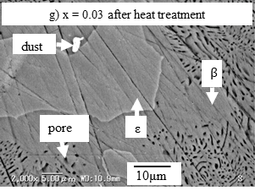
Thermal conductivity (κ) and ZT of β-Fe_{0.97-x}Ni_{x}Co_{0.03}Si₂
Pores
The ZT_{max} = 0.31 at 720 K is obtained in the x = 0.01 sample due to the reduction in ρ with higher μ_{H}.
The κ slightly decreases with Ni probably due to the increase in pores.

Slide 18
Conclusions

Slide 19
Summary
The electrical resistivity decreases with Ni addition due to the increased mobility.
The Seebeck coefficient decreases with Ni doping level due to the formation of ε-phase.
The thermal conductivity slightly decreases with Ni doping because of porosity.
The highest ZT = 0.31 at 720 K is obtained in the x = 0.01.
Authors | Dopant | Maximum ZT | Fabrication method
Abbassi et al. at 723 K ¹⁾ | Co 5% | 0.14 | Spark plasma sintering
Kim et al. at 845 K ²⁾ | Co 5% +Ge 2% | 0.11 | Pressuring sintering
Du et al. at 900 K ³⁾ | Co 6% +Ru 5% | 0.33 (low κ) | Pressure sintering
This study at 720 K | Co 3% +Ni 1% | 0.31 | Arc melting
Future issue
The thermal conductivity could be further reduced by alloying with heavy elements or the nanostructuring techniques.
Abbassi et al., Nanomaterials 11, 2852 (2021).
Kim et al., Intermetallics 11, 399 (2003).
Du et al., ACS Appl. Mater. Interfaces 11, 32151 (2019).

Slide 20
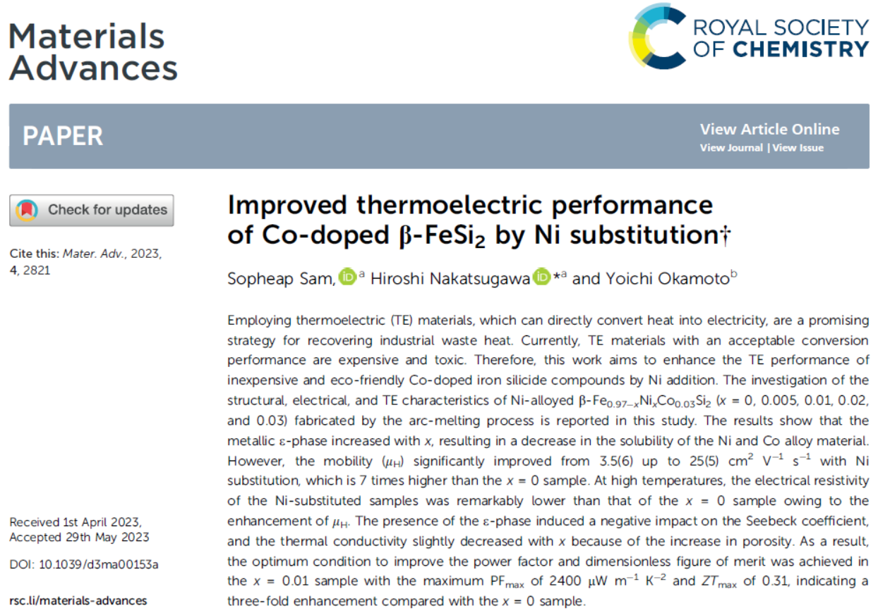
Thank you for your kind attention!
For more details, please refer to our full paper published in Materials Advances journal!
S. Sam, H. Nakatsugawa, and Y. Okamoto, Mater. Adv. 2023, 4, 2821-2830.

Slide 21
Appendix A
Effective mass depends on band structure for Co and Ni-doped FeSi₂
Energy, E
Ni doping
Co doping
of Ni doping
of Co doping <
of Ni doping
Conduction band
of Co doping
Wave number, k
m*_{Co} > m*_{Ni}
Valence band
Co-doped sample
m* = 6.0m_{e} ,
μ_{H} = 4 cm²V⁻¹s⁻¹
τ =13.6 fs
Ni-doped sample
m* = 0.12m_{e}
μ_{H} = 10-40 cm²V⁻¹s⁻¹
τ = 0.68 fs - 2.73 fs

Slide 22
Appendix B
Negative pole (electron, e⁻)
Non-doped FeSi₂
bipolar effect
Bipolar = 2 poles
Low carrier density, n_{H}
Positive pole (hole, h⁺)
n_{e-} ≈ n_{h+}
e⁻ & h⁺ are mixed/ excited.
Conduction band
S_{e-}
S_{e-}
e⁻
e⁻
e⁻
e⁻
e⁻
mobility
Low temperature
High temperature
large m_{e}*
S_{e-} > S_{h+}
S_{e-} ≈ S_{h+}
Valence band
h⁺
h⁺
h⁺
h⁺
small m_{h}*
S_{h+}
S_{h+}
Total Seebeck, S_{Total} = - S_{e-} + S_{h+} = -S
S_{Total} = - S_{e-} + S_{h+} ≈ 0
Decrease Seebeck
Co and Ni-doped FeSi₂
Seebeck coefficient
High carrier density, n_{H}
S_{e-}
n_{e-} ≫ n_{h+}
Conduction band
S_{e-}
e⁻
e⁻
e⁻
e⁻
e⁻
e⁻
e⁻
e⁻
e⁻
Low temperature
High temperature
S_{e-}≫ S_{h+}
S_{e-} ≫ S_{h+}
Valence band
h⁺
h⁺
h⁺
h⁺
S_{h+}
S_{h+}
S_{Total} = - S_{e-} + S_{h+} = -S
S_{Total} = - S_{e-} + S_{h+} = -S
Uniform Seebeck

Slide 23
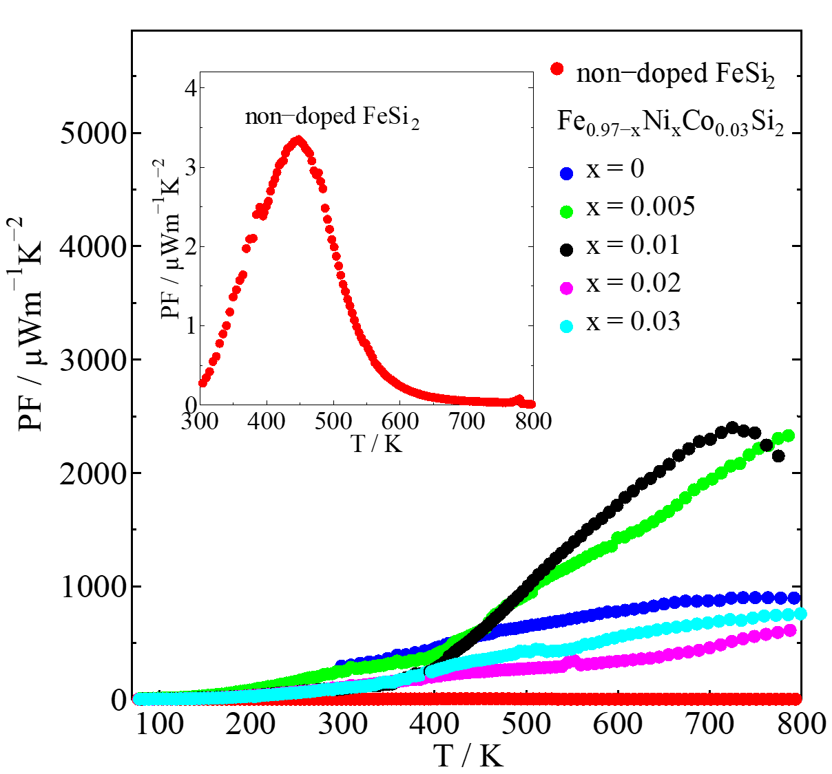

Appendix C
Lattice constants
Power factor (PF)
Ni concentration (x)

