Slide 1
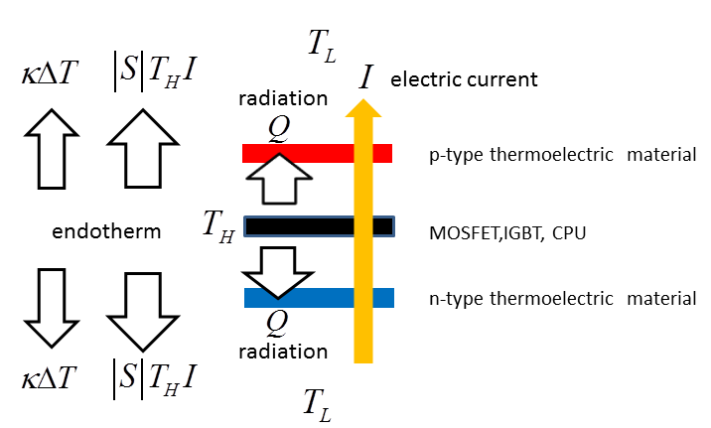
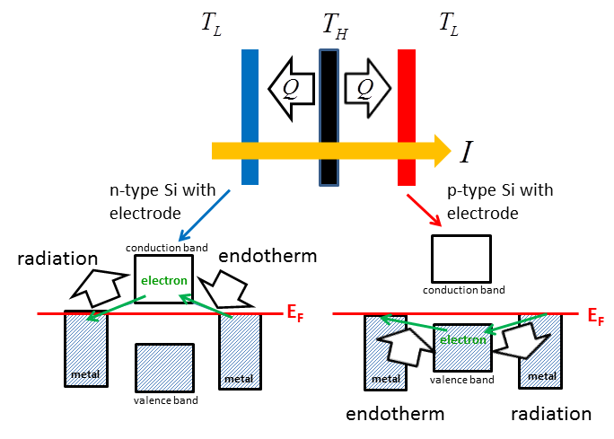
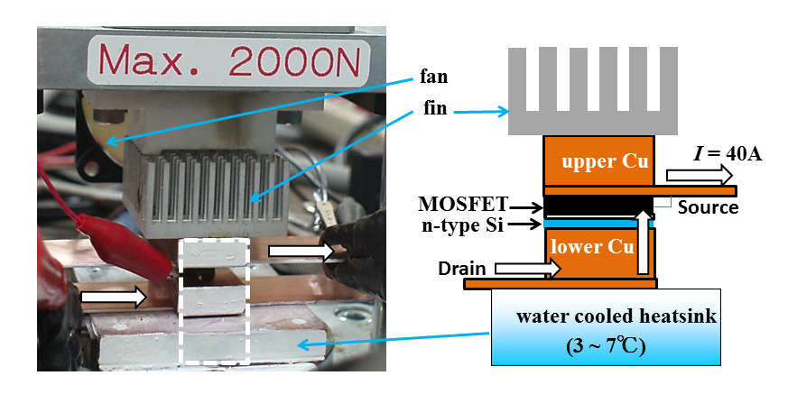
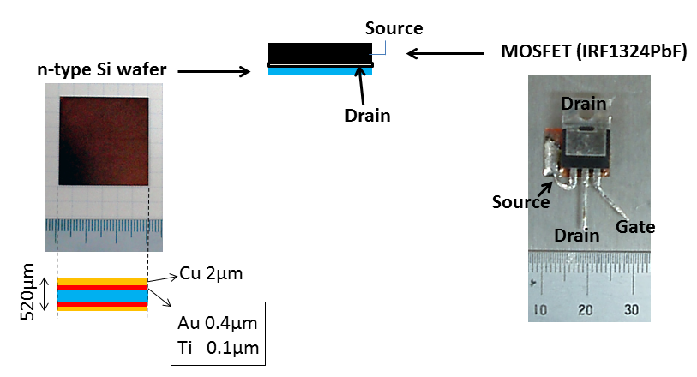
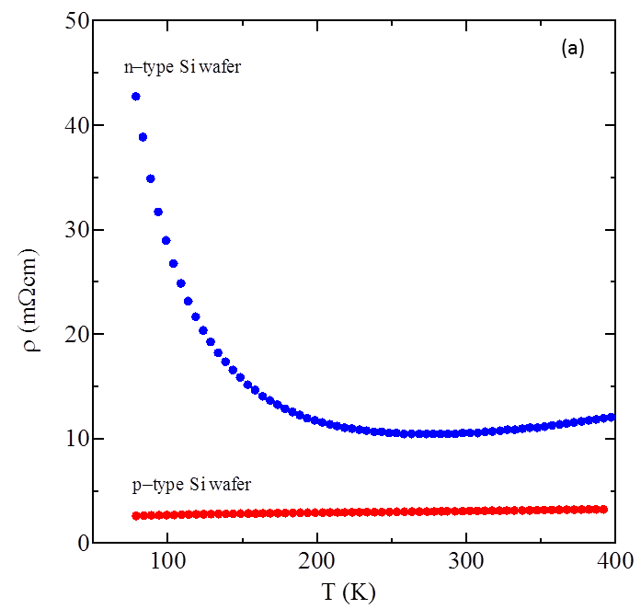
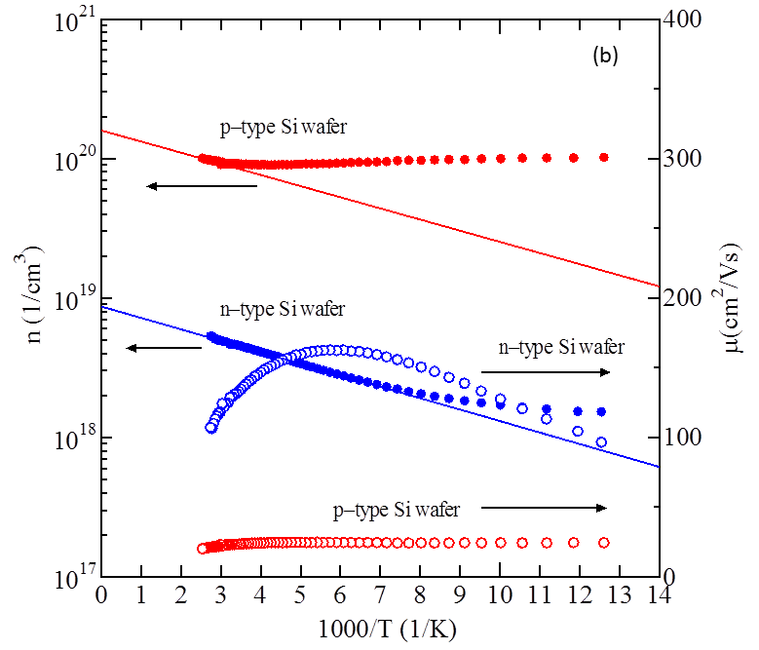
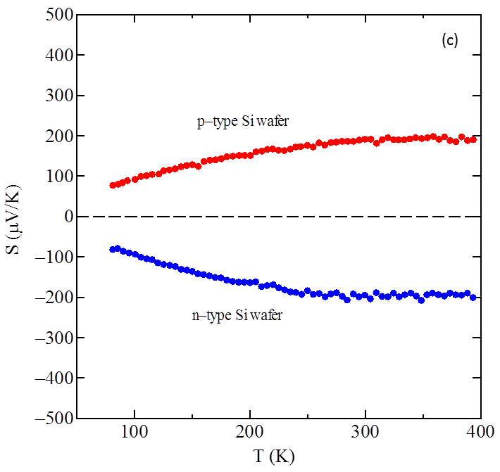
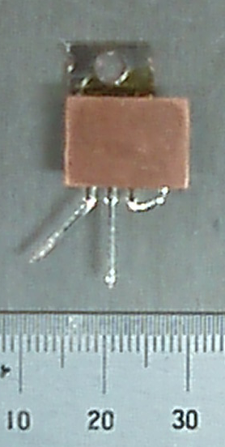
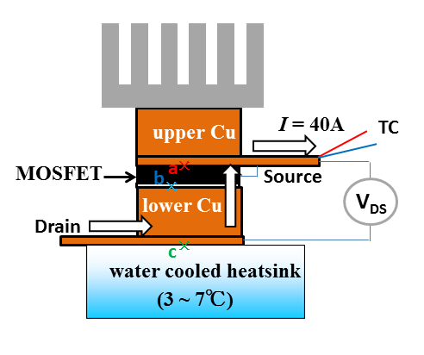
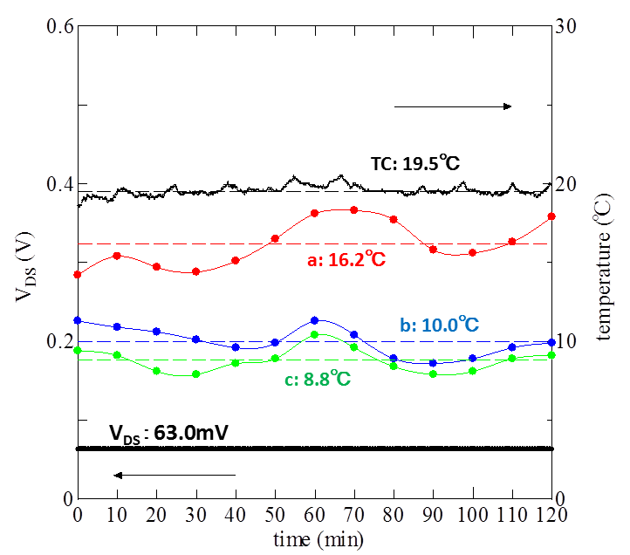
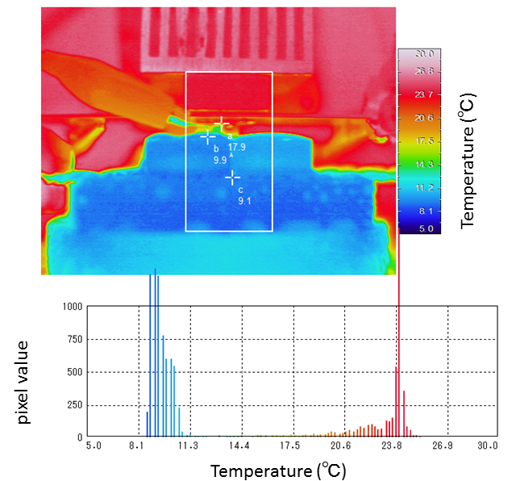
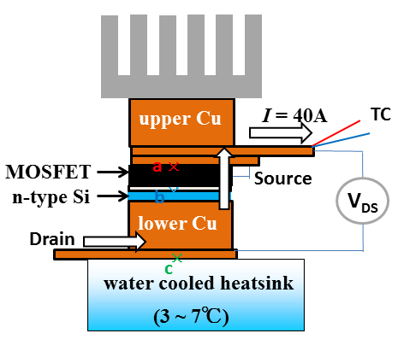
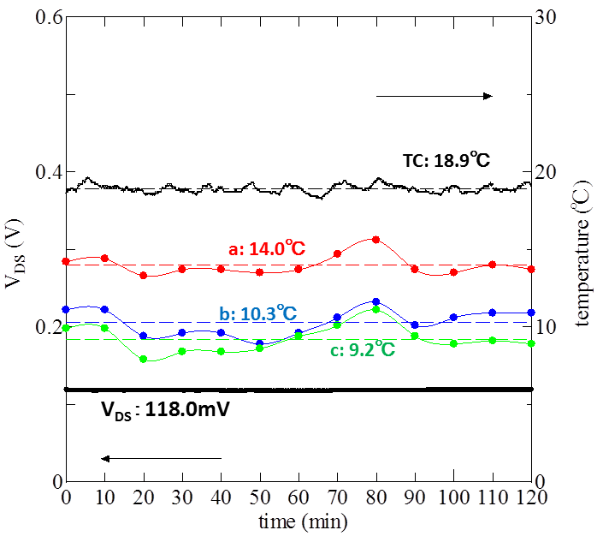
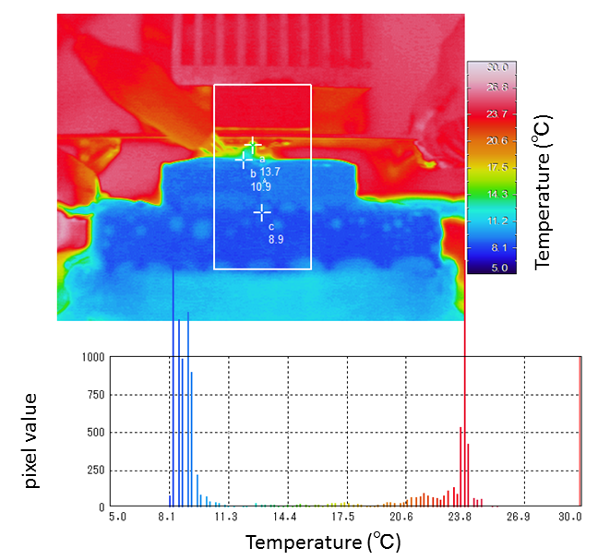
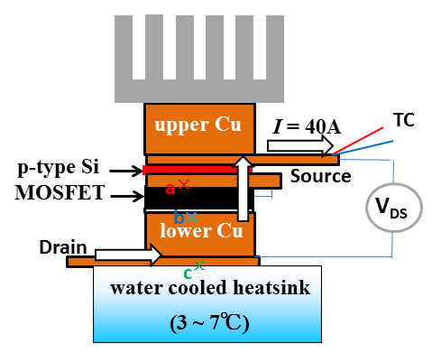
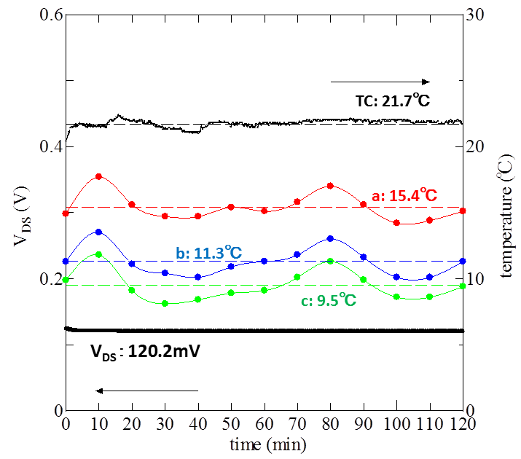
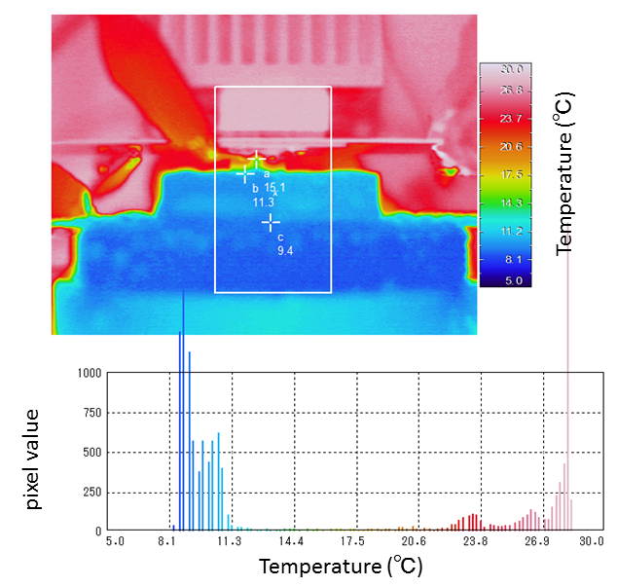
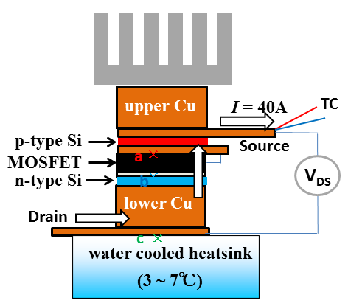
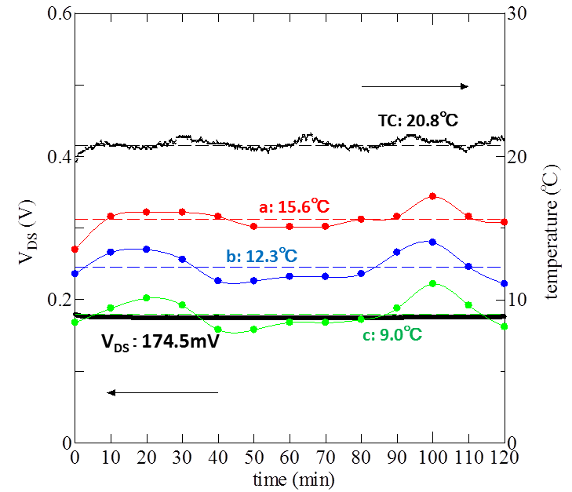
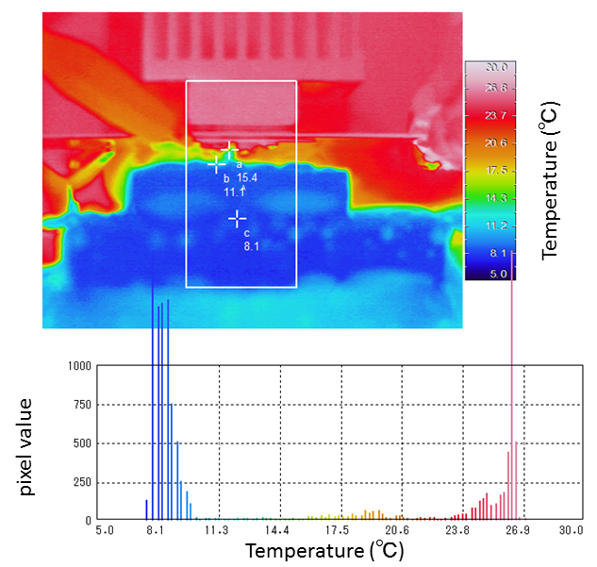
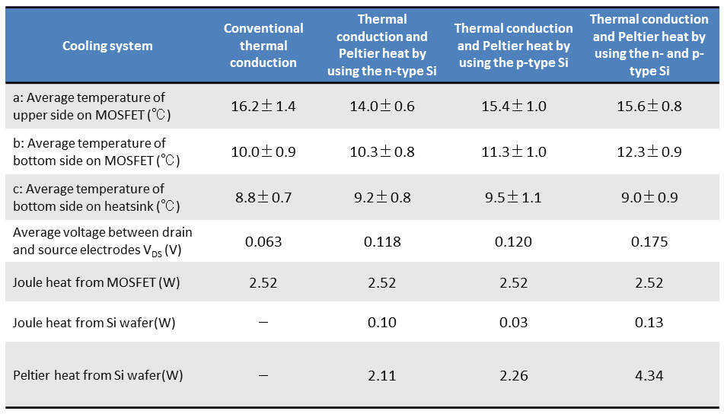
Observation of self-cooling on power MOSFET with silicon wafers using infrared thermography
H.Nakatsugawa^{1,*}, Y.Okamoto², T.Kawahara³ , and S.Yamaguchi ³
¹Yokohama National University, ²National Defense Academy, ³Chubu University
*E-mail : naka@ynu.ac.jp TEL : +81-45-339-3854
INTRODUCTION
EXPERIMENTAL
Silicon semiconductor power devices that include MOSFETs, IGBTs and CPUs are used in a daily life to give us modern life in the present time. When we use the electrical equipment incorporating these devices, the improvement of heat removal or cooling is one of the most important issues because they will not function correctly if they are operated at temperatures above 150℃.
The self-cooling device consists of the n-type and/or p-type thermoelectric material connected to a power MOSFET.[1,2] Since the electric current flows from the bottom to the upper direction, the heat flux is transferred from the power MOSFET to outside (lower and/or upper side) of the n-type and/or p-type thermoelectric material, where the fin/fan or the water cooled heatsink are connected to diffuse the heat to the circumstance. In particular, the self-cooling device uses both the thermal conduction and the Peltier heat flux driven by its self-current in the device.
The aim of this study is to develop the self-cooling device in order to improve heat removal or cooling for the power MOSFET.
The electric current of 40A flowed in the self-cooling device from lower to upper direction, where the voltage of 10V was applied between the gate and the source. To determine whether the self-cooling device remove the Joule heat from the power MOSFET, we measured the time dependence of the temperature distribution of the self-cooling device by the infrared thermography (TVS-200EX, NEC Avio) every 10 minutes in two hours and analyzed by the software of InfReC Analyzer (NS9500, NEC Avio).
Fig1. Schematic structure of the self-cooling device
Fig2. Experimental setup to estimate the self-cooling device (left) and schematic illustration (right), where white arrow shows the direction of the electric current (I=40A).
Self-cooling device
Fig4. SEM image and EPMA micrographs of the chemical composition of the coatings on the Si wafer
193 μV/K
The self-cooling device consists of the n-channe power MOSFET and the n-type and/or the p-type Si wafer which was coated with 0.1μm of Ti to ensure adhesion and 0.4μm of Au deposited by sputtering.
10.3 mΩcm
－200 μV/K
3.00 mΩcm
Fig3. Self cooling-device composed of the power MOSFET and the n-type Si wafer
Fig5. Temperature dependence of the electrical resistivity
Fig6. Temperature dependence of the density and the mobility
Fig7. Temperature dependence of the Seebeck coefficient
RESULTS AND DISCUSSION
120 minutes
120 minutes
The Joule heat from the power MOSFET is measured 2.5W from the voltage between the drain and the source. The average temperatures of the upper side on the MOSFET, the bottom side on the MOSFET, and the heatsink are 16.2℃, 10.0℃, and 8.8℃, respectively.
The Peltier heat from the n-type Si wafer is estimated |S|TI = 2.1W corresponding to |S| = 186μV/K, T = 284K and I = 40A. The average temperatures of the upper side on the MOSFET, the bottom side on the MOSFET, and the heatsink are 14.0℃, 10.3℃, and 9.2℃, respectively.
120 minutes
120 minutes
The Peltier heat from the p-type Si wafer is estimated |S|TI = 2.3W corresponding to |S| = 196μV/K, T = 289K and I = 40A. The average temperatures of the upper side on the MOSFET, the bottom side on the MOSFET, and the heatsink are 15.4℃, 11.3℃, and 9.5℃, respectively.
The Peltier heat from the Si wafers is estimated |S|TI = 4.3W corresponding to |S| = 377μV/K, T = 287K and I = 40A. The average temperatures of the upper side on the MOSFET, the bottom side on the MOSFET, and the heatsink are 15.6℃, 12.3℃, and 9.0℃, respectively.
SUMMARY
We indicate for the first time that the average temperature of the upper side on the power MOSFET with the n-type silicon wafer is cooled down about 2.2℃, in which the electric current of 40A flows from upper to lower direction for the self-cooling device. This certainly warrants future work on the improvement of the measurement condition. Nonetheless, the n-type and/or p-type silicon wafers would be one of the candidate materials for use to improve the heat removal or cooling for silicon power devices.
結論
REFERENCES
[1] H.Nakatsugawa et al., J.Electronic Materials, Vol.38, pp.1387-1391 (2009).
[2] S.Fukuda et al., Japanese J.Applied Physics, Vol.50, pp.031301 (2011).
ACKNOWLEDGMENTS : This study has been partly supported by the Grants-in-Aid for Scientific Research #22560691.

