Slide 1
High temperature thermoelectric properties of perovskite type
Pr_{0.9}Sr_{0.1}Mn_{1-x}Fe_{x}O₃ (0≦x≦1)
Hiroshi Nakatsugawa^{1,*}, Miwa Saito², and Yoichi Okamoto³
¹Yokohama National University, 79-5 Tokiwadai, Hodogaya-ku, Yokohama 240-8501, Japan
²Kanagawa University, 3-27-1 Rokkakubashi, Kanagawa-ku, Yokohama 221-8686, Japan
³National Defense Academy, 1-10-20 Hashirimizu, Yokosuka 239-8686, Japan
*e-mail of presenting author: naka@ynu.ac.jp
Notes:
Thank you, Mr. Chairman.
Good morning everyone. Today, I’d like to talk about this title.
My name is Hiroshi Nakatsugawa from Yokohama National University, Japan.

Slide 2
Outline
Introduction
Experimental procedure
Results and Discussion
crystal structure
magnetic susceptibility
Heikes formula
Electric resistivity
thermopower
Thermal conductivity and ZT
Summary
Notes:
This slide shows the contents of my presentation.
First, I’m going to talk about Introduction.
Second, I want to explain Experimental procedure briefly.
Third, I’d like to talk about Results and Discussion.
Finally, I will summarize my talk.

Slide 3
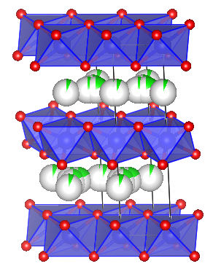
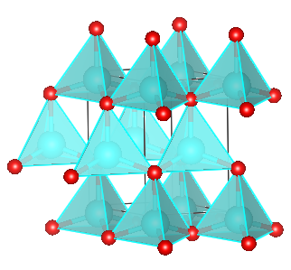
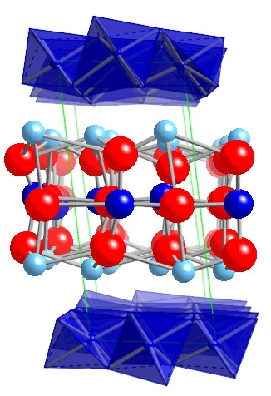
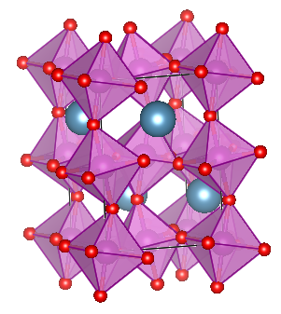
Introduction
Oxides which show high carrier density and high Seebeck coefficient
Oxides which show high carrier density in the conduction band
Oxides which show high electron mobility and high electric conductivity
P-type thermoelectric oxides
Ｎ-type thermoelectric oxides
CoO₂ layer
Na_{x}CoO₂
Al doped ZnO
J.Appl.Phys. 79, 1816 (1996)
Na layer
Phys. Rev. B56, R12685 (1997)
CoO₂ layer
Perovskite-type oxides
Ca_{0.9}Yb_{0.1}MnO₃
[Ca₂CoO₃]_{0.62}CoO₂
J.Appl.Phys. 100, 084911 (2006)
Block layer
Ca_{0.96}Bi_{0.04}Mn_{0.96}V_{0.04}O₃
Jpn.J.Appl.Phys. 39, L531 (2000)
Solid State Commun. 145, 132 (2008)
Notes:
I’d like to start by talking about Introduction. Today, oxides are known as a possible candidate for thermoelectric materials at high temperature.
In the case of p-type thermoelectric oxides, layered cobalt oxides show high carrier density and high Seebeck coefficient. In the case of n-type thermoelectric oxides, aluminum doped zinc oxide shows high carrier density in the conduction band, and perovskite-type oxides show high electron mobility and high electric conductivity at high temperature.

Slide 4
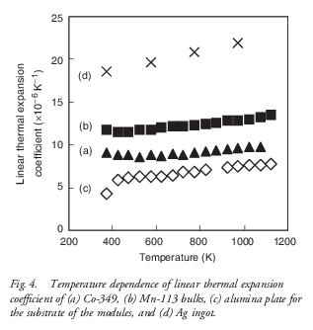
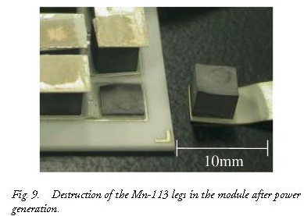
Introduction
η_{max} = 2%
Ag ingot
CaMnO₃
Ca349
Al₂O₃ plate
Ca_{2.7}Bi_{0.3}Co₄O₉
(Ca349)
CaMn_{0.98}Mo_{0.02}O₃
(CaMnO₃)
Int.Appl.Ceram.Tech. 4, 535 (2007)
J.Am.Ceram.Soc. 87, 1952 (2004)
Thermoelectric oxides module which consists of PN elements of small linear thermal expansion coefficient difference is desired.
perovskite-type oxides :
Pr_{0.9}Sr_{0.1}Mn_{1-x}Fe_{x}O₃ (0≦x≦1)
Notes:
In fact, Urata et al. have built thermoelectric modules consisting of layered cobalt oxide and perovskite-type oxide.
However, the n-type elements were damaged by thermal stress between the alumina substrate and the n-type element.
To overcome such a lack of oxide thermoelectric materials, thermoelectric module which consists of PN elements of small linear thermal expansion coefficient difference is desired. So, we have paid attention to perovskite-type oxides.
The purpose of this study is to investigate p-type thermoelectric properties of this materials.

Slide 5
Experimental procedure
fabrication
イオン半径
(Å)
BVパラメーター
r₀ (Å)
determinaiton
Pr_{0.9}Sr_{0.1}Mn_{1-x}Fe_{x}O₃ (0≦x≦1)
solid-state reaction method
powder X-ray diffraction @RT
: RINT2500
Rietveld analysis
: RIETAN-FP program
χ ：5K - 350K @ H = 1T , MPMS
ρ ：dc four-probe method
S ：steady-state technique
κ = dC_{v}α
d：Archimedes method @RT
C_{v}：differential scanning calorimetry@RT
α：laser flash method, TC-7000
stoichiometric mixture
calcined at 1000℃ in air
pressed into pellets
sintered at 1300℃ in O₂
Notes:
Now, I want to talk about Experimental procedure briefly. Polycrystalline samples were synthesized by using solid-sate reaction method.
Crystal structure parameters were studied by using Rietveld analysis of powder X-ray diffraction data. Magnetic susceptibility was measured by using MPMS below 350K under magnetic field of 1T. Electric resistivity was measured by using dc four-probe method, and Seebeck coefficient was measured by using steady-state technique. Thermal conductivity was measured from bulk density, specific heat, and thermal diffusivity. In particular, thermal diffusivity was measured by using laser flash method above room temperature.

Slide 6
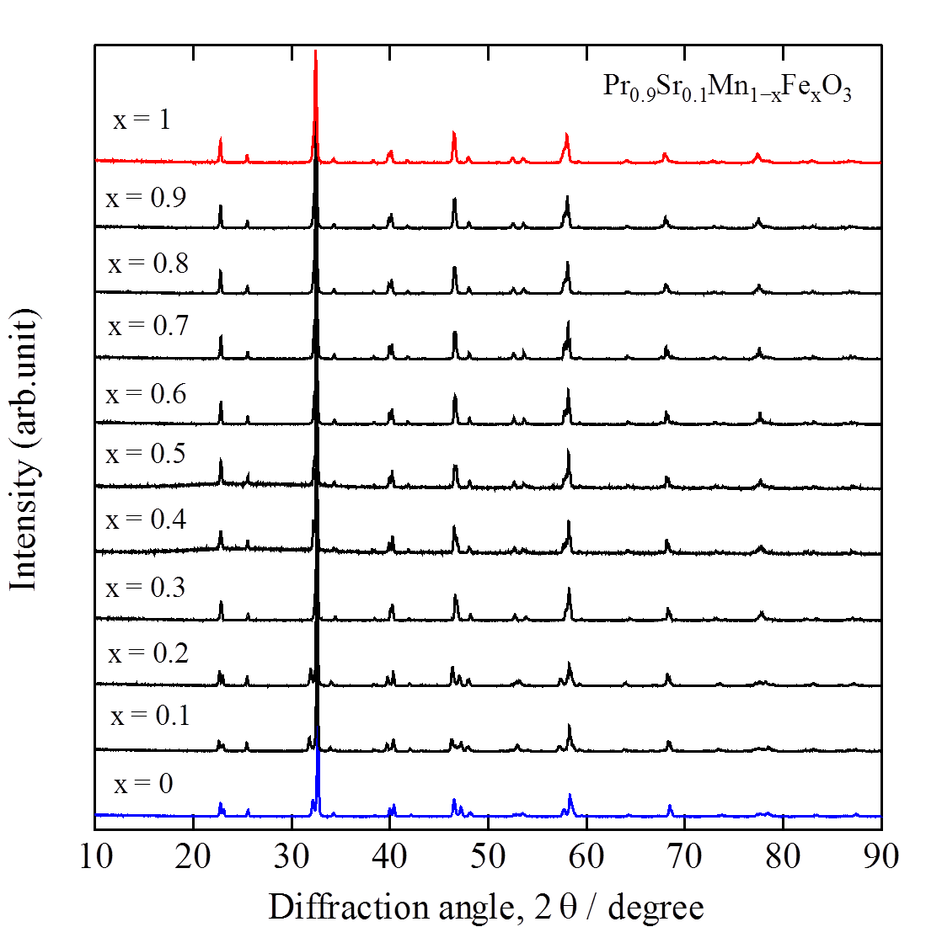
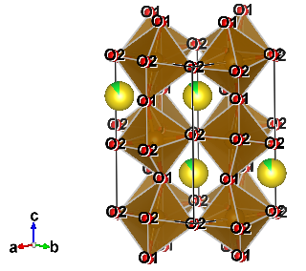
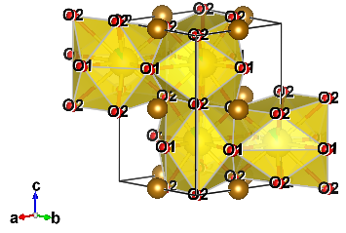
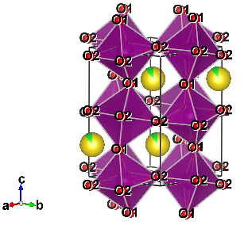
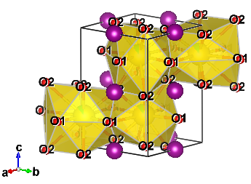
crystal structure
Pr_{0.9}Sr_{0.1}Mn_{1-x}Fe_{x}O₃ (0≦x≦1)
Pbnm
BVS = 3.13 (v.u.)
BVS = 2.89 (v.u.)
Fe-O1 : 1.995(Å)
Fe-O2 : 1.988(Å)
Fe-O2 : 1.996(Å)
Mn-O1 : 1.963(Å)
Mn-O2 : 1.939(Å)
Mn-O2 : 2.032(Å)
Jahn-Teller
distortion
Pbnm
BVS = 3.07 (v.u.)
BVS = 2.97 (v.u.)
Notes:
Next, I’d like to move on to Results and Discussion.
Firstly, I’d like to talk about crystal structure of praseodymium strontium manganese iron oxides.
X-ray diffraction data show that all samples are single phase and crystal structure is orthorhombic structure.
The bond valence sum of A site and B site was observed about 2.9 and 3.1which corresponds to a nominal ionic valence, respectively.
In particular, manganese rich samples were observed the Jahn-Teller octahedral distortion.

Slide 7
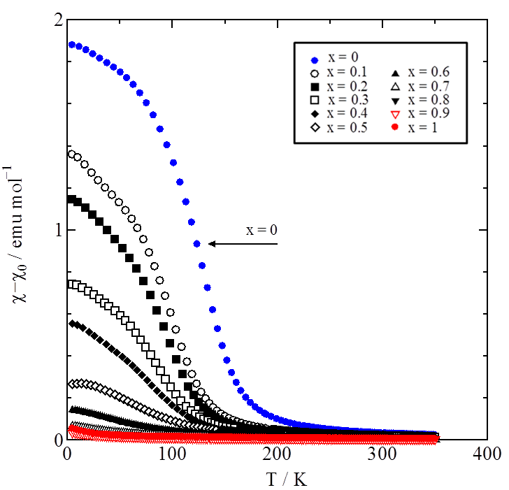
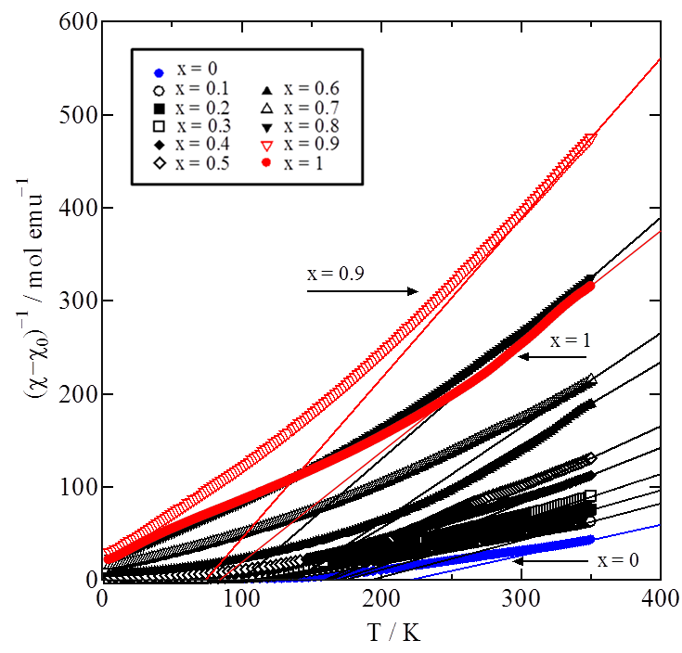
magnetic susceptibility
Notes:
This slide shows temperature dependence of magnetic susceptibility and inverse magnetic susceptibility
This figure shows ferromagnetism is suppressed with changing from manganese rich samples to iron rich samples.
On the other hand, the slope of the linear relation shows inverse Curie constant.
From Curie constant , we can obtain the effective magnetic moment and the spin quantum number of B site ions.

Slide 8
Heikes formula
x = 1
= 183μV/K
= 21μV/K
LS Fe³⁺
LS Fe⁴⁺
LS Fe³⁺
LS Fe³⁺
IS Fe³⁺
LS Fe⁴⁺
IS Fe³⁺
IS Fe³⁺
x = 0
= 170μV/K
HS Mn³⁺
HS Mn³⁺
HS Mn³⁺
HS Mn⁴⁺
HS Mn³⁺
HS Mn³⁺
HS Mn³⁺
HS Mn³⁺
Notes:
In the case of manganese rich sample of x = 0, the B site ions consist of high spin manganese trivalent and tetravalent ions.
The thermopower in the high temperature limit is estimated to be 170μV/K by using Heikes formula.
In the case of iron rich sample of x = 1, the B site ions consist of low spin iron trivalent, low spin iron tetravalent, and intermediate spin iron trivalent ions.
Therefore, the thermopower in the high temperature limit is estimated to be 204μV/K which corresponds to experimental value.

Slide 9
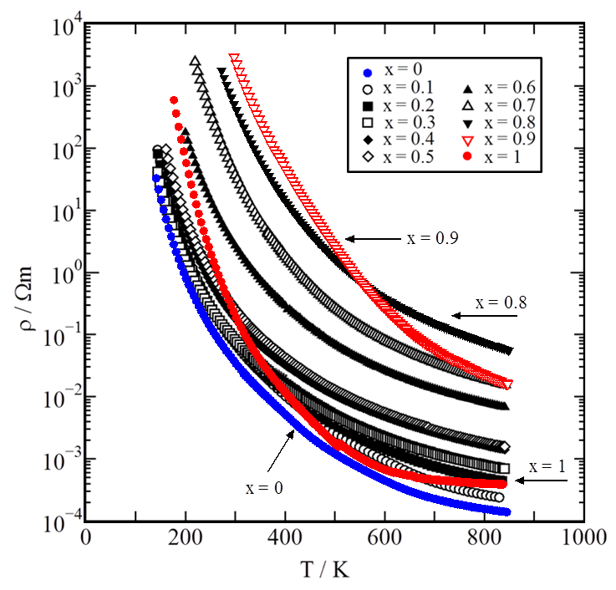
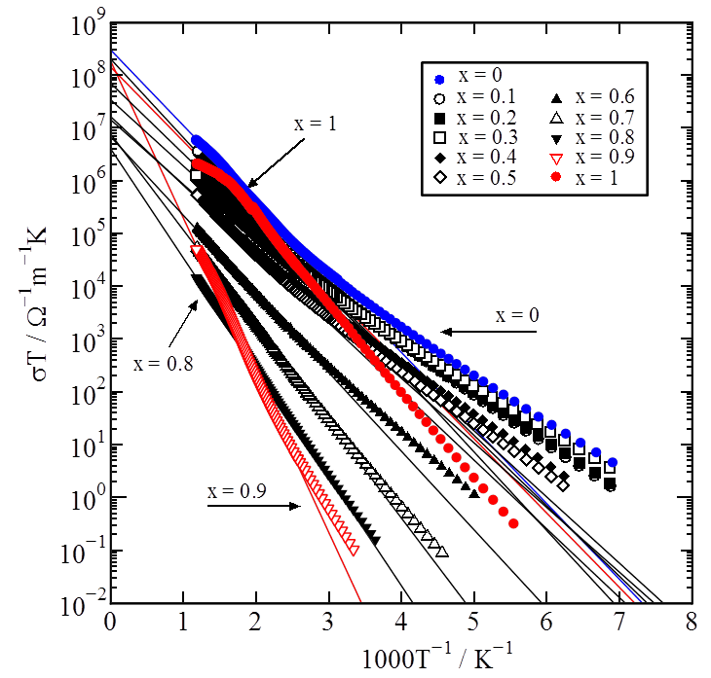
electric resistivity
Notes:
This slide shows temperature dependence of electric resistivity and Arrhenius relation of σT against inverse temperature.
All samples show a semiconducting behavior over the whole temperature range and resistivity increases with increasing x.
However, resistivity decrease rapidly as x increases from x = 0.9 to x = 1.
This means that low spin iron ions dominates the electric structure of the iron rich samples.
In addition, all samples show a small polaron behavior above room temperature.

Slide 10
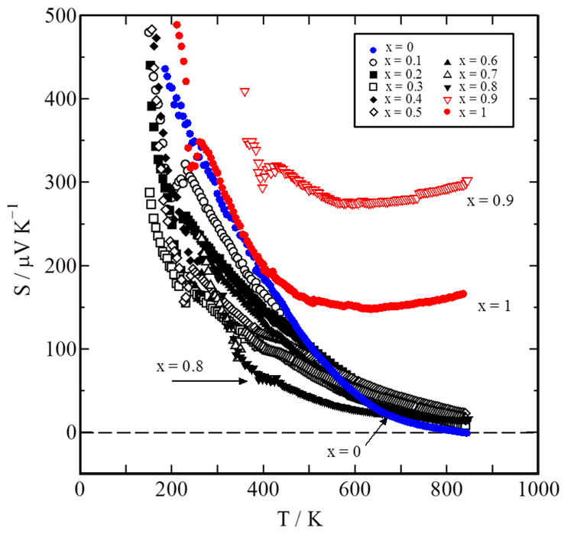
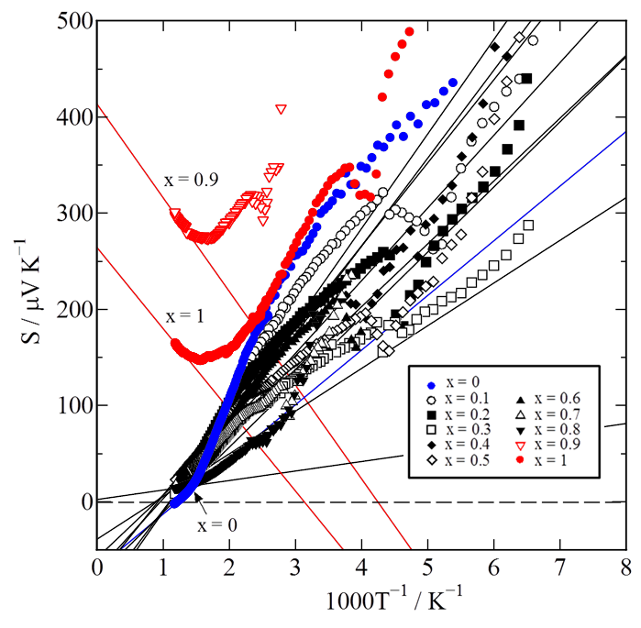
thermopower
Notes:
This slide shows temperature dependence and inverse temperature dependence of thermopower.
All samples show a large positive thermopower below room temperature.
Above room temperature, the thermopower of manganese rich samples decrease gradually and approach zero.
On the other hand, the thermopower of iron rich samples keep large value and show a gradual increase.
In particular, the thermopower in the high temperature limit of iron rich samples is in good agreement with experimental values.

Slide 11
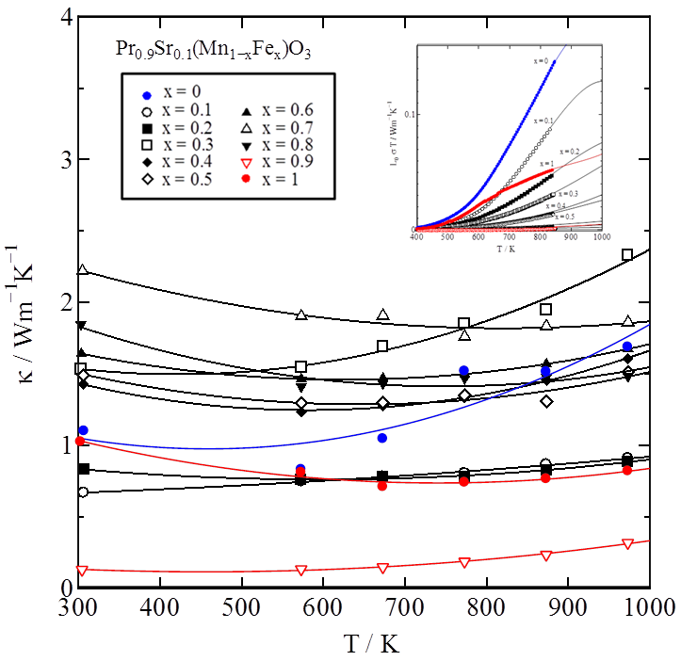
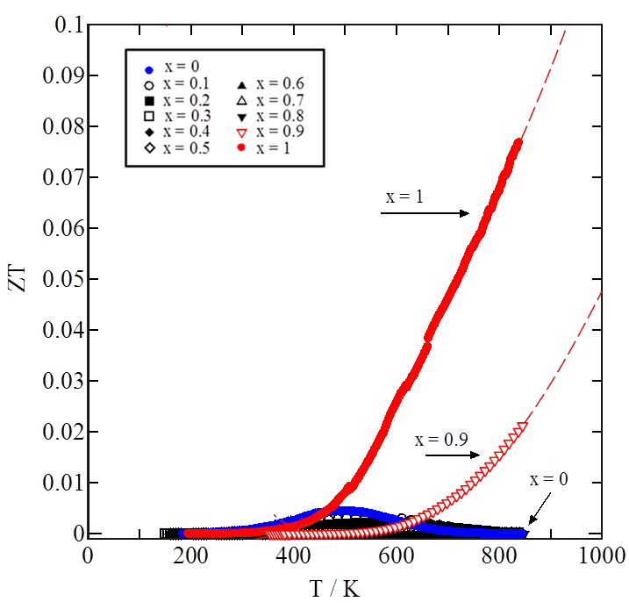
thermal conductivity and ZT
Notes:
This slide shows temperature dependence of thermal conductivity and ZT.
All samples show small thermal conductivity up to 2.5 W/mK over the whole temperature range.
Although electric thermal conductivity increase with increasing temperature, the influence is very small.
So lattice thermal conductivity is more important than electric thermal conductivity in this sample.
Clearly, the sample for x = 1 shows the largest ZT of 0.08 at 850K.
This indicates that hole-doped perovskite-type iron oxides show promising p-type thermoelectric properties at high temperature.

Slide 12
Summary
With increasing x, the majority ions of B-site changes from HS Mn³⁺ and HS Mn⁴⁺ to LS Fe³⁺ and LS Fe⁴⁺. In particular, part of trivalent ions for x = 1 change from LS Fe³⁺ to IS Fe³⁺.
All the samples show a small polaron behavior above room temperature.
The positive S for x≧0.9 show a gradual increase up to 850K and the predicted S∞ defined by Heikes formula for x≧0.9 are in good agreement with experimental values.
The largest ZT value for x = 1 is 0.08 at 850K. This indicates that hole-doped perovskite-type Fe oxides show promising p-type thermoelectric properties at high temperature.
Notes:
Conclusion is as follows. In conclusion,
with increasing x, the majority ions of B-site changes from HS Mn³⁺ and HS Mn⁴⁺ to LS Fe³⁺ and LS Fe⁴⁺. In particular, part of trivalent ions for x = 1 change from LS Fe³⁺ to IS Fe³⁺.
All the samples show a small polaron behavior above room temperature.
The positive S for x≧0.9 show a gradual increase up to 850K and the predicted S∞ defined by Heikes formula for x≧0.9 are in good agreement with experimental values.
The largest ZT value for x = 1 is 0.08 at 850K. This indicates that hole-doped perovskite-type Fe oxides show promising p-type thermoelectric properties at high temperature.

Slide 13
Thank you for your attention.
Notes:
Thank you for your attention.

Slide 14
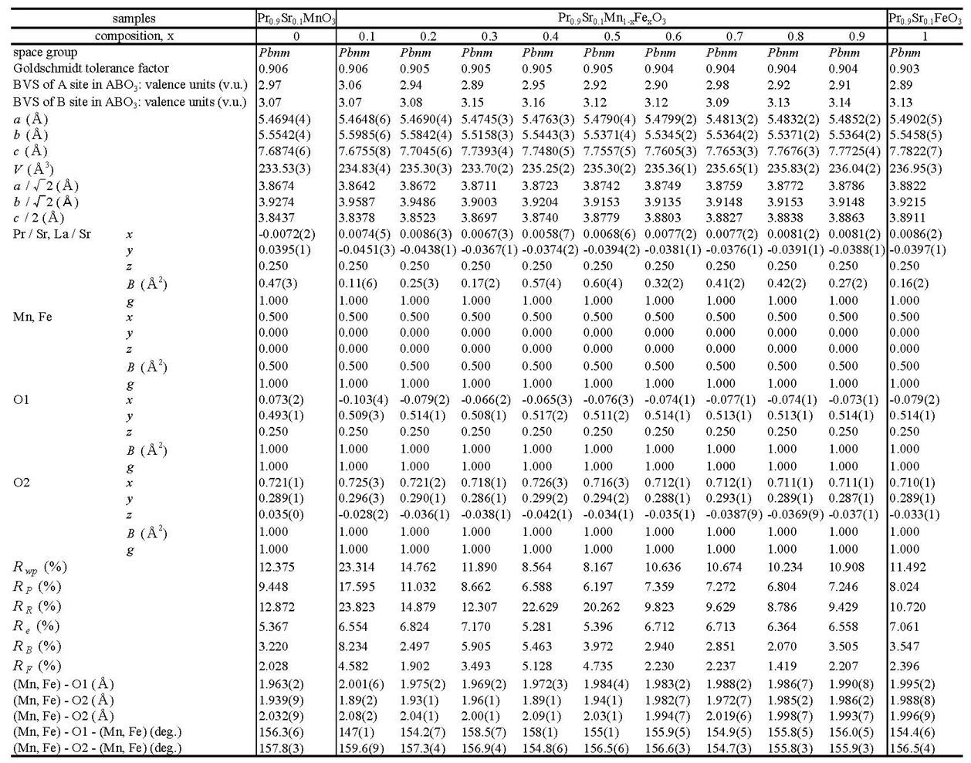

Slide 16
ions | ionic radius | bond valence parameter
La³⁺ | 1.36 | 2.172
Pr³⁺ | 1.179 | 2.138
Sr²⁺ | 1.44 | 2.118
Fe³⁺ | 0.645 | 1.751
Fe⁴⁺ | 0.585 | 1.765
Mn³⁺ | 0.645 | 1.732
Mn⁴⁺ | 0.53 | 1.750
O²⁻ | 1.40 | －

