Slide 1


P-type thermoelectric properties of stoichiometric full-Heusler alloy Fe₂TiSn sintered samples
Yokohama National University
T.Ozaki and H.Nakatsugawa
Notes:
Thank you, chairperson. Today, I’d like to talk about P - type thermoelectric properties of stoichiometric full - Heusler alloy iron 2 titanium tin sintered samples.

Slide 2
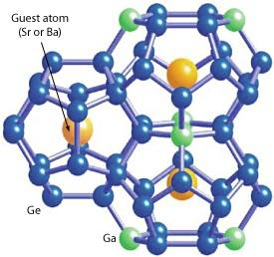
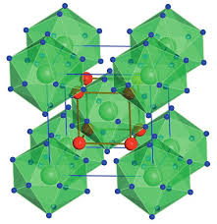
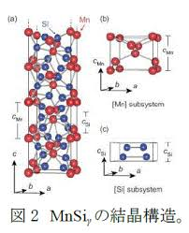
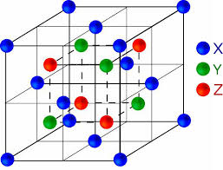
Introduction
Thermoelectric PG system
Thermoelectric materials
High Temp
clathrate
Skutterudite
e⁻
h⁺
n
p
Silicide
half Heusler
resistance
Low Temp
electric current
S :Sebeeck coefficient [V/K]
ρ :electric resistivity [Ωm]
and more
κ :thermal conductivity [W/mK]
A lot of thermoelectric materials have been studied
Improvement of ZT
S
ρ
κ
Notes:
Firstly, I’d like to start by talking about thermoelectric power generation. In thermoelectric power generation, as shown in this figure, p-type thermoelectric materials and n-type thermoelectric materials are bonded to π type, and electricity is generated by giving a temperature difference like this. The conversion efficiency of this method is evaluated by the dimensionless figure of merit ZT, and ZT is made up of these three physical property values. As you can see from this equation, it is necessary to have high Seebeck coefficient, low electrical resistivity and thermal conductivity for ZT improvement. In addition, various types of materials are being researched as shown here as thermoelectric materials.

Slide 3
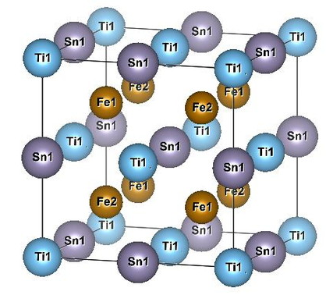
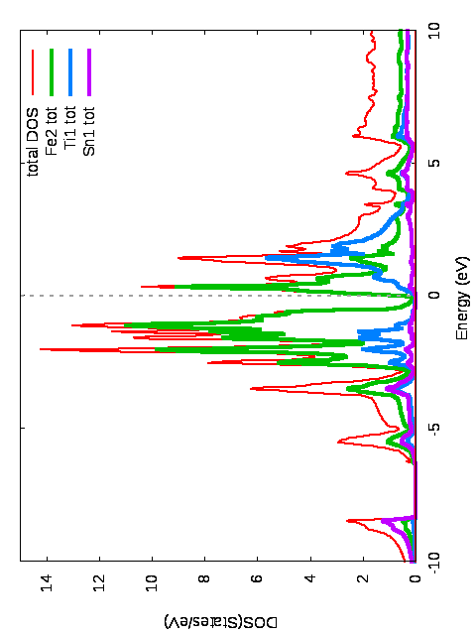
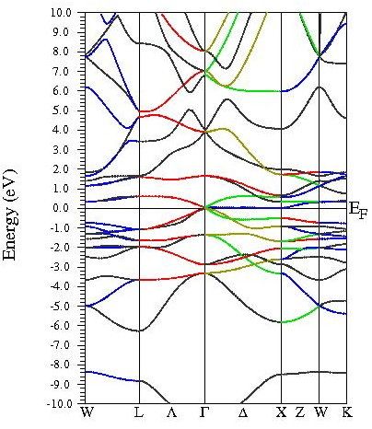
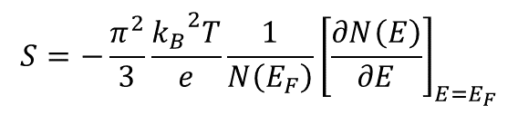
back ground
full-Heusler alloy
Intermetallic compounds with composition X₂YZ
When valence electron concentration per atom is six,
(ex Fe₂VAl, Fe₂TiSn etc)
pseudogap is formed at Fermi level.
from Mott’s theory
$$S=−\frac{π^{2}}{3}\frac{{k_{B}}^{2}T}{e}\frac{1}{N\left(E_{F}\right)}{\left[\frac{∂N\left(E\right)}{∂E}\right]}_{E=E_{F}}$$
High Sebeeck coefficient is expected
Notes:
Secondly, I want to explain full Heusler alloy among thermoelectric materials. A full Heusler alloy is intermetallic compounds with composition X 2 YZ and full Heusler alloy has feature that pseudo gap is formed near the Fermi level when the valence electron concentration VEC per atom is 6. This figure is density of state curve of iron 2 titanium tin calculated using wien2k, which has a very small density of state near the Fermi level, this is a pseudo gap. From the Mott’s theory, Seebeck coefficient is expressed by this equation, so it is suggested that a full Heusler alloy having a small density of state at the Fermi level and its density of state rapidly changing has a high Seebeck coefficient.

Slide 4
aim of study
Fe₂TiSn
From the first principles calculation, it was suggested that S was higher at 300K than Fe₂VAl
Fe₂TiSn has low κ of 7～8 W/mK as compared with other full Heusler alloys ( Fe₂VAl : 28W/mK)
But
κ is still higher than the currently used Bi-Te based material
We aim to improve thermoelectric characteristics by controlling grain refinement, promoting phonon scattering at grain boundaries, and reducing κ for Fe₂TiSn sintered sample
Notes:
Among full Heusler alloys, iron 2 titanium tin has been suggested to have a higher Seebeck coefficient at around room temperature compared with iron 2 vanadium aluminium which has been studied from the first principles calculations. In addition, iron 2 titanium tin shows a low value of 7 to 8 W / mK as compared with other full Heusler alloys. However, it still shows high thermal conductivity compared with currently used Bi - Te based thermoelectric materials. Therefore, in this research, we aim to improve thermoelectric performance of iron 2 titanium tin sintered body by controlling crystal grain and promoting phonon scattering to reduce thermal conductivity.

Slide 5
Experimental methods
Production method
arc melting
Fe : Ti : Sn = 2 : 1 : 1
milling using stainless ball
milling time(in Air or Ar)
1h /3h /12h
press forming
calcining at
723K/2h
calcining of vacuum
annealing at
1073K/48h
annealing of vacuum
sintered sample
Evaluation method
crystal structure：XRD (SmartLab)
Rietveld analysis : RIETAN-FP program
micro-structuer ：SEM (VE-8800)
particle size distribution ：ImageJ
S ：steady method
ρ ：dc four-probe method
κ ：PEM-2
RH :van der Pauw method
Notes:
Next, I’d like to talk about experiment methods. Samples were prepared like this. Samples are milled for 1h, 3h and 12h in Air and Ar. In addition, the evaluation method of the sample was done as shown here.

Slide 6
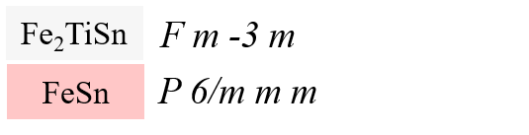
XRD patterns
(a) 1h milling in Air
(220)
 | S | R_{wp} | R_{e}
1h | 7.7645 | 8.454 | 1.089
1h_Ar | 6.3231 | 6.062 | 0.959
3h | 5.9214 | 6.43 | 1.086
3h_Ar | 4.876 | 5.081 | 0.984
12h | 5.9214 | 6.43 | 1.086
12h_Ar | 5.8636 | 5.636 | 0.961
(222)
(420)
(511)
(111)
(200)
(311)
(400)
(331)
(422)
(b) 1h milling in Ar
(220)
(111)
(422)
In Ar samples,
formation of the second phase was suppressed.
(400)
(200)
(222)
(420)
(511)
(311)
(331)
Notes:
Then, I’d like to move on to results and discussion. First, Rietveld analysis of sample 1h milled in Air and Ar was obtained as shown this figure. As a result of the Rietveld analysis of all samples, it was obtained as shown in this table. As you can see this table, the results are improved for all samples in samples milled in argon, compared to samples milled in air. From this, it turned out that In Ar samples, formation of the second phase was suppressed.

Slide 7
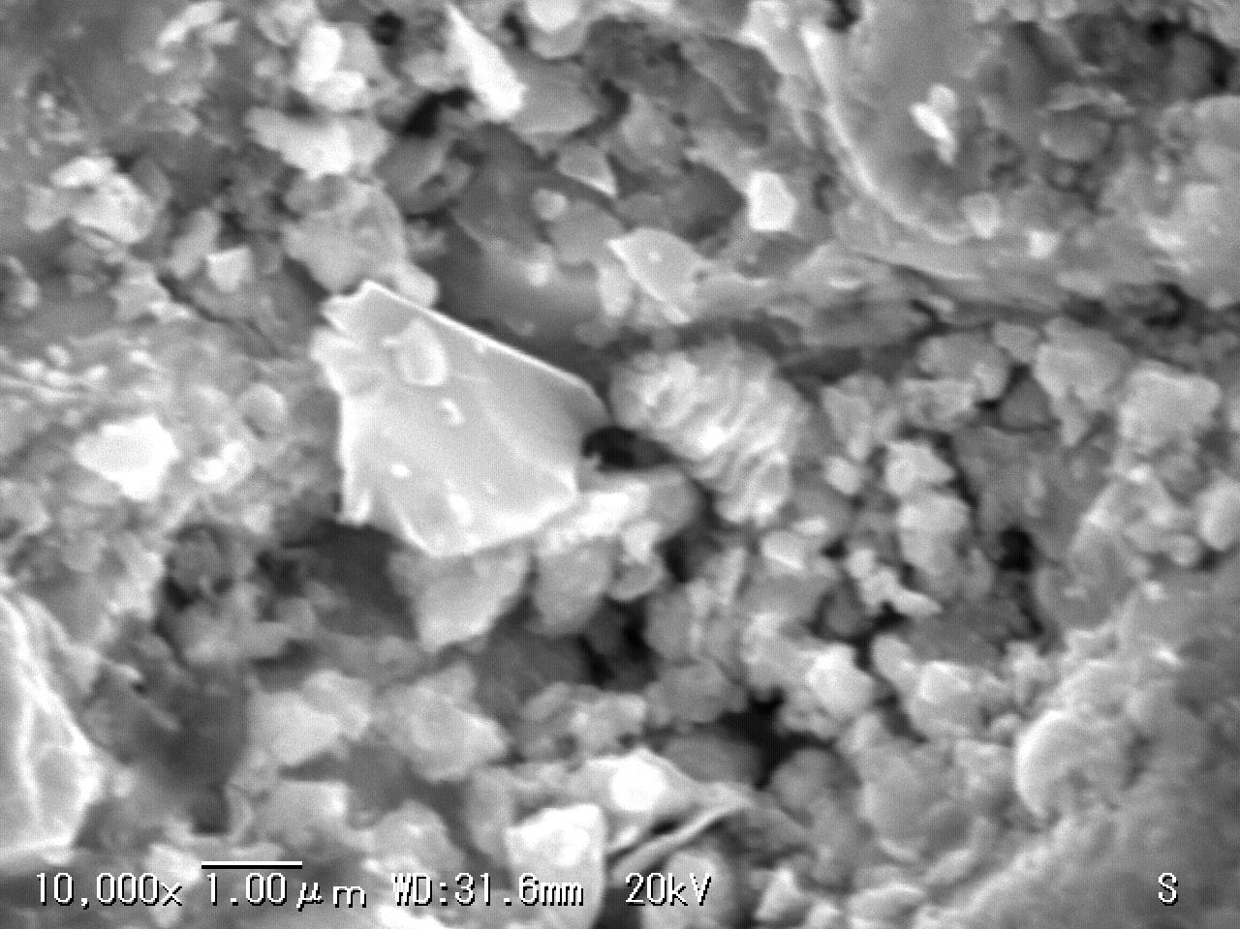
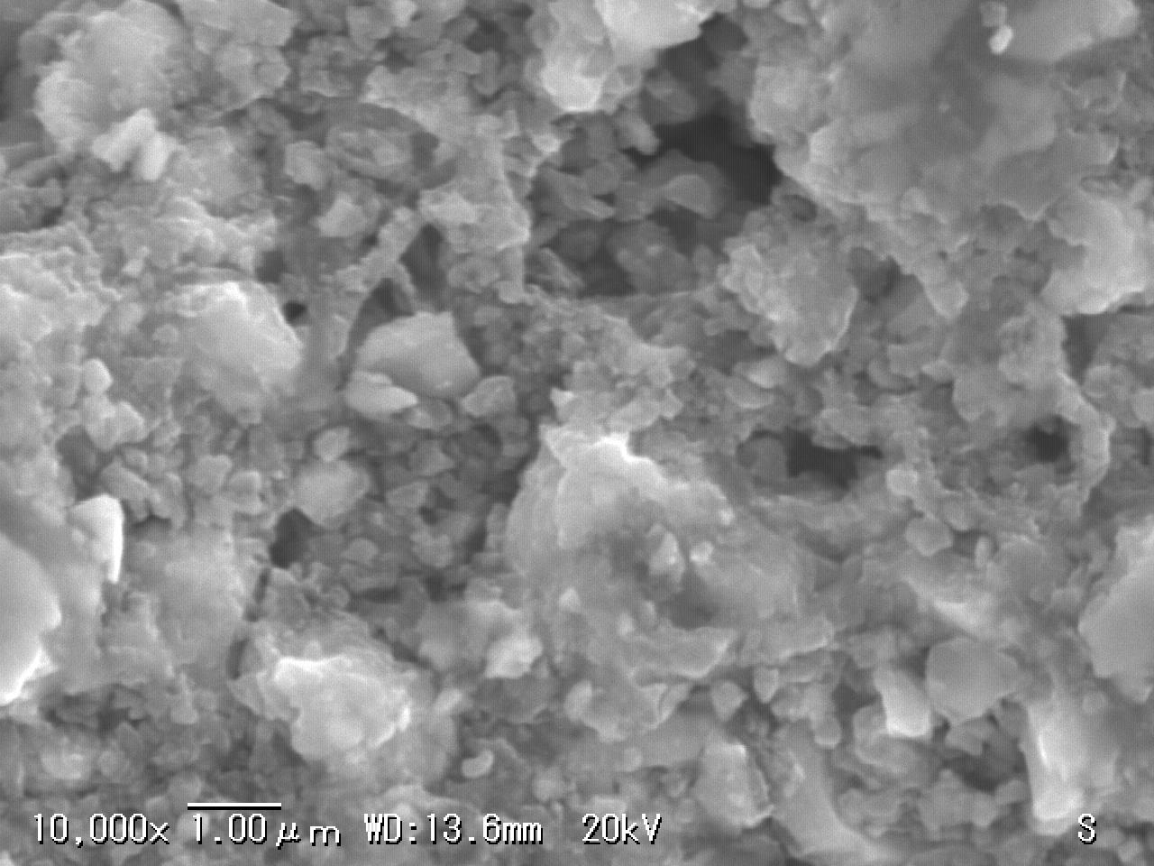
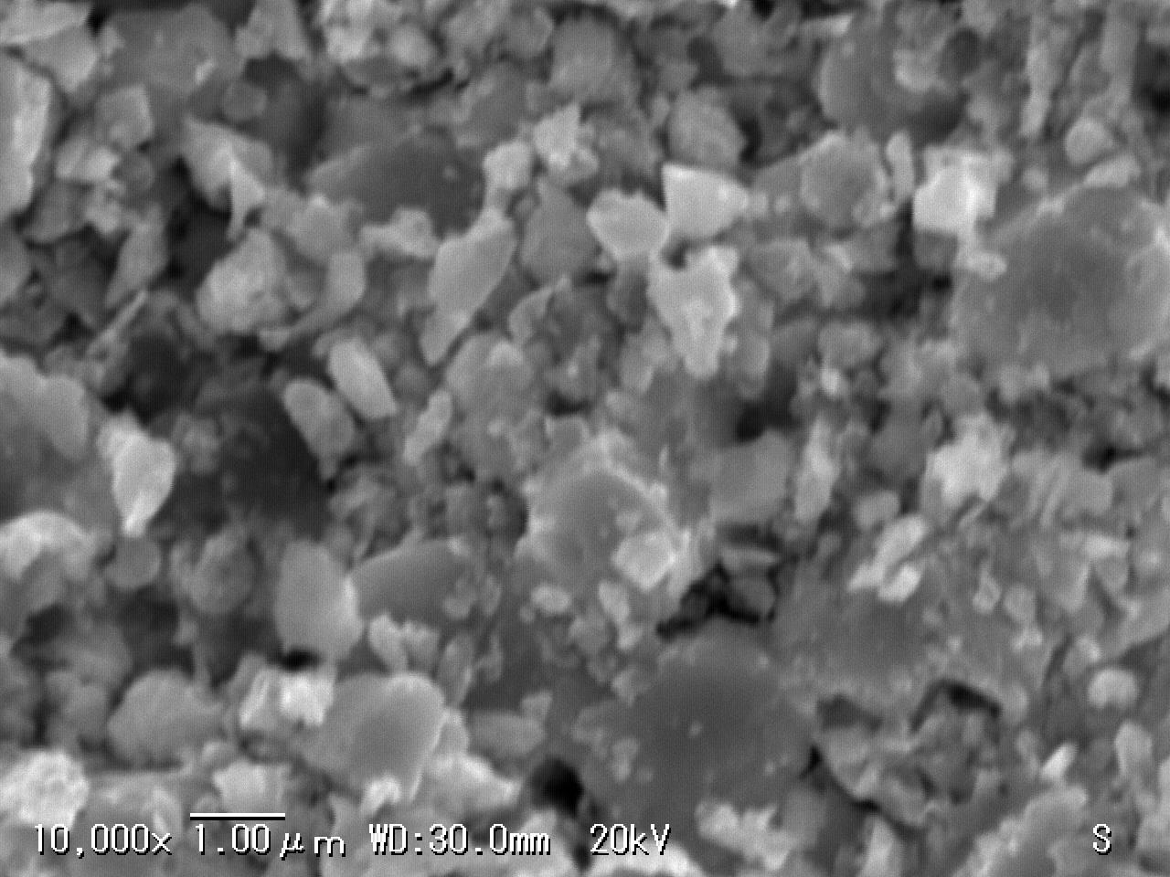
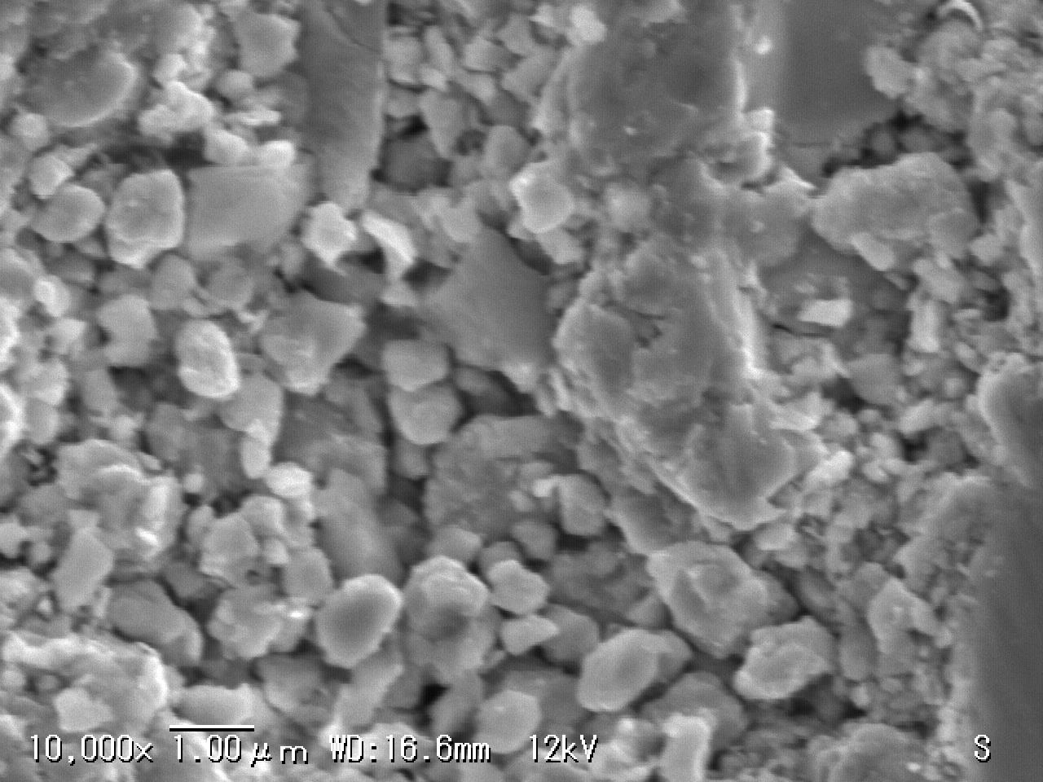
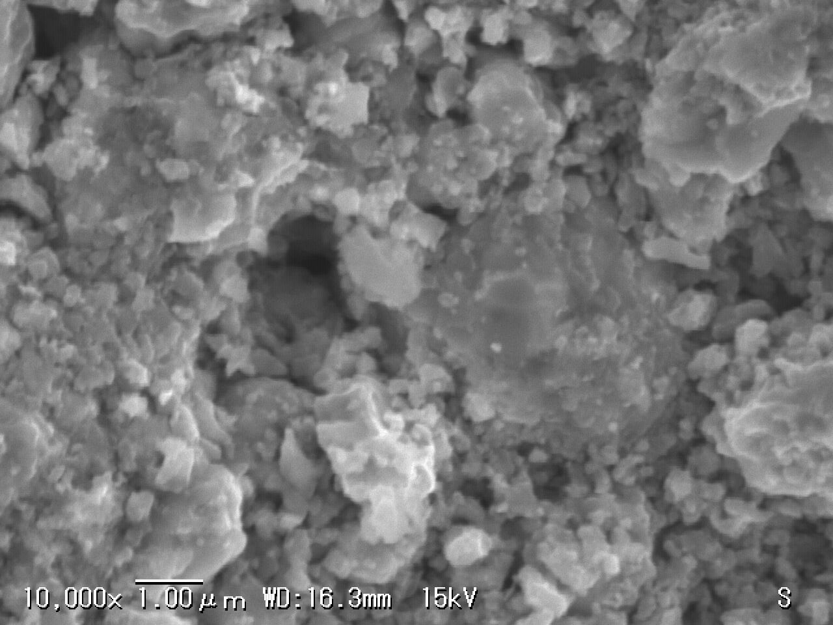
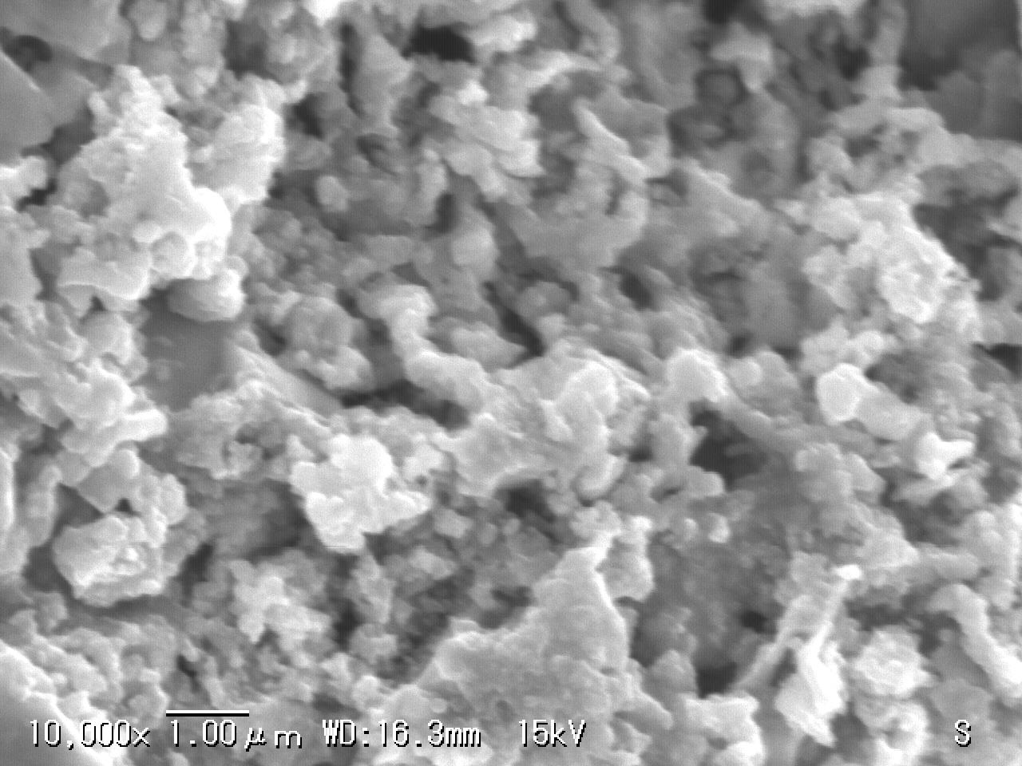
SEM images
(a) 1h milling in Air
(b) 3h milling in Air
(c) 12h milling in Air
1 μm
1 μm
1 μm
(d) 1h milling in Ar
(e) 3h milling in Ar
(f) 12h milling in Ar
1 μm
1 μm
1 μm
Notes:
This is SEM images of the fracture surface of each sample. From these images, we can see that as the milling time increases in air in argon, the particle size decreases.

Slide 8
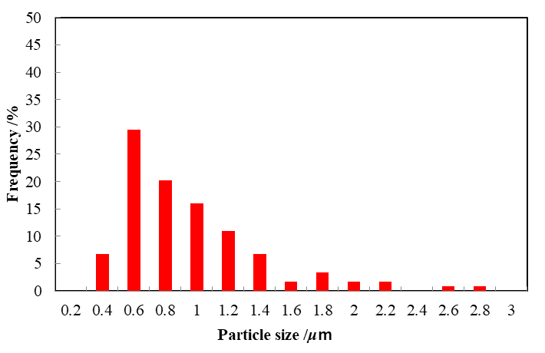
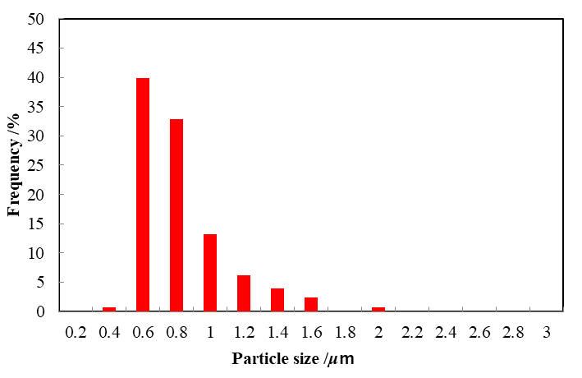
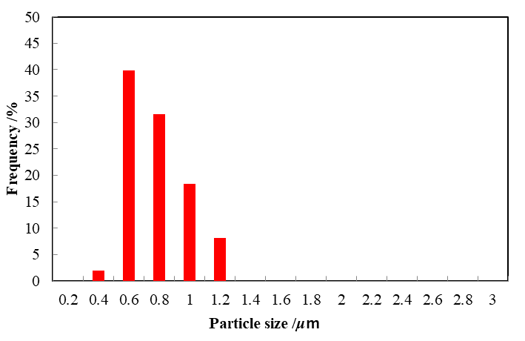
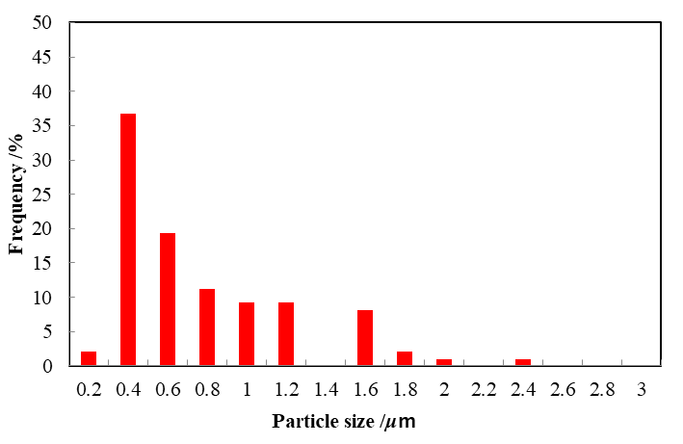
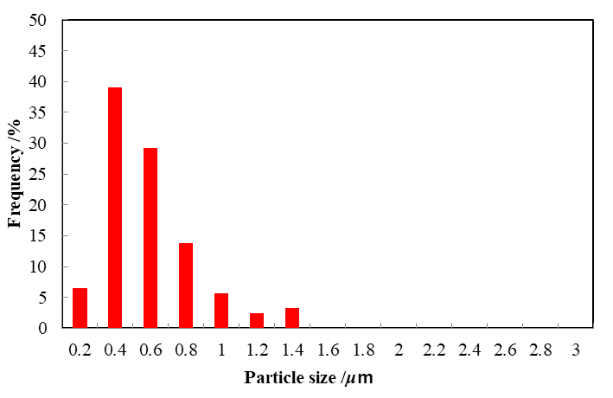
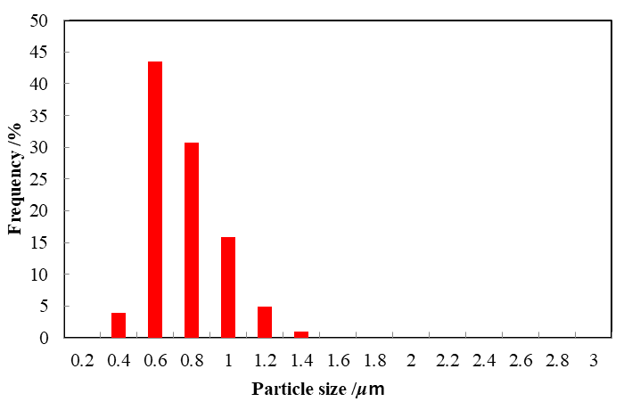
particle size distribution
(a) 1h milling in Air
(b) 3h milling in Air
(c) 12h milling in Air
Average particle size
0.86μm
Average particle size
0.72μm
Average particle size
0.69μm
(d) 1h milling in Ar
(e) 3h milling in Ar
(f) 12h milling in Ar
Average particle size
0.88μm
Average particle size
0.69μm
Average particle size
0.66μm
Notes:
In addition, this is the result of particle size analysis of the previous SEM image using Imagej. As you can see from these figures, as the milling time got longer, the variation in particle size was suppressed, and the average particle diameter was 0.88 μm in 3 hours in argon, whereas it decreased to 0.66 μm in 12 hours in argon.

Slide 9
electric resistivity ρ
Notes:
I’d like to move on to the measurement results of the physical properties. First, the resistivity measurement result was obtained as shown here. There was no significant change due to milling atmosphere and milling time. This suggests that second phase resulting from stoichiometric composition of Fe2TiSn is not enough to affect resistivity.

Slide 10
Sebeeck coefficient S
Notes:
Next, Seebeck coefficient measurement result is here. milled in Ar as compared with milled in the air, the change in Seebeck coefficient due to milling time was suppressed. As shown here, the carrier density has changed from the Hall measurement result. From this fact, milling in air produced a second phase, which shifted from the stoichiometric composition, thereby changing the Seebeck coefficient. And the difference of carrier density is cause of larger Seebeck coefficient for sample milled in Ar than sample milled in air.

Slide 11
thermal conductivity κ
Notes:
Then, the thermal conductivity was obtained as shown in this figure. As you can see from this, the milling time becomes longer in argon in the air, the thermal conductivity has been reduced. However, since no significant change in thermal conductivity was observed in the sample milled for 12h as compared with milled for 3h, it is considered that milling treatment of 3h is enough for crystal grain refinement processing contributing to reduction of thermal conductivity.

Slide 12
thermal conductivity κ
κ_{ph} = κ - κ_{car}
Wiedemann-Franz rule
κ_{car} = LT/ρ (L = 2.45×10⁻⁸WΩ/K²)
Notes:
Calculation of lattice thermal conductivity and carrier thermal conductivity from this Wiedemann Franz 's rule Results were obtained as shown in this figure. As you can see, it can be seen that the carrier thermal conductivity of each sample did not change almost and the lattice thermal conductivity was reduced.

Slide 13
dimensionless figure of merit ZT
Notes:
Finally, ZT was obtained like this figure. 0.0013@305 K of the sample milled in argon for 3 h showed the maximum p-type thermoelectric characteristics. This is due to the difference in composition and reduction in thermal conductivity due to milling time.

Slide 14
Conclusion
By milling in Ar, formation of second phase was suppressed and stoichiometric Fe₂TiSn composition was maintained, and the decrease of |S| in the Ar sample was suppressed.
As milling time longer, dispersion of particle size was suppressed, and average particle size was reduced from 0.88μm at 1h to 0.66μm at 12h.
As milling time longer, lattice thermal conductivity decreased, especially 4.24W/mK@350 K for the sample milled for 12h in Ar.
Maximum dimensionless figure of merit ZT was p-type thermoelectric characteristics of 0.0013@305K of milled for 3h in Ar.
As future plans, further improvements of ZT are expected by preparing Fe₂TiSn sintered sample with stoichiometric composition shifted.
Notes:
In conclusion, By milling in argon, formation of second phase was suppressed and stoichiometric iron 2 titanium tin composition was maintained, and the decrease of Seebeck coefficient in the argon sample was suppressed.
As milling time longer, dispersion of grain size was suppressed, and average grain size was reduced from 0.88μm at 1h to 0.66μm at 12h.
As milling time longer, lattice thermal conductivity decreased, especially 4.24W/mK@350 K for the sample milled for 12h in argon.
Maximum dimensionless figure of merit ZT was p-type thermoelectric characteristics of 0.0013@305K of milled for 3h in argon.
As future plans, further improvements of ZT are expected by preparing iron 2 titanium tin sintered sample with stoichiometric composition shifted.

Slide 15
Thank you for your kind attention.

