Slide 1

The 31st International Korea-Japan Seminar on Ceramics
TE-I03
A study on thermoelectric properties of perovskite-type oxides
Yokohama National University
Hiroshi Nakatsugawa
Notes:
Thank you, Mr. Chairman. It is a great honor to be able to speak to you today.
My name is Hiroshi Nakatsugawa from Yokohama National University, Japan.
Today, I’d like to talk about thermoelectric properties of perovskite-type oxides.

Slide 2
outline
Introduction
Experimental Procedure
Results and Discussion
  Pr_{1-x}Sr_{x}MnO₃ (0.1≦x≦0.7)
  Pr_{1-x}Ca_{x}MnO₃ (0.1≦x≦0.7)
  La_{1-x}Sr_{x}FeO₃ (0.1≦x≦0.3)
Conclusions
Notes:
This slide shows the contents of my presentation.
First, I’m going to talk about Introduction of thermoelectrics.
Second, I want to explain Experimental Procedure.
Third, I’d like to talk about Results and Discussion. There are three parts.
Finally, I will summarize this talk.

Slide 3
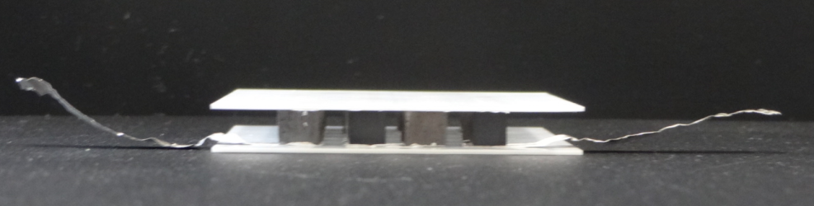
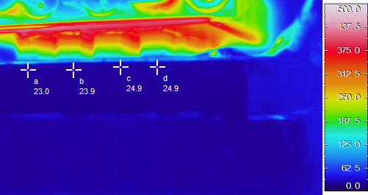
thermoelectric generation
50mm
1.4V
0.2W
n-type
Ca_{0.99}Yb_{0.01}MnO₃
p-type
[(Ca_{0.9}Y_{0.1})₂CoO₃]_{0.62}CoO₂
500℃
heater
640K
297K
⊿T = 343K
water cooled heatsink
0.6A
Z<T> = 0.25
η_{max} = 4%
0℃
Notes:
I’d like to start by talking about Introduction of thermoelectrics.
Thermoelectric energy conversion can directly convert waste heat from automobiles, facilities, and power plants into electrical energy.
We can indicate the potential of thermoelectric materials by the dimensionless figure of merit ZT, where S is Seebeck coefficient, σ is electric conductivity, and κ is thermal conductivity.

Slide 4
thermoelectric theory
T_{H}
j_{Q}
j
T_{L}
criteria of practical application
TE energy conversion efficiency
Notes:
Since electrons in solids carry electricity together with thermal entropy, so there is a coupling between electrical and heat current density.
The thermoelectric energy conversion efficiency is defined by the ratio between electric power and heat flux at high temperature.
By optimizing the efficiency, we can obtain maximum efficiency as a function of ZT.
Maximum efficiency increases with increasing temperature and temperature difference.
In particular, ZT=1 is the criteria of practical application for thermoelectric materials.

Slide 5
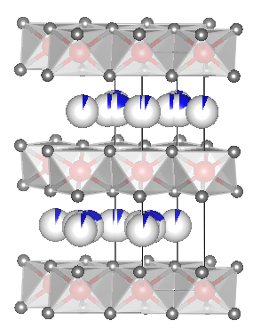
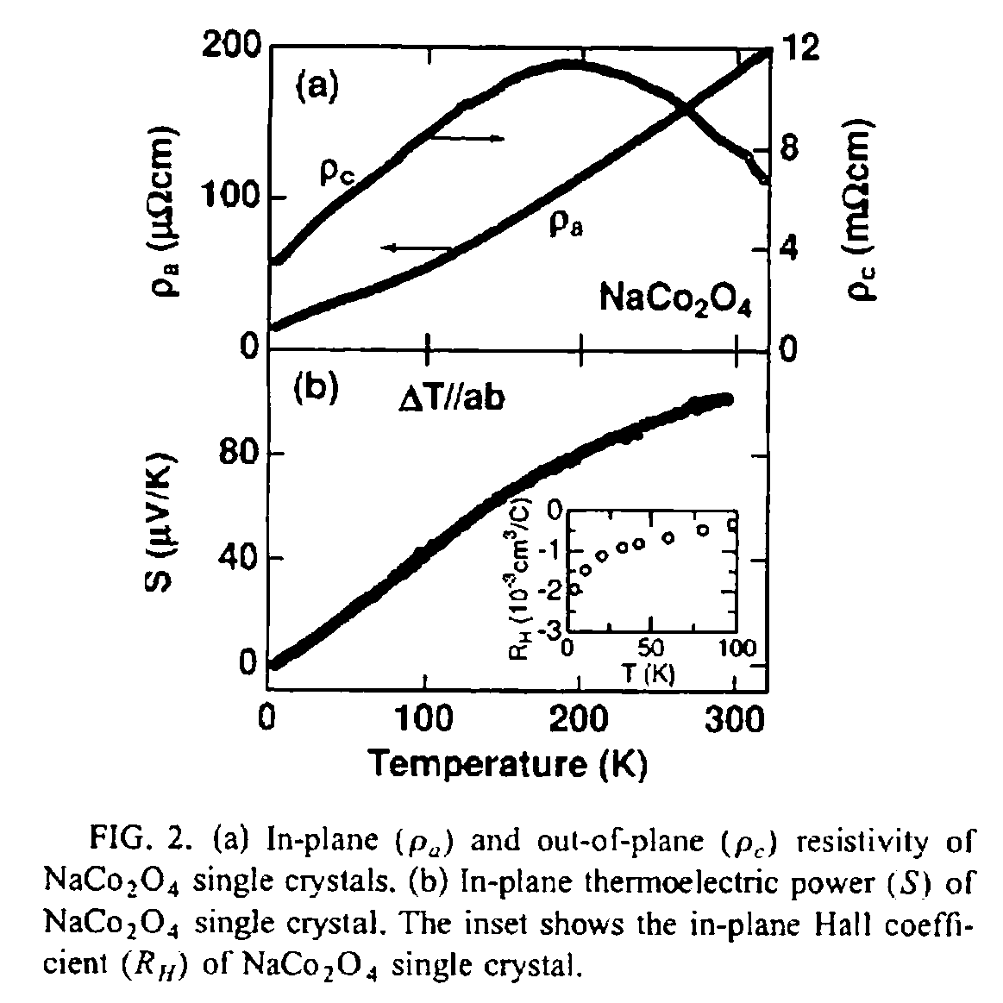
layered Co oxide Na_{x}CoO₂
CoO₂
layer
Na
layer
I.Terasaki et al., Phys.Rev. B56, R12685 (1997).
Notes:
In this respect, oxides are attractive because they are thermally and chemically stable for long time use at high temperature in air.
Recently, sodium cobalt layered oxide has been discovered as a possible candidate for thermoelectric materials at high temperature.

Slide 6
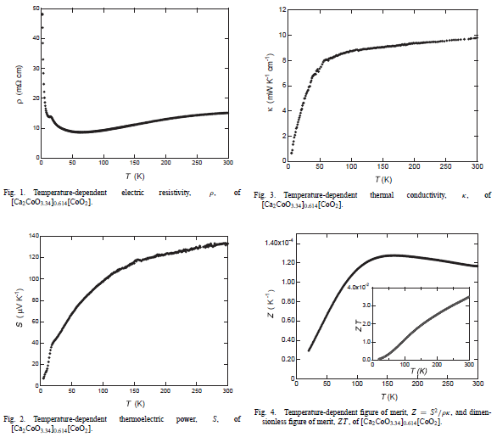
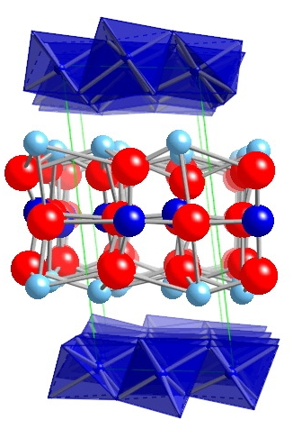
misfit-layered Co oxide Ca₃Co₄O₉
Ca₂CoO_{3＋δ}
block layer
CoO₂
layer
Y.Miyazaki et al., Jpn.J.Appl.Phys. 39, L531 (2000).
Notes:
Furthermore, the misfit-layered calcium cobalt oxide has been studied as a candidate for p-type thermoelectric materials.
This material shows low electric resistivity, high Seebeck coefficient, and low thermal conductivity at room temperature.

Slide 7
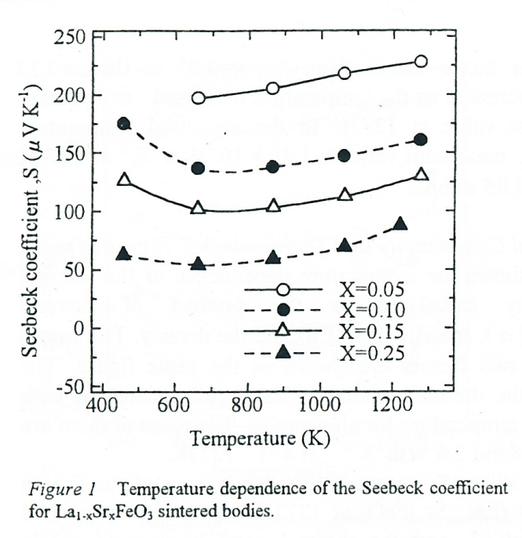
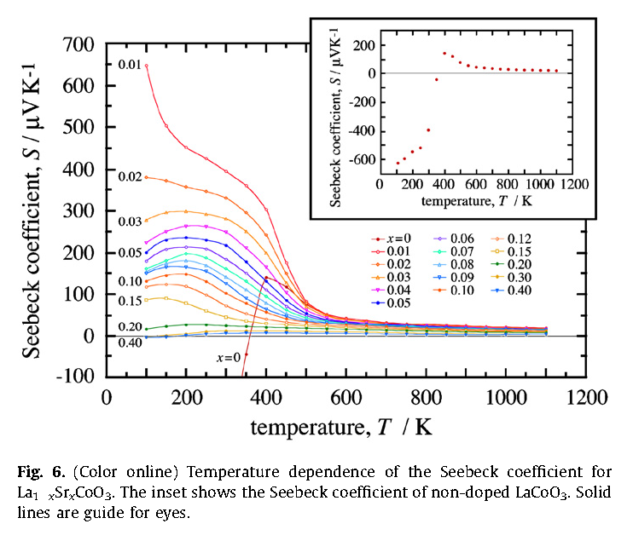
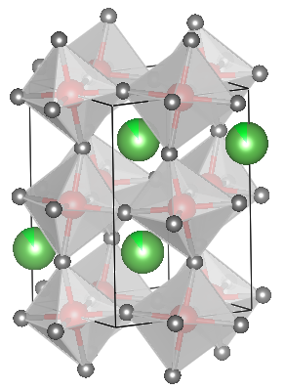
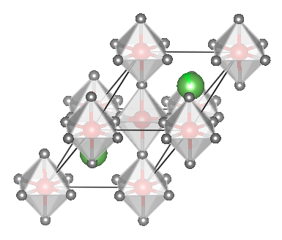
perovskite-type oxides
M.Iijima et al., Proceedings of ICT98, 598 (1998).
K.Iwasaki et al., J.Solid State Chem. 181, 3145 (2008).
La_{1-x}Sr_{x}FeO₃(0.05≦x≦0.25)
La_{1-x}Sr_{x}CoO₃(0.00≦x≦0.40)
Fe³⁺(d⁵)
Fe⁴⁺(d⁴)
Co³⁺(d⁶)
Co⁴⁺(d⁵)
g₃ = 6
g₄ = 10
g₃ = 1
g₄ = 6
Notes:
This slide shows the temperature dependence of perovskite-type iron and cobalt oxides.
These materials have been reported large Seebeck coefficient, which is one of the essential condition for thermoelectric materials.
The large Seebeck coeffient can be explained by using Heikes formula from a localized picture.
When spin and orbital degrees of freedom in 3d transition metal gives large value, the large Seebeck coefficient can be expected

Slide 8
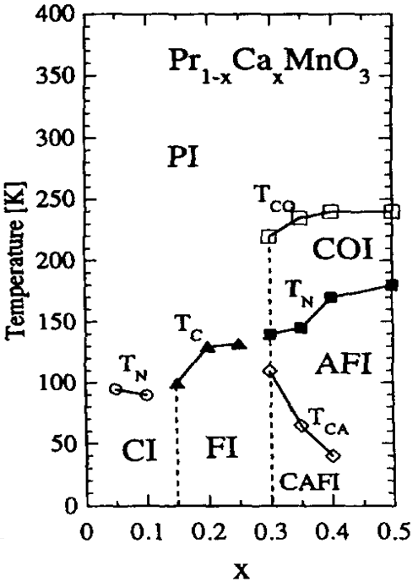
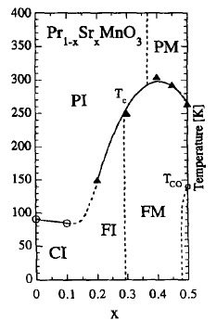
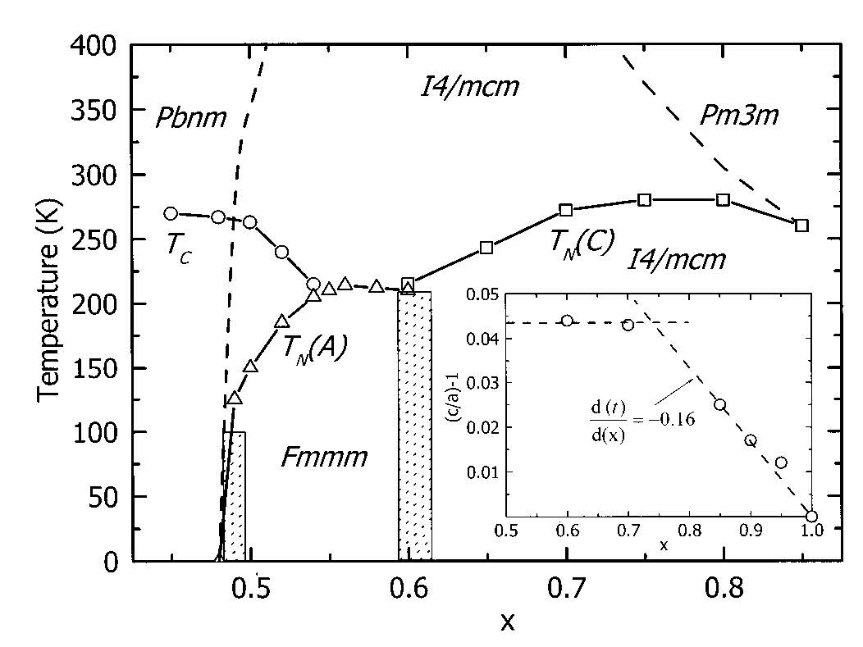
perovskite Mn oxides
A_{1-x}Ca_{x}MnO₃(0.1≦x≦0.7)
A_{1-x}Sr_{x}MnO₃(0.1≦x≦0.7)
Y.Tokura et al., Physica C 263, 544 (1996)
Z.Jirak et al., J.Appl.Phys.11, 7404 (2001)
Notes:
In this presentation, we would like to focus on perovskite-type manganese oxides.
In particular, praseodymium calcium and praseodymium strontium manganese oxides will be discussed.
These materials show orthorhombic crystal structure around 0.9 of tolerance factor.
At low tolerance factor, these materials cannot be perovskite structure, and can be tetragonal or rhombohedral crystal structure at high tolerance factor.
These figures show phase diagram. At low temperature, these materials show ferromagnetic ground state or anti-ferromagnetic ground state.

Slide 9
perovskite Mn oxides
A_{1-x}Ca_{x}MnO₃(0.1≦x≦0.7)
A_{1-x}Sr_{x}MnO₃(0.1≦x≦0.7)
Low x (Mn⁴⁺ poor) ; p-type
Mn³⁺
Mn⁴⁺
Mn³⁺
Mn³⁺
Mn³⁺
Mn⁴⁺
Mn³⁺
Mn⁴⁺
High x (Mn⁴⁺ rich) ; n-type
Mn⁴⁺
Mn⁴⁺
Mn³⁺
Mn⁴⁺
g₃ = 10
g₄ = 4
g₃ = 5
g₄ = 4
Notes:
Perovskite manganese oxides show both p-type and n-type thermoelectric properties because eg holes play carrier at low x and eg electrons play carrier at high x.
At high temperature, these carriers play as a small polaron hopping conduction.
Since Jahn-Teller distortion of octahedra is gradually effective for polaron formation, the eg splitting is valid like this.
So, spin and orbital degrees of freedom in trivalent manganese ion changes from 10 to 5.
We expect that perovskite manganese oxides show large p-type and n-type thermoelectric properites at high temperature.

Slide 10
Experimental Procedure
conventional solid-state reaction
  sintered 1673K in N₂
X-ray diffraction
  RINT2500 @RT
Rietveld analyses
  RIETAN-FP program
Magnetic susceptibility χ
  MPMS, 5K～RT, H = 0.1T or 1T
electric resistivity ρ
  ResiTest8300, 80K～395K, ZEM-3, 373K～1073K
Seebeck coefficient S
  ResiTest8300, 80K～395K, ZEM-3, 373K～1073K
thermal conductivity κ
  bulk density : SMK-401 @RT
  specific heat : X-DSC7000 @RT
  thermal diffusivity : TC-7000, 573K～1073K
Notes:
Now, I want to talk about Experimental Procedure.
Polycrystalline samples were synthesized by using conventional solid-state reaction.
Crystal structure parameters were studied by using Rietveld analyses of X-ray diffraction data.
Magnetic susceptibility was measured by using MPMS below room temperature under magnetic field of 0.1T or 1T.
We measured electric resistivity and Seebeck coefficient by using ResiTest below room temperature and ZEM-3 above room temperature.
Thermal conductivity was measured by using laser flash method above room temperature.

Slide 11
Results and Discussion
Pr_{1-x}Sr_{x}MnO₃ (0.1≦x≦0.7)
Pr_{1-x}Ca_{x}MnO₃ (0.1≦x≦0.7)
La_{1-x}Sr_{x}FeO₃ (0.1≦x≦0.3)
Notes:
Next, I’d like to move on to Results and Discussion.
Firstly, I’d like to talk about praseodymium strontium manganese oxides.

Slide 12
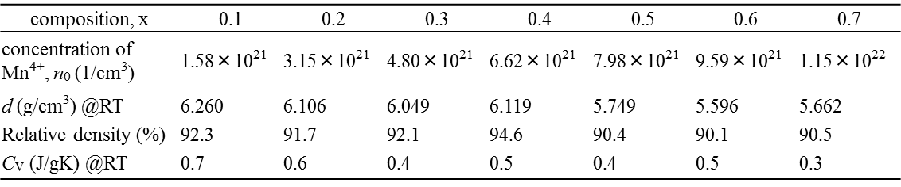
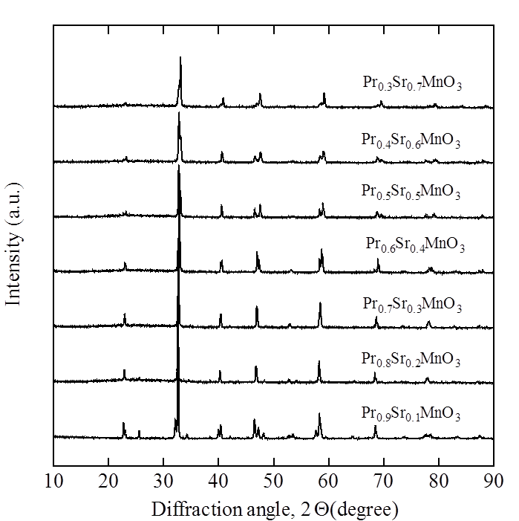
crystal structure
I4/mcm
Pbnm
Notes:
X-ray diffraction data show that all samples are single phase and crystal structure changes from orthorhombic structure to tetragonal structure at x equals 0.4.
Unit cell volume decreases with increasing x because tetravalent manganese ion introduces with increasing x, but ionic radius of tetravalent manganese ion is much smaller than that of trivalent manganese ion.
On the other hand, orthorhombic distortion modifies with increasing x because of Jahn-Teller distortion of octahedra.

Slide 13
magnetic susceptibility χ
Notes:
This slide shows the temperature dependence of magnetic susceptibility.
All samples up to x equals 0.5 have Curie temperature and show ferromagnetic ground state below Tc.
The sample for x equals 0.5 has a charge ordering ground state below Tco.
On the other hand, samples for x equals 0.6 and 0.7 have A-type anti-ferromagnetic ground state and C-type anti-ferromagnetic ground state below TN.

Slide 14
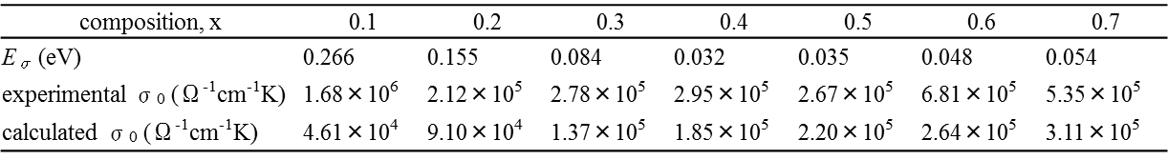
electric conductivity σ
Notes:
This figure shows temperature dependence of electric resistivity.
Below Tc, x equals 0.1 and 0.2 show ferromagnetic insulator and x equals 0.3 and 0.4 show ferromagnetic metal.
Below TN, x equals 0.6 and 0.7 show anti-ferromagnetic insulator.
On the other hand, all samples show small polaron hopping conduction above room temperature.
This figure shows Arrhenius relation of σT against inverse Temperature which yield well straight lines for all samples.

Slide 15
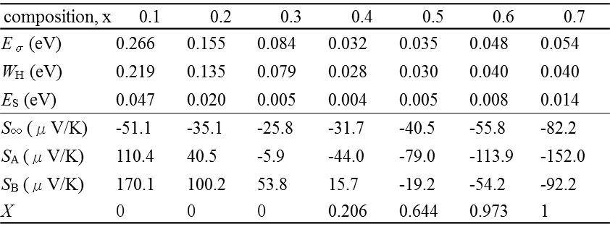
Seebeck coefficient S
Notes:
This slide shows temperature dependence of Seebeck coefficient.
The samples for x equals 0.1 and 0.2 show large positive Seebeck coefficient below room temperature and sharp fall above room temperature.
All samples show negative Seebeck coefficient at high temperature and obey the straight lines which represent this relation.
In particular, temperature independent term is descrived by Heikes formula.
By taking account of Jahn-Teller distortion, the Heikes formula for x equals 0.4, 0.5, 0.6, and 0.7 is in good agreement with experimental value.

Slide 16
thermal conductivity κ
Notes:
This slide shows temperature dependence of thermal conductivity.
The plots and solid lines show total thermal conductivity and the dashed lines represent lattice thermal conductivity above 500K.
The electric thermal conductivity is calculated by using Wiedemann-Frantz law, where L0 is Lorenz number.
However, the influence of electric the thermal conductivity on the total thermal conductivity is very small than that of lattice thermal conductivity.
In particular, the lattice thermal conductivity maintains small values over the whole temperature range.

Slide 17
figure of merit ZT
Notes:
This figure shows temperature dependence of dimensionless figure of merit for all samples.
The inset also shows temperature dependence of ZT, especiallly for x equals 0.1, 0.2, and 0.3.
As you can see, ZT value increases with increasing temperature above x equals 0.3.
It is clear that the n-type sample of x equals 0.7 shows the largest ZT of all samples above room temperature. The largest ZT value is 0.085 at 1073K.
On the other hand, the sample of x equals 0.1 shows the largest ZT in the p-type samples, attaining a maximum value of 0.0035 at 468K.

Slide 18
Results and Discussion
Pr_{1-x}Sr_{x}MnO₃ (0.1≦x≦0.7)
Pr_{1-x}Ca_{x}MnO₃ (0.1≦x≦0.7)
La_{1-x}Sr_{x}FeO₃ (0.1≦x≦0.3)
Notes:
Secondly, I’d like to talk about praseodymium calcium manganese oxides.

Slide 19
magnetic susceptibility χ
Pr_{1-x}Sr_{x}MnO₃
Pr_{1-x}Ca_{x}MnO₃
Notes:
This slide shows temperature dependence of magnetic susceptibility under magnetic field of 1T.
It is clear that the magnetic susceptibility of praseodymium calcium manganese oxides is suppressed ferromagnetism compare to that of praseodymium strontium manganese oxides because of increase of the anti-ferromagnetism.

Slide 20
Seebeck coefficient S
Pr_{1-x}Sr_{x}MnO₃
Pr_{1-x}Ca_{x}MnO₃
Notes:
However, temperature dependence of Seebeck coefficient shows similar behavior between praseodymium calcium manganese oxides and praseodymium strontium manganese oxides.

Slide 21
Results and Discussion
Pr_{1-x}Sr_{x}MnO₃ (0.1≦x≦0.7)
Pr_{1-x}Ca_{x}MnO₃ (0.1≦x≦0.7)
La_{1-x}Sr_{x}FeO₃ (0.1≦x≦0.3)
Notes:
Thirdly, I’d like to talk about lanthanum strontium iron oxides.

Slide 22
magnetic susceptibility χ
Pr_{1-x}Ca_{x}MnO₃
La_{1-x}Sr_{x}FeO₃
Notes:
This slide shows temperature dependence of magnetic susceptibility under magnetic field of 1T.
As you can see, the ferromagnetism disappears in the magnetic susceptibility of lanthanum strontium iron oxides in the whole temperature range.

Slide 23
Seebeck coefficient S
Pr_{1-x}Ca_{x}MnO₃
La_{1-x}Sr_{x}FeO₃
Notes:
Therefore, the large positive Seebeck coefficient can be expected in the samples of lanthanum strontium iron oxides at the high temperature.

Slide 24
Conclusions
Above RT, all the samples for Pr_{1-x}Sr_{x}MnO₃ exhibit small polaron hopping conduction. In particular, the Jahn-Teller distortion for x ≧ 0.4 is effective for the polaron formation.
Although the samples for x = 0.1 and 0.2 show large positive Seebeck coefficient, all the samples show negative Seebeck coefficient at high temperature.
The n-type largest ZT of all the samples above RT is 0.085 at 1073K for x = 0.7.
The p-type largest ZT is obtained for x = 0.1, attaining a maximum value of 0.0035 at 468K.
The large p-type Seebeck coefficient can be expected in the perovskite-type iron oxides at the high temperature.
Notes:
In conclusion, above room temperature, all the samples for praseodymium strontium manganese oxides exhibit small polaron hopping conduction. In particular, the Jahn-Teller distortion above x equals 0.4 is effective for the polaron formation. Although the samples for x equals 0.1 and 0.2 show large positive Seebeck coefficient, all the samples show negative Seebeck coefficient at high temperature. We obtained that the n-type largest ZT of all the samples above room temperature is 0.085 at 1073K for x equals 0.7. In addition, the p-type largest ZT is obtained for x equals 0.1, attaining a maximum value of 0.0035 at 468K. Moreover, the large p-type Seebeck coefficient can be expected in the perovskite-type iron oxides at the high temperature

Slide 25
Thank you
for your kind attention
Notes:
Thank you for your kind attention.

