Slide 1
Fabrication and properties of thermoelectric modules made of 3d transition-metal oxides
Yokohama National University (YNU)
Hiroshi Nakatsugawa
The 5th ISAFM between YNU and CNU
August 23-25, 2013 Changwon, Korea
Notes:
Thank you Prof. Bae for kind introduction. Good morning ladies and gentlemen. My name is Hiroshi Nakatsugawa from Yokohama National University. It is my great honor to be allowed to deliver this talk to you. Today, I would like to talk about “Fabrication and properties of thermoelectric modules made of 3d transition-metal oxides.”

Slide 2

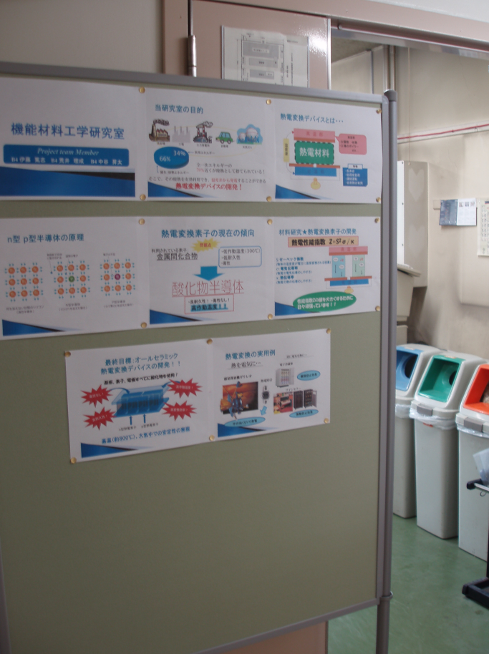
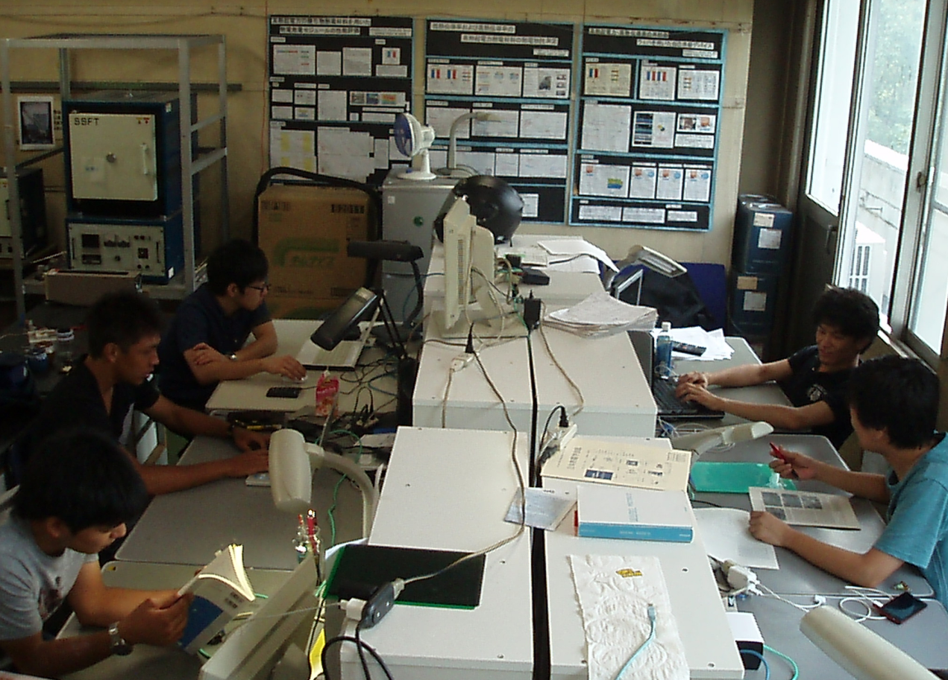
“A usual day in my Lab”
Notes:
First of all, I would like to introduce “a one day in my laboratory”.

Slide 3
Outline
Introduction
Experimental procedure
Results and discussion
Summary
Acknowledgments
Notes:
First, I’m going to talk about Introduction. Secondly, I will mention Experimental procedure. After that, I will discuss Results and discussion. Finally, summarize my talk.

Slide 4
Outline
Introduction
Experimental procedure
Results and discussion
Summary
Acknowledgments
Notes:
OK, let me move to Introduction.

Slide 5
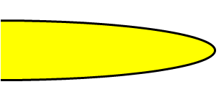
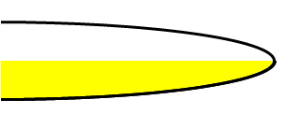
Band insulator and metal
●
●
●
●
●
●
●
●
●
●
●
●
●
●
●
●
●
●
●
●
●
●
●
●
●
●
●
●
●
●
●
●
●
●
●
●
●
●
●
●
●
●
●
●
●
●
●
●
Energy
Energy
Density of States (DOS)
Density of States (DOS)
Notes:
I’m going to begin my talk by giving you a brief background of strongly-correlated electrons system. Firstly, I explain insulator and metal based on the band theory. This lattice has two electrons for each site. And the band fills the states. As you know, this is the band insulator. On the other hand, this lattice has one electron for each site. This band is half-filling. So, this is the band metal.

Slide 6
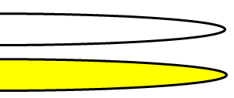
Mott insulator
U = 0
U ≠ 0
●
●
●
●
●
●
●
●
●
●
●
●
●
●
●
●
●
●
●
●
●
●
●
●
●
●
●
●
●
●
●
●
●
●
●
●
●
●
●
●
●
●
●
●
●
●
●
●
Energy
Energy
U
Density of States (DOS)
Density of States (DOS)
Notes:
Next, I explain strongly-correlated electrons system. If the Coulomb repulsion U between electrons is not negligible, electrons keep away each other. As a result, the half-filling band splits upper Hubbard band and lower Hubbard band. This is called Mott insulator, where most of the electrons are localized and the spin state is in the antiferromagnetic ordering. Therefore, Mott insulator is an antiferromagnetic insulator.

Slide 7
filling control
U < t
U > t
●
●
●
●
●
●
●
●
t
●
t
●
●
●
●
●
●
●
t
●
●
●
●
●
●
●
●
●
t
●
●
●
●
●
●
●
metal
Mott insulator
delocalization / itineracy
localization
Notes:
After that, I explain the metal-insulator transition. By using filling control, a hole is introduced and an electron can be moved to other site. When the Coulomb repulsion is superior to the transfer integral, electrons remain to be localized. However, when the transfer integral is superior to the Coulomb repulsion, electrons are delocalized suddenly and Mott insulator changes to metal. This metal-insulator transition is called Mott transition.

Slide 8
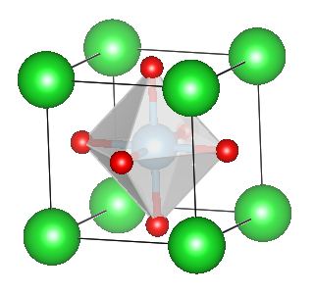
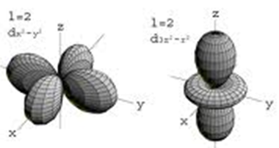
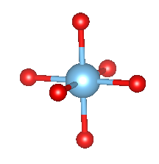
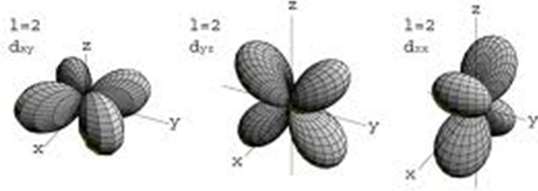
3d transition-metal oxides
La³⁺
Ca²⁺, Sr²⁺
O²⁻
d_{x2-y2}
d_{3z2-r2}
e_{g} orbital
perovskite structure
crystal field splitting
3d orbital
z
t_{2g} orbital
y
x
d_{xy}
d_{yz}
d_{zx}
Notes:
The typical stage of Mott transition is 3d transition-metal oxides. In particular, perovskite structure is the typical structure for 3d transition-metal oxides. The 3d orbital of the transition-metal at the center of the oxygen octahedron splits the eg orbital and the t2g orbital. The t2g orbital consists of three orbitals. On the other hand, the eg orbital consists of two orbitals. This is called crystal field splitting.

Slide 9
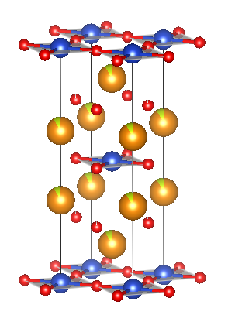
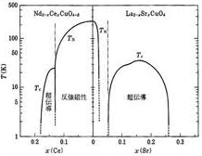
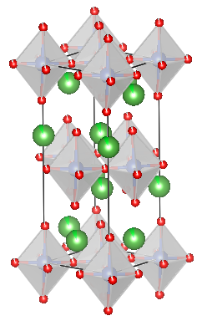
high-T_{c} superconductivity
3d¹
3d²
3d³
3d⁴
3d⁵
3d⁶
3d⁷
3d⁸
3d⁹
electron doping
hole doping
Cu³⁺
Cu²⁺
PI
PI
metal
Nd³⁺/Ce⁴⁺
metal
AFI
La³⁺/Sr²⁺
SC
SC
Nd_{2-x}Ce_{x}CuO₄
La_{2-x}Sr_{x}CuO₄
Notes:
For example, the stage of high-Tc superconductivity is in the eg orbital of the Cu2+ ion and the Cu3+ ion. This phase diagram shows that superconductivity appears at the boundary between the antiferromagnetic insulator and the metal by using filling control. As you can see, the antiferromagnetic insulator means the Mott insulator.

Slide 10
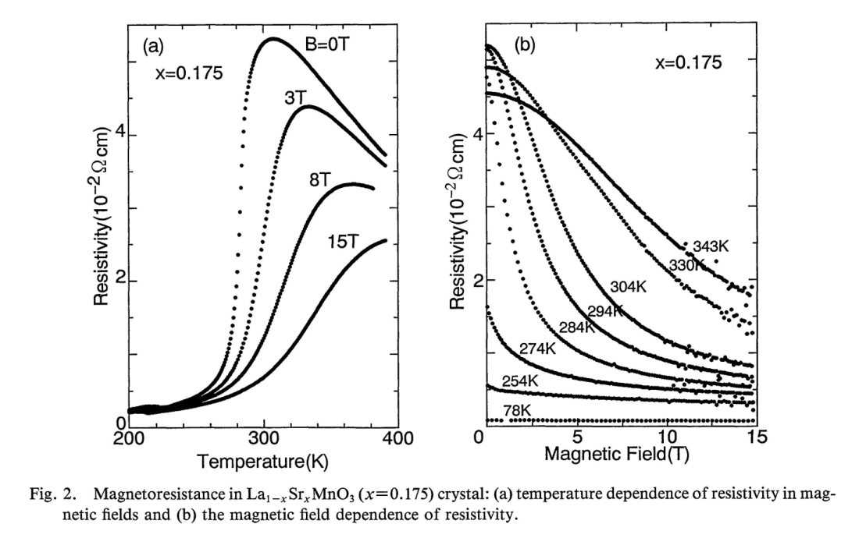
colossal magnetic resistance
3d¹
3d²
3d³
3d⁴
3d⁵
3d⁶
3d⁷
3d⁸
3d⁹
Mn⁴⁺
Mn³⁺
La_{0.825}Sr_{0.175}MnO₃
t
t
t
applied magnetic field
Notes:
Colossal magnetic resistance also appears at the boundary between the antiferromagnetic insulator and the metal by using filling control, where the stage of the colossal magnetic resistance is in the eg orbital of the Mn3+ ion and the Mn4+ ion. The hole doped LaMnO3 appears ferromagnetic metal below Curie temperature and paramagnetic semiconductor above Curie temperature. In particular, the applied magnetic field induces ferromagnetic ordering and decrease of resistance simultaneously. This is called the colossal magnetic resistance.

Slide 11
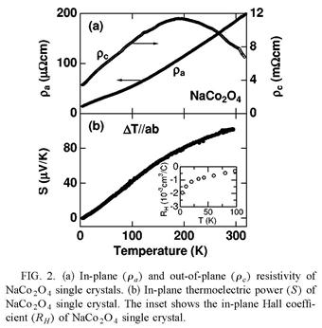
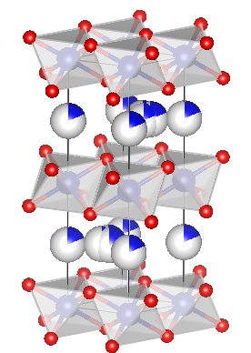
thermoelectric cobalt oxide
3d¹
3d²
3d³
3d⁴
3d⁵
3d⁶
3d⁷
3d⁸
3d⁹
Na_{x}CoO₂
Co⁴⁺
Co³⁺
g₄ = 6
g₃= 1
CoO₂ layer
Na_{x} layer
CoO₂ layer
Na_{x} layer
CoO₂ layer
Notes:
The stage of the thermoelectric cobalt oxide is in the t2g orbital of the Co3+ ion and the Co4+ ion, where thermoelectric means to convert waste heat into useful electric power. In particular, the large Seebeck coefficient can be explained by the Heikes formula. This formula consist of the degeneracies of the Co3+ ion and the Co4+ ion induced by spin and orbital degrees of freedom. That is why the cobalt oxide is one of the thermoelectric materials with large Seebeck coefficient.

Slide 12
thermoelectric properties
F_{w0}
E=μ
F_{w1}
half bandwidth
3.6k_{B}T
F_{w0}
－1.6k_{B}T
1.6k_{B}T
F_{w2}
－2.4k_{B}T
2.4k_{B}T
very small
Notes:
From the Boltzmann transport equation point of view, the thermoelectric properties, that is, electric conductivity, Seebeck coefficient and thermal conductivity are expressed as follows. These formulae look like complicated on the surface, but consist of only three functions, that is, Fw0, Fw1 and Fw2, respectively. It’s very simple. These functions indicate that thermoelectric properties depend on the different type of electrons. In particular, it can be understood that the large Seebeck coefficient needs to be semiconductor.

Slide 13
Seebeck coefficient
E－μ >> 0
Notes:
In the high-temperature limit of Seebeck coefficient, the first term goes to zero, so that Seebeck coefficient is given by the chemical potential and temperature, where S is the entropy of the system and g is the degeneracy of the electrons. In terms of band theory, Seebeck coefficient is black line. In contrast, bule and red lines are Seebeck coefficients enhanced by the spin and/or the orbital degrees of freedom. It is significant that strongly-correlated electrons system is necessary for the large Seebeck coefficient.

Slide 14
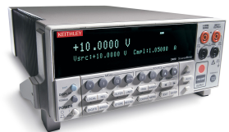
thermoelectric generation
m=∞
m=1
n
p
m=0
current
load
Source Meter (KEITHLEY 2400)
Notes:
In addition, I mention the assessment of the thermoelectric generation. In order to check the thermoelectric module, a temperature difference is applied. Then, a voltage of a load is measured with decreasing current by using KEITHLEY 2400 source meter. If a load resistance is represented as m times r, maximum current can be measured when m equals zero and open voltage can be measured when m equals infinity, where r is an internal resistance of a thermoelectric module. As a result, the criterion of assessment is to evaluate the maximum output power and maximum conversion efficiency.

Slide 15
Outline
Introduction
Experimental procedure
Results and discussion
Summary
Acknowledgments
Notes:
OK, let me move to Experimental procedure.

Slide 16
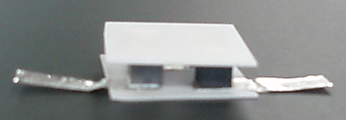
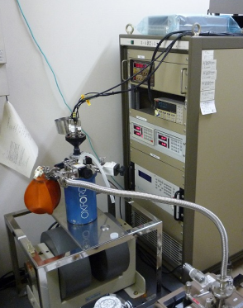
Experimental procedure
polycrystalline La_{1-x}Ca_{x}MnO₃
n : Ca_{0.99}Yb_{0.01}MnO₃
X-ray diffraction
  RINT2500 (Rigaku, 40kV, 200mA)
Rietveld crystal structure analysis
  RIETAN-FP program
magnetic susceptibility
  MPMS (Quantum Design)
  5K-350K, H=1T
electric resistivity
  ResiTest8300
  80K-395K
Seebeck coefficient
  ResiTest8300
  80K-395K
thermal conductivity
  DSC and TC-7000 (ULVAC)
p : [(Ca_{0.9}Y_{0.1})₂CoO₃]_{0.62} CoO₂
alumina plate (1mm thickness)
silver sheet
(0.05mm thickness)
heater (100～600℃)
alumina plate
current
n
p
silver sheet
water cooled heatsink (2℃)
Source Meter
(KEITHLEY 2400)
Notes:
The polycrystalline samples were prepared by standard solid-state reaction method. The X-ray diffraction was measured by RINT2500. The crystal structure was analyzed by using RIETAN-FP program. The magnetic susceptibility was measured by MPMS equipment. The electric resistivity and Seebeck coefficient were measured by ResiTest8300. The thermal conductivity, that is, the specific heat and the thermal diffusivity were measured by DSC (differential scanning calorimeter) and laser flash method by TC-7000, respectively. The thermoelectric elements were electrically connected by silver sheet using silver paste as a bonding agent. The p-n pairs were placed between two alumina plates and acted as hot and cold ends for thermoelectric legs.

Slide 17
thermoelectric properties
n type : Ca_{0.99}Yb_{0.01}MnO₃
n
p
p type : [(Ca_{0.9}Y_{0.1})₂CoO₃]_{0.62} CoO₂
T=300K | ρ (Ωcm) | S (μV/K) | κ (W/mK) | Z (K⁻¹)
n type | 0.080 | －230 | 3.4 | 1.9×10⁻⁵
p type | 0.065 | 140 | 1.4 | 2.2×10⁻⁵
Notes:
This table shows the thermoelectric properties of the n-type and p-type thermoelectric elements at room temperature, that is, small electric resistivities, large Seebeck coefficients, small thermal conductivities and figure of merits.

Slide 18
Outline
Introduction
Experimental procedure
Results and discussion
Summary
Acknowledgments
Notes:
OK, let me move to Results and discussion.

Slide 19
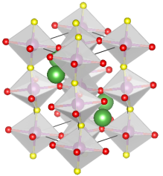
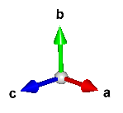
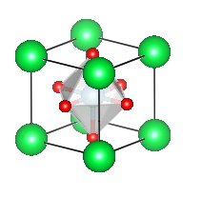
lattice parameters a, b, c
La_{1-x}Ca_{x}MnO_{3+δ}
O2
O1
Mn
La/Ca
Space group: Pnma (No.62)
pseudo-cubic structure
Notes:
This figure shows the orthorhombic perovskite structure of Ca doped LaMnO3. These figures show the lattice parameters of pseudo-cubic perovskite structure against the amount of Ca doping x. When x equals 0.1, there is a misfit in the ab plane between the samples sintered in oxygen and nitrogen. On the other hand, when x equals 0.2, the lattice parameter of the pseudo-cubic shows an isotropic.

Slide 20
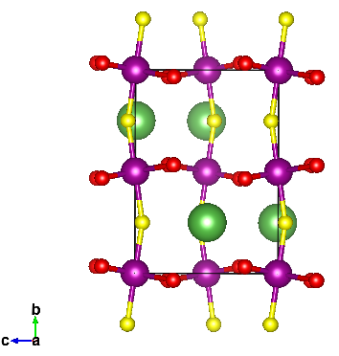
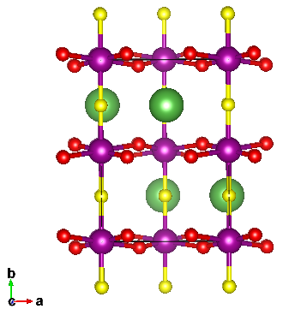
interionic distances Mn-O
La_{1-x}Ca_{x}MnO_{3+δ}
Mn-O1
Mn-O1
Mn-O2
Mn-O2
Notes:
These figures show interionic distances between Mn ion and oxygen ion. The figure to the left indicates interionic distances in the ac plane against the amount of Ca doping. The figure to the right indicates interionic distances perpendicular to the direction of the ac plane against x. When x equals 0.1 and x equals 0.15, as you know, there is a difference between the samples sintered in oxygen and nitrogen. On the other hand, when x equals 0.2, interionic distances are isotopic.

Slide 21
interionic angles Mn-O-Mn
La_{1-x}Ca_{x}MnO_{3+δ}
Mn-O2-Mn
Mn-O1-Mn
Notes:
These figures show interionic angles between Mn, oxygen and Mn ions. The upper figure shows angles in the ac plane against x. The lower figure indicates angles perpendicular to the direction of the ac plane against x. The angles in the ac plane are remain constant about 160 degrees. On the other hand, the angles perpendicular to the direction of the ac plane show a sharp fall at x equals 0.2. This means that the transition from the ferromagnetic to the orbital ordering.

Slide 22
magnetic susceptibilities
La_{0.9}Ca_{0.1}MnO_{3+δ}
La_{0.85}Ca_{0.15}MnO_{3+δ}
La_{0.8}Ca_{0.2}MnO_{3+δ}
antiferromagnetic ordering
ferromagnetic ordering
Notes:
These figures show magnetic susceptibilities against temperature. The closed circles are the sample sintered in oxygen and the open circles are the sample sintered in nitrogen. Around 200K, the magnetic transition can be confirmed. From these figures it can be concluded that the magnetic ordering at low temperature is not only antiferromagnetic but also ferromagnetic..

Slide 23
thermoelectric properties
La_{0.9}Ca_{0.1}MnO_{3+δ}
La_{0.85}Ca_{0.15}MnO_{3+δ}
La_{0.8}Ca_{0.2}MnO_{3+δ}
electric resistivity
Seebeck coefficient
Notes:
These figures show thermoelectric properties against temperature. The closed circles are the sample sintered in oxygen and the open circles are the sample sintered in nitrogen. The electric resistivity changes from antiferromagnetic insulator to ferromagnetic metal. In addition, the Seebeck coefficient of the sample sintered in nitrogen shows a large value at x equals 0.1 and that of the sample sintered in oxygen shows a large value at x equals 0.2.

Slide 24
power factors
La_{0.9}Ca_{0.1}MnO_{3+δ}
La_{0.85}Ca_{0.15}MnO_{3+δ}
La_{0.8}Ca_{0.2}MnO_{3+δ}
antiferromagnetic insulator
ferromagnetic metal
Notes:
These figures show power factors against temperature. The closed circles are the sample sintered in oxygen and the open circles are the sample sintered in nitrogen. From these figures it can be concluded that the large thermoelectric property is due to the strongly correlated electrons system at the boundary between antiferromagnetic insulator and ferromagnetic metal.

Slide 25
thermoelectric generation
n
p
current
load
total resistance：
manufacturing factor (MF)
Notes:
The next result is the performance assessment of the thermoelectric generation. In general, the contact resistance exists in the thermoelectric module. Therefore, we must consider both the internal resistance and the contact resistance. The manufacturing factor means the proportion of the internal resistance in the total resistance.

Slide 26
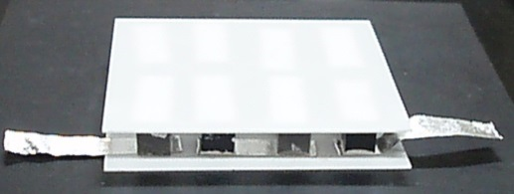
4×4 thermoelectric module
X (mm)
X (mm)
Y (mm)
Y (mm)
Z (mm)
p
n
Z (mm)
 | X | Y | Z
1 | 5.0 | 5.2 | 5.0
2 | 4.9 | 5.2 | 5.1
3 | 5.0 | 5.0 | 5.0
4 | 5.1 | 5.1 | 5.0
5 | 4.9 | 5.3 | 5.0
6 | 5.1 | 4.9 | 5.1
7 | 4.9 | 5.0 | 5.0
8 | 5.1 | 4.9 | 5.0
 | X | Y | Z
a | 5.2 | 5.4 | 5.1
b | 5.4 | 5.1 | 5.1
c | 5.1 | 5.4 | 5.1
d | 5.3 | 5.3 | 5.1
e | 5.3 | 5.2 | 5.1
f | 5.1 | 5.3 | 5.1
g | 5.2 | 5.4 | 5.0
h | 5.2 | 5.3 | 5.1
b
3
f
7
2
c
6
g
a
4
e
8
1
d
5
h
Notes:
This picture shows 4 times 4 thermoelectric module. This module consists of 8 n-type thermoelectric elements and 8 p-type thermoelectric elements, where n-type is CaMnO3 oxide and p-type is Ca3Co4O9 oxide. These tables show the size of elements. The internal resistance and Seebeck coefficient of the thermoelectric module are 2.22Ω and 2.96mV/K, respectively.

Slide 27
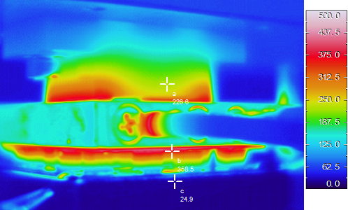
773K
MF (%) | ⊿T (K) | R_{c} (Ω)
104 | 421 | 0
500K
heater
632K
module
298K
water cooled heatsink
273K
Z (T_{H}+T_{L})/2
0.174
P_{max} (mW) | η_{max} (%)
182 | 1.40
Notes:
This figure shows the voltage and the output power for the thermoelectric module as a function of electric current when temperature difference is 421K. The close circles are voltage and open circles are output power. This result shows that the contact resistance of the module is almost zero. The maximum output power shows 182mW, and the maximum conversion efficiency indicates 1.4%.

Slide 28
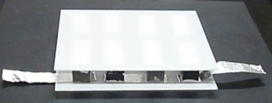

performance assessment
maximum output power P_{max}
maximum conversion efficiency η_{max}
Notes:
In conclusion, I would like to mention that the performance assessment of our thermoelectric module is high-quality. The figure to the left indicates maximum output power per p-n pair against temperature difference. The maximum output power increases with increasing temperature difference. In addition, our data is absolutely higher than the previous research. The figure to the right shows maximum conversion efficiency against temperature difference. The maximum conversion efficiencies are also increase with increasing temperature difference.

Slide 29
Outline
Introduction
Experimental procedure
Results and discussion
Summary
Acknowledgments
Notes:
OK, let’s summarize my talk.

Slide 30
Summary
Strongly-correlated electrons system is necessary for thermoelectric properties.
The large thermoelectric property is due to the strongly correlated electrons system at the boundary between AFI and metal.
The maximum output power of our thermoelectric module is absolutely higher than that of the previous research.
Notes:
To summarize, Strongly-correlated electrons system is necessary for thermoelectric properties. The large thermoelectric property is due to the strongly correlated electrons system at the boundary between antiferromagnetic insulator and metal. In fact, the maximum output power of our thermoelectric module is absolutely higher than that of the previous research.

Slide 31

Acknowledgements
Thank you for your kind attention.
Notes:
I would like to acknowledge my students in my laboratory for preparing samples, and so on. OK, let’s finish my talk. Thank you for your kind attention.

