Slide 1


Improvement of thermoelectric properties of β-FeSi₂ by Ni substitution
Sopheap Sam^{1,} *, Hiroshi Nakatsugawa¹, Yoichi Okamoto²
Yokohama National University, Japan
National Defense Academy, Japan
* E-mail: sam-sopheap-fh@ynu.jp
2022-July-20th

Slide 2
Outline
Introduction
- Crystal and band structure FeSi_{2.}
- Phase transition of FeSi_{2.}
- Review of previous research.
- Improve TE performance of β-FeSi₂ by Ni substitution.
2. Experimental method
- Fabrication and measurement.
3. Results and discussions
- Crystal structure and phase identification.
- Thermoelectric properties (Seebeck coefficient, electrical resistivity, thermal conductivity, and ZT).
4. Conclusions

Slide 3
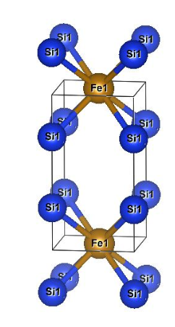
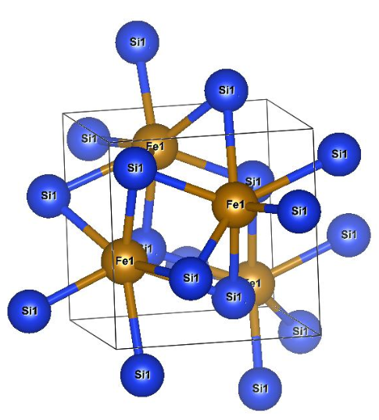
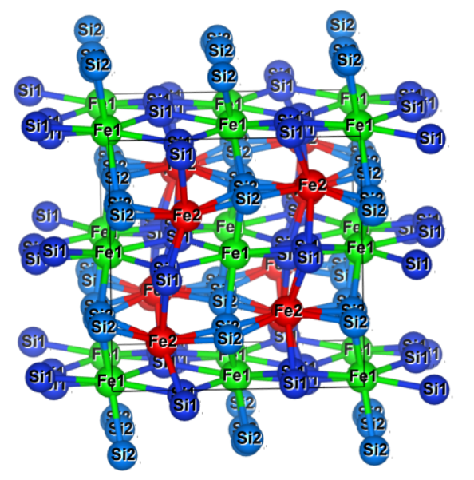
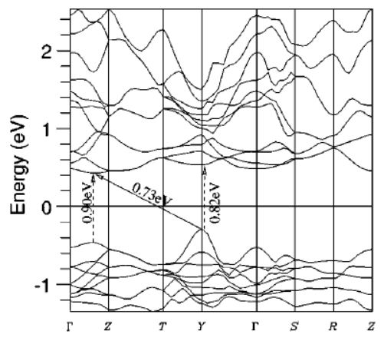
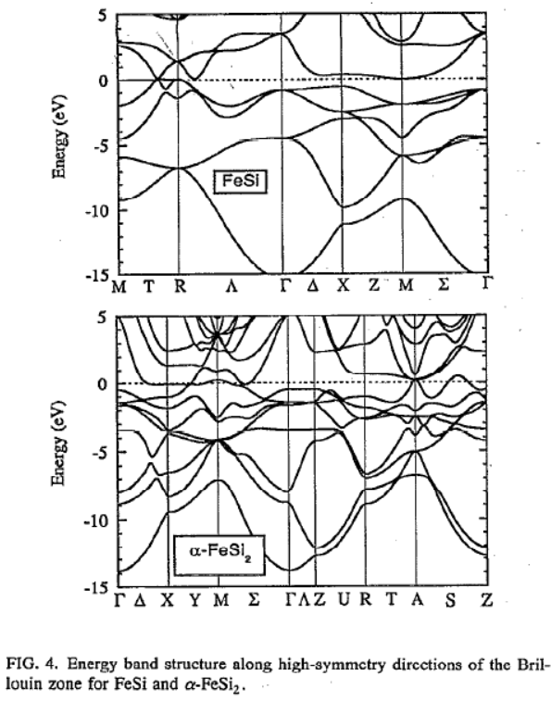
Crystal and band structure of each phase FeSi₂
Orthorhombic β-phase
Tetragonal α-phase
Cubic ε-phase
Si2
Fe1
Si1
Fe2
Space group: Cmce
Space group: P4mmm
Space group: P2₁3
S. J. Clark et al., Physical review B., 58,16 (1998)
R. Girlanda et al., J. Appl. Phys. 76, 2837 (1994)

Slide 4
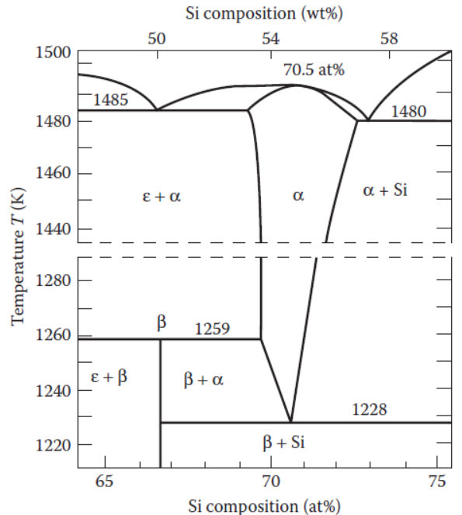
Phase transition diagram of FeSi₂
The β-FeSi₂ based material is a promising candidate for thermoelectric (TE) application working at high temperatures due to:
Environmental friendliness
Good thermal stability
Strong oxidation resistance
Low cost.
[X. L. Du et al., Acs Applied Materials & Interfaces, 12, 12901-12909 (2020)]
The equilibrium phase diagram for the system Fe–Si by Piton and Fay. α-phase:FeSi2, β-phase:FeSi2, ε-phase:FeSi.

Slide 5
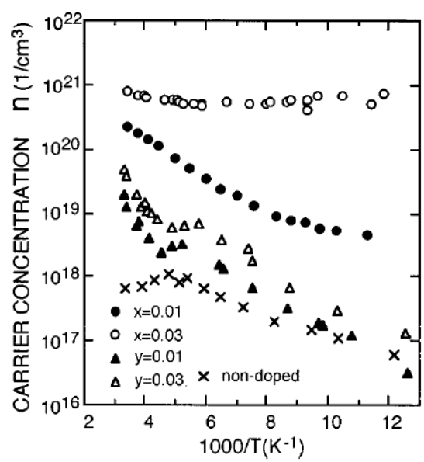
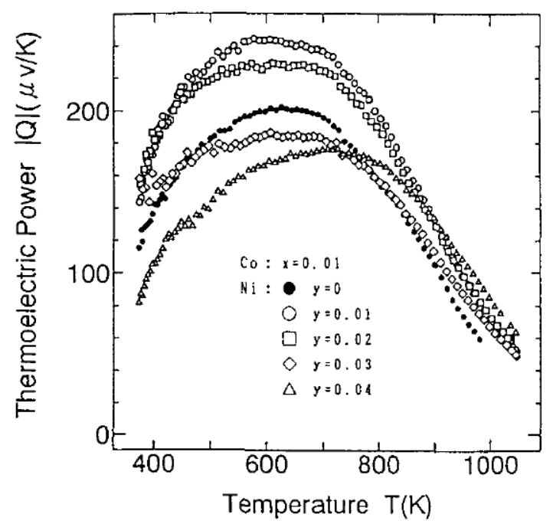
Review of previous research
S_{max} at Ni doping 0.01
β-Fe_{0.99-y}Co_{0.01}Ni_{y}Si₂
β-Fe_{1-y}Ni_{y}Si₂
J. Tani and H. Kido, Journal of Applied Physics, 84, 1408-1411 (1998).
H. Nagai et. al., Journal of the Japan Society of Powder and Powder Metallurgy, 41, 560-564, 1994.
ρ can be reduced due to an increase in carrier concentration.
S can be increased by Ni substitution probably due to a reduction in mobility.
S: Seebeck coefficient [V/K]
ρ: resistivity [Ω.m]
κ: thermal conductivity[W/m.K]

Slide 6
Improve TE performance of β-FeSi₂ by Ni substitution
Resistivity (ρ) can be decreased by the increase in carrier density (n_{H}) by Ni-doping due to the larger valence electron.
mobility
Seebeck coefficient (S) :
large m_{e}*
In β-FeSi₂ (x=0), the Seebeck coefficient |S| decreases with increasing temperature because of the bipolar effect.
By Ni doping, Hall mobility μ_{H} decreases and |S| increases because of the majority carrier for electrons.
small m_{h}*
However, with increasing x, as decreasing the ρ, the |S| also decreases. Therefore, we need to find the optimum Ni doping to improve the TE of β-Fe_{1-x}Ni_{x}Si₂.

Slide 7
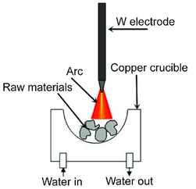
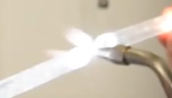
Experimental method
Fabrication :
Measurement :
Arc-melting (20g)
NC wire cut
7x7x1.5mm
Vacuum sealing in quartz tube
Heat treatment 1150 ºC, 3h
Annealing
840 ºC, 20h
XRD by Smart Lab, Rigaku
Rietveld analysis by RIETEN-FP
Thermal conductivity by power efficiency measurement (PEM-2)
ZT calculated by above parameters
Carrier concentration and mobility at RT by ResiTest 8300
Resistivity and Seebeck coefficient by ResiTest 8300 and homemade apparatus
3D SEM VE-8800
7x7x1.5mm
Furnace 1150 ºC, 3h.
Furnace 840 ºC, 20 h.

Slide 8
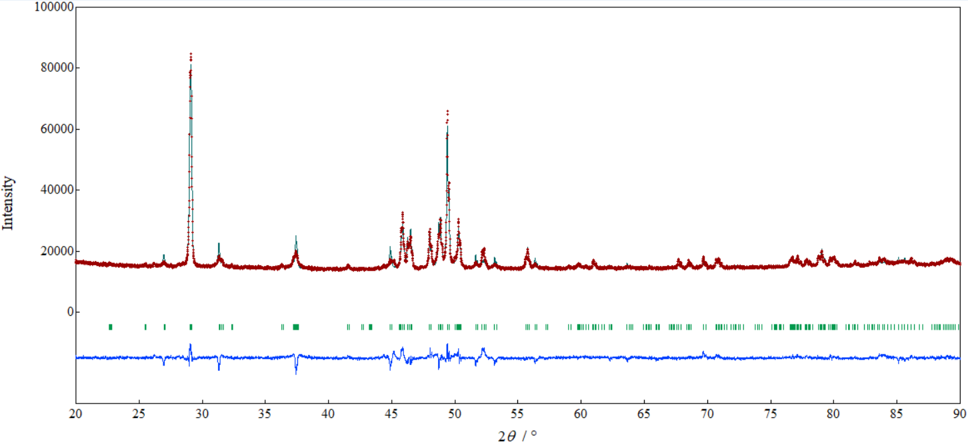
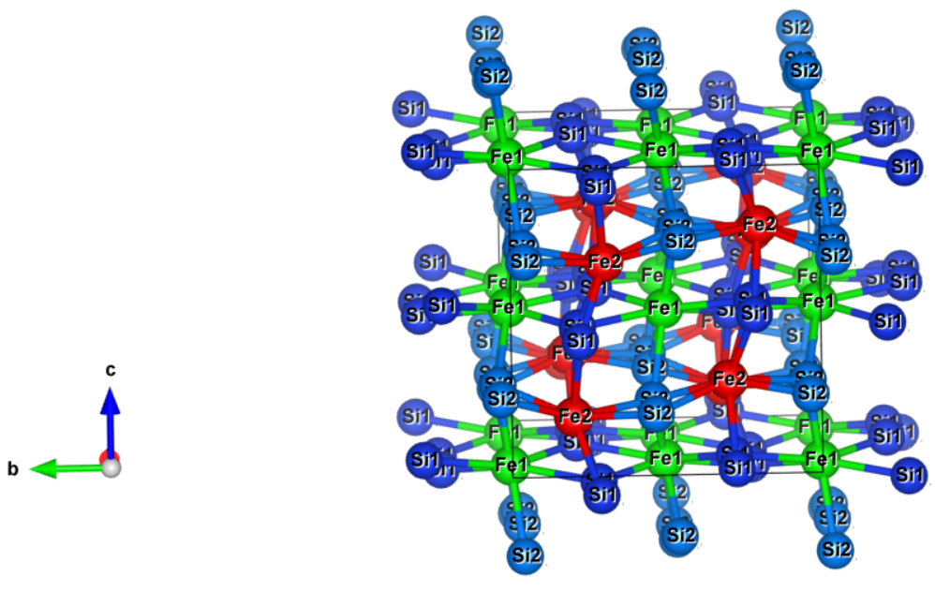
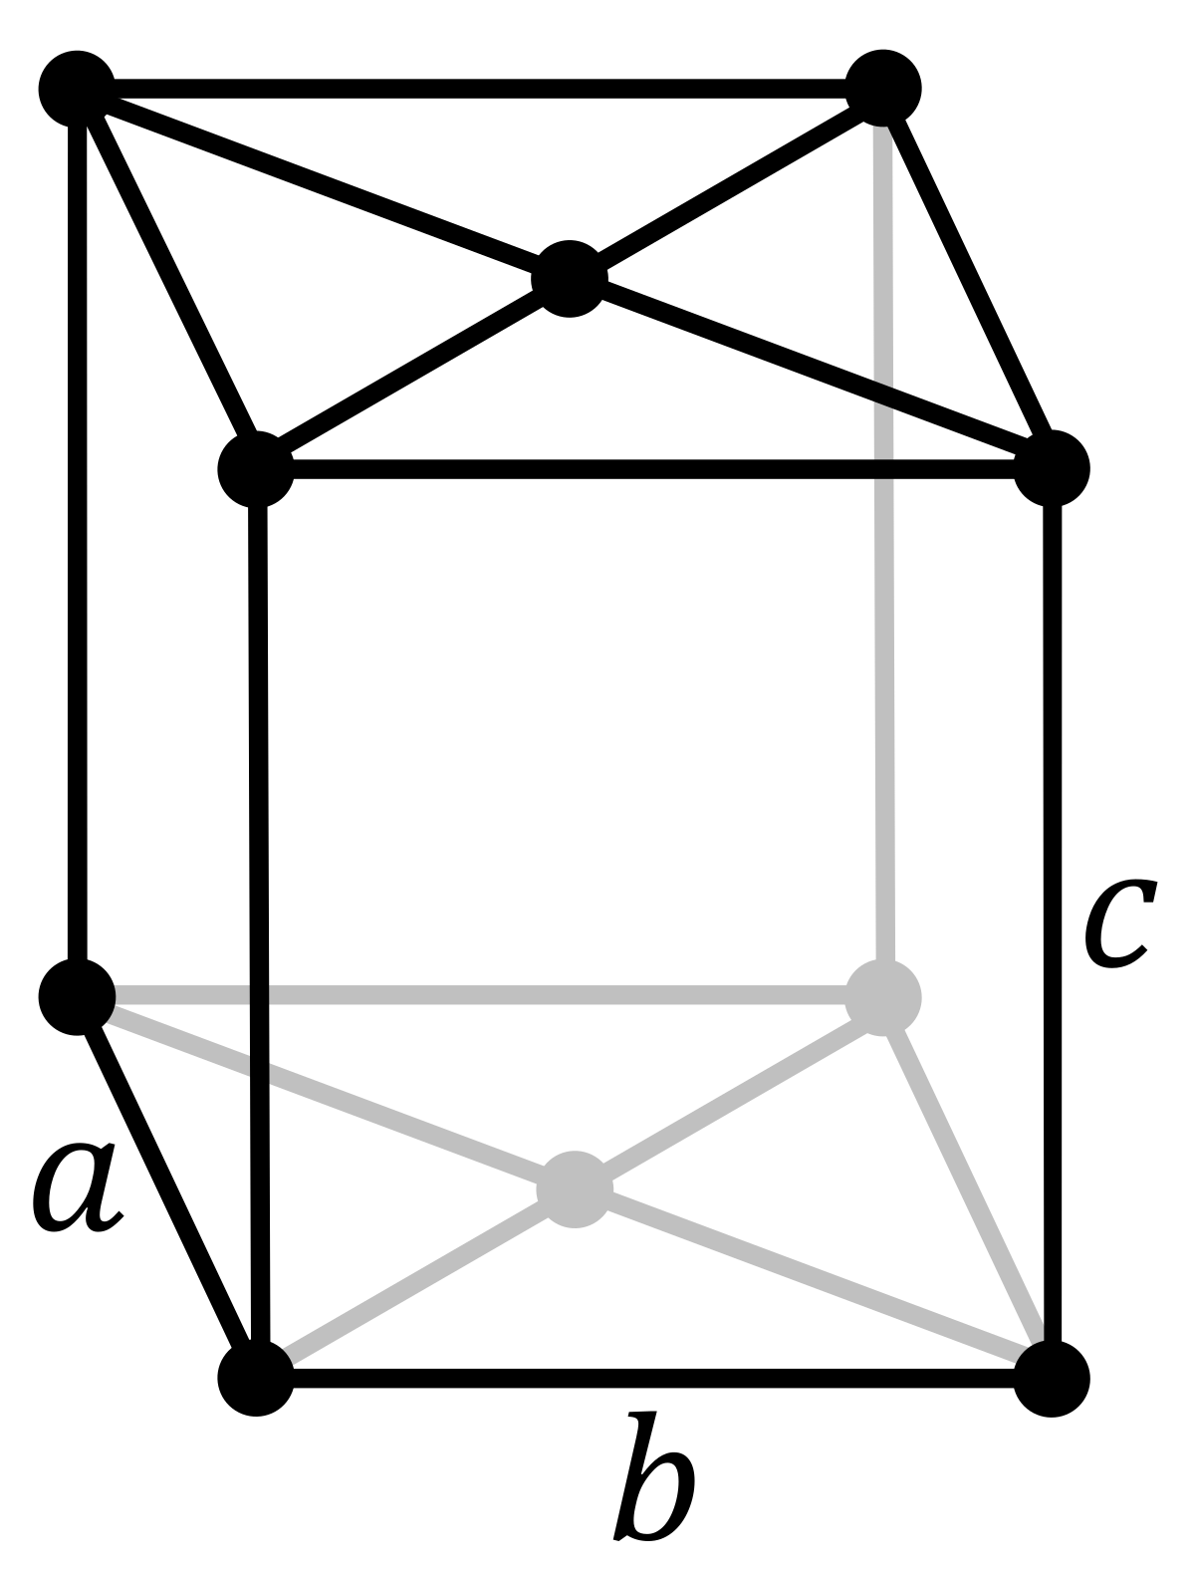
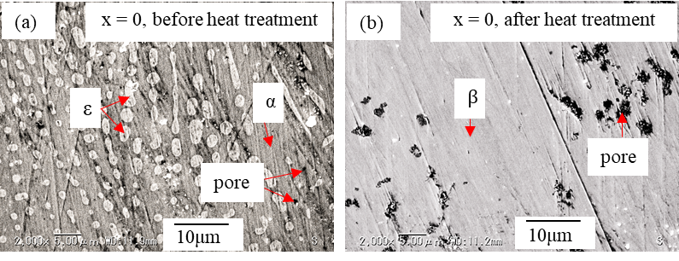
Crystal structure and phase identification by Rietveld analysis
By using Rietveld Analysis with the measured data of XRD, all samples were grown in single beta β phase crystal structure with Cmce space group (base-centered orthorhombic) after heat treatment 1150 ºC 3 h and annealing 840 ºC 20 h.
FeSi₂
Si2
(202)
β-FeSi₂
Fe1
(422)
Si1
(331)
Fe2
(112)
(312)
(024)
(221)
(242)
(533)
(515)
(602)
SEM images also verify with the XRD result for the single β-phase after heat treatment.

Slide 9
Electrical resistivity (ρ) of β-Fe_{1-x}Ni_{x}Si₂
x
n_{H}
ρ
μ_{H}
ρ
The increase in n_{H} contributes positively to the decrease in ρ.
The decrease in μ_{H} contributes negatively to the decrease in ρ.

Slide 10
Seebeck coefficient (S) of β-Fe_{1-x}Ni_{x}Si₂
x=0, bipolar effect deteriorates S due to a narrow band gap.
x
n_{H}
|S|
The bipolar effect is reduced by Ni substitution

Slide 11
Thermal conductivity (κ) and ZT of β-Fe_{1-x}Ni_{x}Si₂
ZT_{max}
The κ of Ni doping samples is higher than that of non-doped samples probably due to an increase in n_{H}.
The ZT_{max} = 0.019 is obtained in x = 0.001 sample due to the significant increase of S and also the decrease in resistivity. PF of x = 0.001 is about 70 times higher than that of x = 0.

Slide 12
Conclusions
The electrical resistivity decreases with Ni doping level due to an increase in n_{H}.
The Seebeck coefficient decrease with Ni doping level, where the highest value is obtained in x = 0.001 with the value of 450 μV/K at 450 – 500 K. Small doping amount is more effective.
The thermal conductivity slightly increases with Ni doping.
The highest ZT = 0.019 at 580-600 K is obtained in the x = 0.001 sample due to the significant increase in Seebeck coefficient and reduction in electrical resistivity.

Slide 13
Comparison with previous reports for TE properties of Fe_{1-x}Ni_{x}Si₂
Authors | x | S [μV/K] | PF [μW/m.K²] | Fabrication method
M. Komabayashi et al. [1] at 300K | 0.06 | -113 | 17 | Thin film by RF sputtering
This study at 300K | 0.001 | -393 | 13 | Bulk +by arc melting
H. Nagai et al. [2] at 650K | 0.01 | -240 | 50 | Bulk by mechanical milling + hot-pressing
This study at 500K | 0.001 | - 450 | 280 | Bulk by arc melting
[1] M. Komabayashi, K. Hijikata, and S. Ido, Jpn. J. Appl. Phys. 30, 331 (1991).
[2] H. Nagai, I. Maeda, S. Katsuyama, and K. Majima, Journal of the Japan Society of Powder and Powder Metallurgy, 41, 560-564, (1994).

Slide 14
Thank you for your attention!

Slide 15
TE properties of β-Fe_{1-x}Ni_{x}Si₂ at RT
x | L_{𝚶} [V²/K²] | r | n_{H} [1/cm³] | μ_{H} [cm²/V.s ] | |S| [μV/K] | ρ [Ω.cm] | κ [W/mK]
0 | 1.792×10⁻⁸ | -1/2 | 1.3(2)×10¹⁶ | 37(4) | 127 | 7.21(3) | 7.16
0.001 | 1.624×10⁻⁸ | -1/2 | 1.2(4)×10¹⁷ | 35(7) | 393 | 1.52(3) | 8.25
0.005 | 1.656×10⁻⁸ | -1/2 | 2.6(2) ×10¹⁷ | 34(3) | 194 | 0.69(1) | 8.57
0.010 | 1.648×10⁻⁸ | -1/2 | 3.2(7) ×10¹⁷ | 27(5) | 205 | 0.716(9) | 8.44
0.015 | 1.674×10⁻⁸ | -1/2 | 4.8(4) ×10¹⁷ | 20(1) | 176 | 0.629(5) | 7.27
0.02 | 1.766×10⁻⁸ | -1/2 | 1.2(4) ×10¹⁸ | 11(3) | 135 | 0.502(2) | 7.12
0.03 | 2.139×10⁻⁸ | -1/2 | 2.3(2) ×10¹⁸ | 10(1) | 62 | 0.26(2) | 6.18

Slide 17
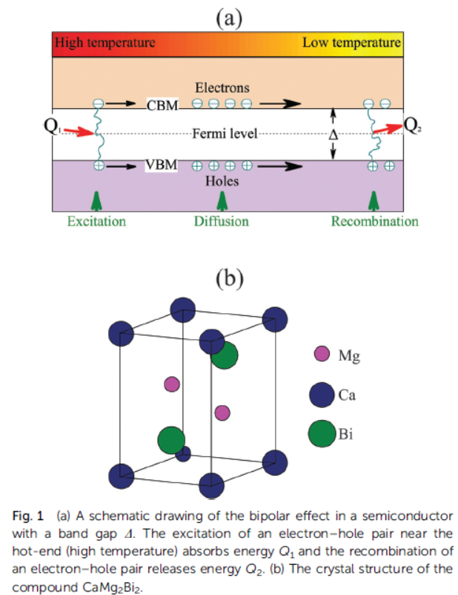
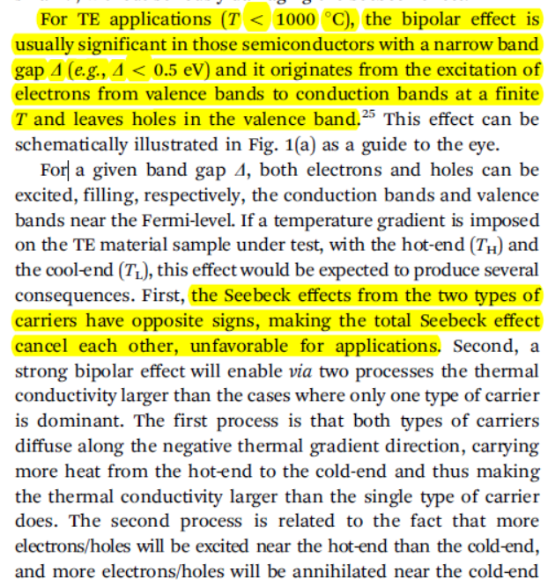
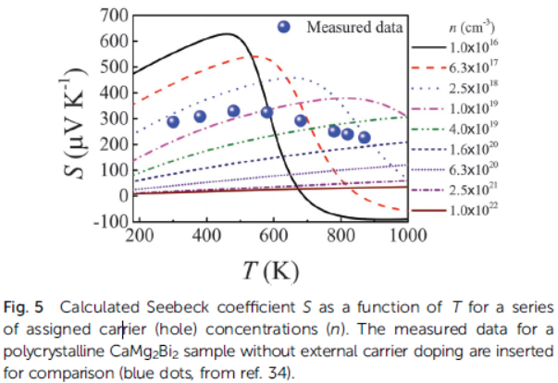
Bipolar
Bipolar effect remarkably dominate at low n_{H} .
J. J. Gong et al., Physical Chemistry Chemical Physics,18, 16566-16574 (2016).

