Slide 1

Effect of Sn and Co addition on thermoelectric properties of β-FeSi2
Sopheap Sam, Genki Kashikawa, Hiroshi Nakatsugawa, Yoichi Okamoto
Graduate School of Engineering Science
Yokohama National University, Japan

Slide 2
Outline
Introduction
2. Experimental method
3. Result and discussion
4. Conclusions

Slide 3
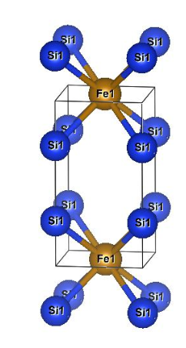
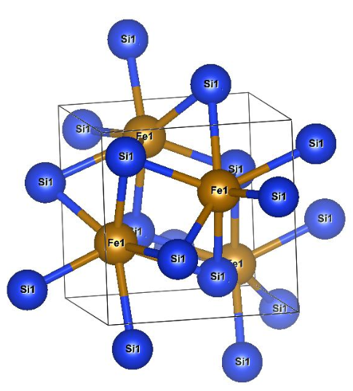
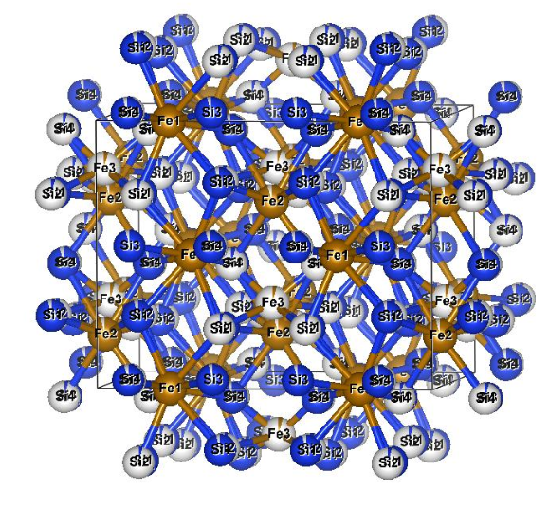
Crystal structure of β-FeSi₂
Crystal Structure of each phase transition of FeSi₂
Orthorhombic β-phase
Tetragonal α-phase
Cubic ε-phase
Space group: Cmca
Space group: P4mmm
Space group: P2₁3

Slide 4
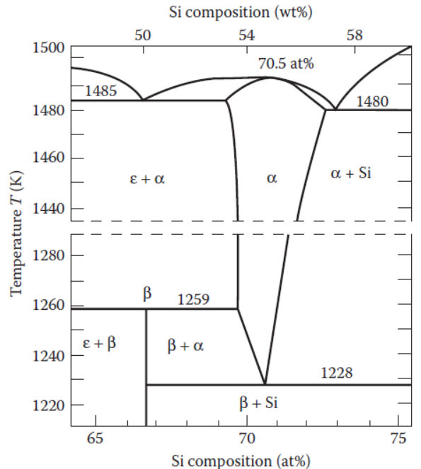
Phase transition diagram of FeSi₂
The high temperature [between the eutectic and peritectoid temperatures (1485 and 1259K)] α and ε-phase of FeSi2 is a metal.
The low temperature (below 1259K) β-phase FeSi2 is a semiconductor.
The equilibrium phase diagram for the system Fe–Si by Piton and Fay. α-phase:FeSi2, β-phase:FeSi2, ε-phase:FeSi.

Slide 5
Why β-FeSi₂ for this study?
The β-FeSi2 based material is a promising candidate for thermoelectric (TE) application working at high temperatures up to 900 ºC due to:
Environmental friendliness
Good thermal stability
Strong oxidation resistance
Low cost
D. Xiaolong et al.,(2020).

Slide 6
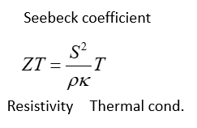
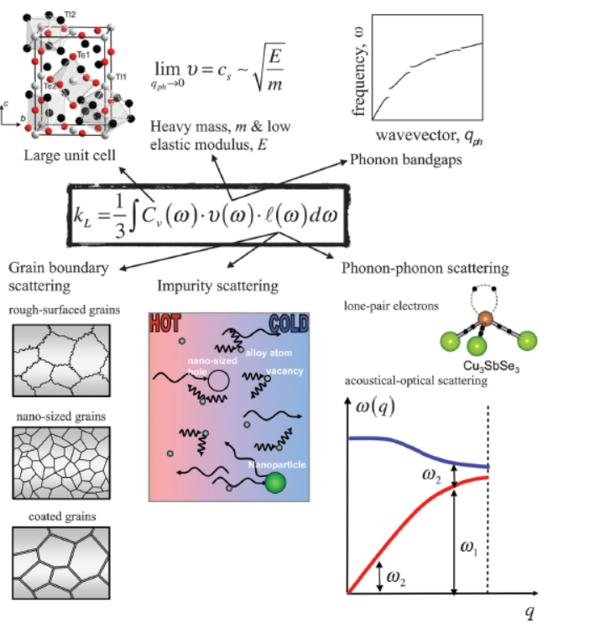

Strategy to improve ZT of β-FeSi₂ by Sn-doped
Density of Si: 2.33 g/cm³
Density of Sn: 7.31 g/cm³
Melting point of Si: 1,410 °C
Melting point of Sn: 231.9 °C
Sn has heavier mass (m) than Si.
Sn has low melting point related the low elastic modulus (E) due to weak chemical bonds.
Therefore, thermal conductivity of β-FeSi₂ can be reduced by doping Sn on Si sides.

Slide 7
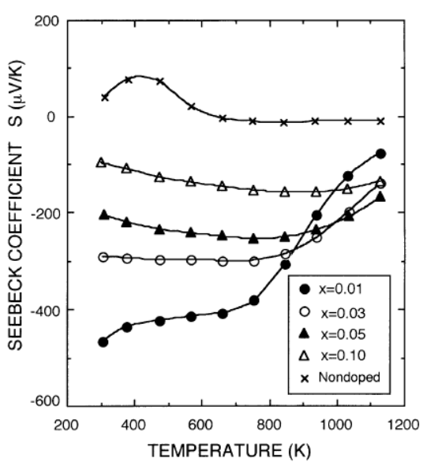
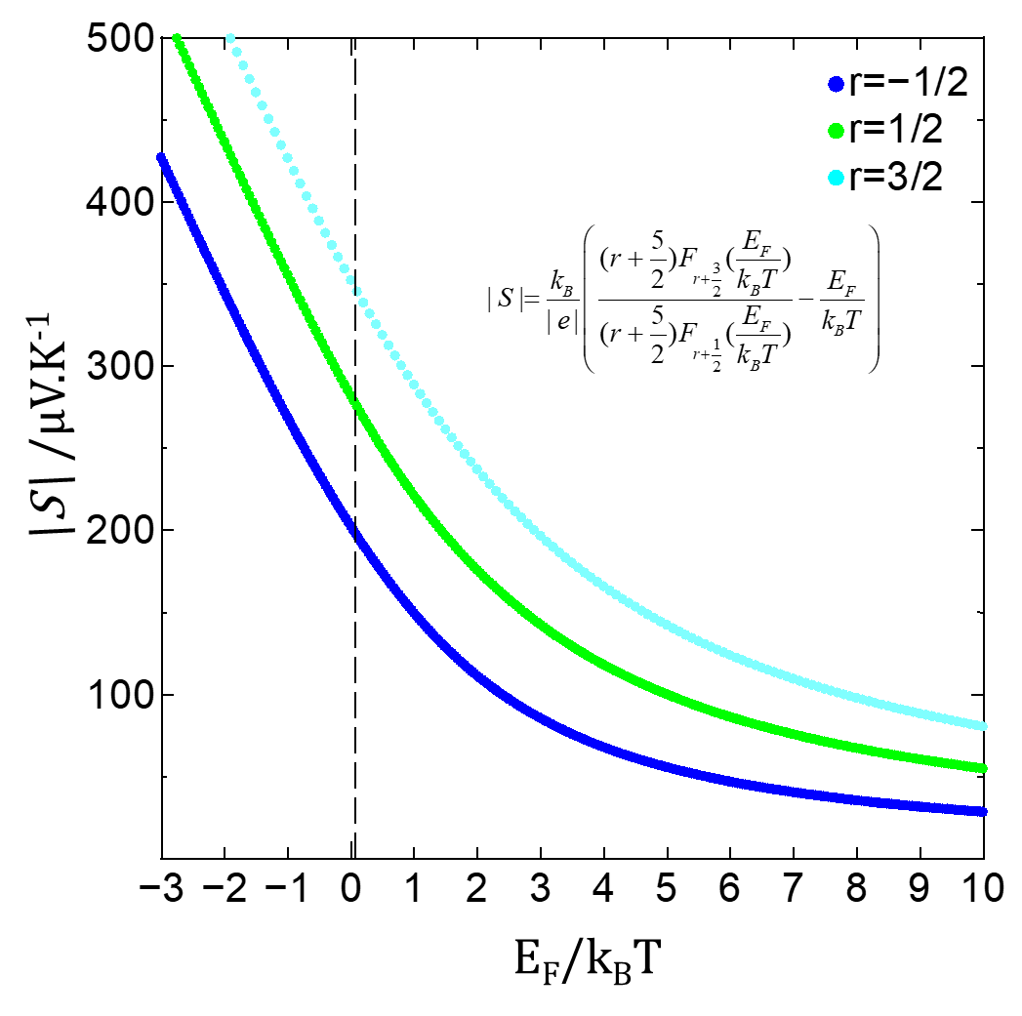
Strategy to improve ZT of β-FeSi₂ by Co-doped
Resistivity: The decrease in electrical resistivity can be achieved by the increase in carrier density by valence electron control.
Seebeck coefficient: The increase of Seebeck coefficient can be obtained by ionized impurity scattering.
Can be improved by carrier doping with different valence electron elements.
●
T = 300K
〇
▲
△
×
(J. Tani and , H. Kido 2001)
Fe_{1-x}Co_{x}Si₂ fabricated by SPS method , where x= 0, 0.01, 0.03, 0.05, 0.1

Slide 8
Experimental method
Fabrication process:
Measurement process:
Arc-melting (20g)
NC wire cut
7x7x1.5mm
Vacuum sealing
Heat treatment 1150 ºC, 3h
Annealing
840 ºC, 20h
XRD
Rietveld analysis
Thermal conductivity by PEM-2
ZT calculated by above parameters
Resistivity by Resitest 8300 and homemade apparatus
Seebeck coefficient by Resitest 8300 and homemade apparatus
SEM-EDX Analysis

Slide 9
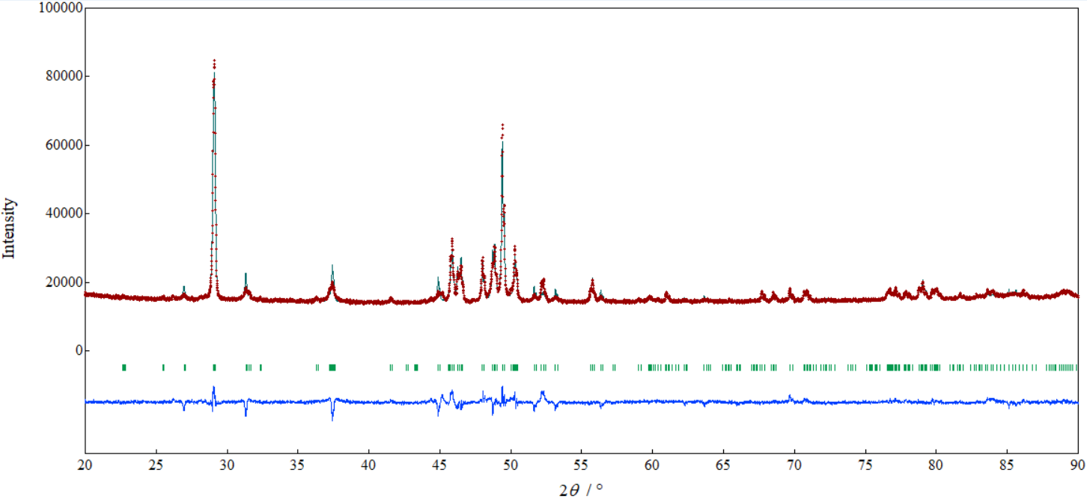
XRD: Crystal Structure identification
β
FeSi₂
(2,2,0)
(4,2,2)
β
β
β
β
β
β
β
β
β
β
By using Rietveld Analysis with the measured data from XRD, all samples were grown in single beta β phase crystal structure with Cmca space group (base-centered orthorhombic) after heat treatment 1150 ºC 3h and annealing 840 ºC 20h.

Slide 10
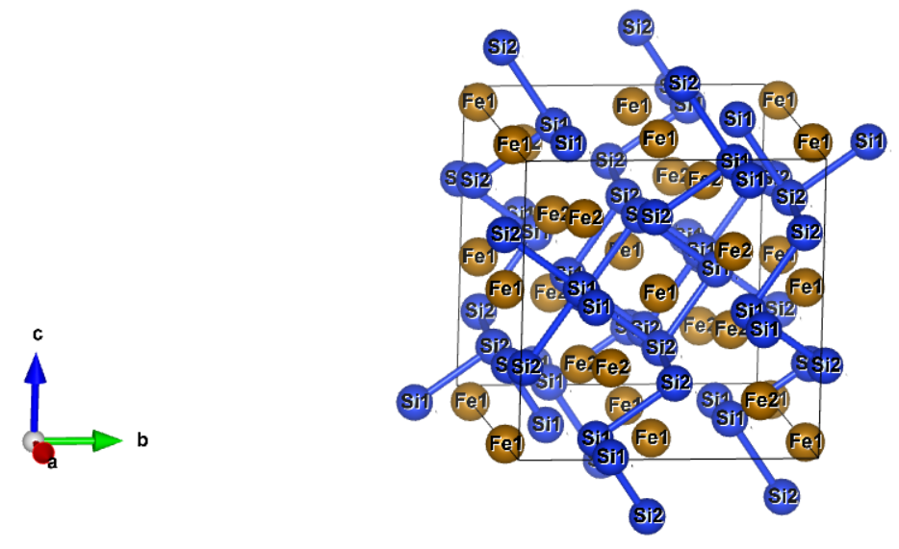
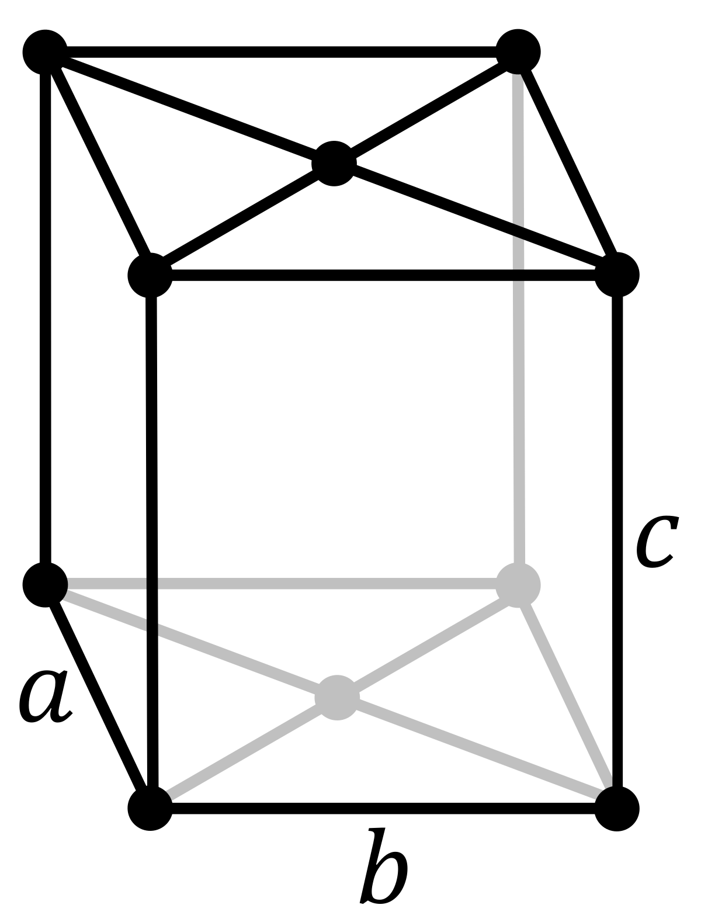
Lattice parameters calculated by Rietveld Analysis
Lattice parameters/ Samples | a[Å] | b[Å] | c[Å] | α [º] | β [º] | γ [º] | V[Å³]
FeSi₂ | 9.87884(5) | 7.80084(4) | 7.83721(4) | 90 | 90 | 90 | 603.960(6)
FeSi_{1.995}Sn_{0.005x1.01} | 9.87932(6) | 7.80152(5) | 7.83931(5) | 90 | 90 | 90 | 604.20(7)
Fe_{0.985}Co_{0.015}Si₂ | 9.88288(5) | 7.80034(4) | 7.8368(5) | 90 | 90 | 90 | 604.138(6)

Slide 11
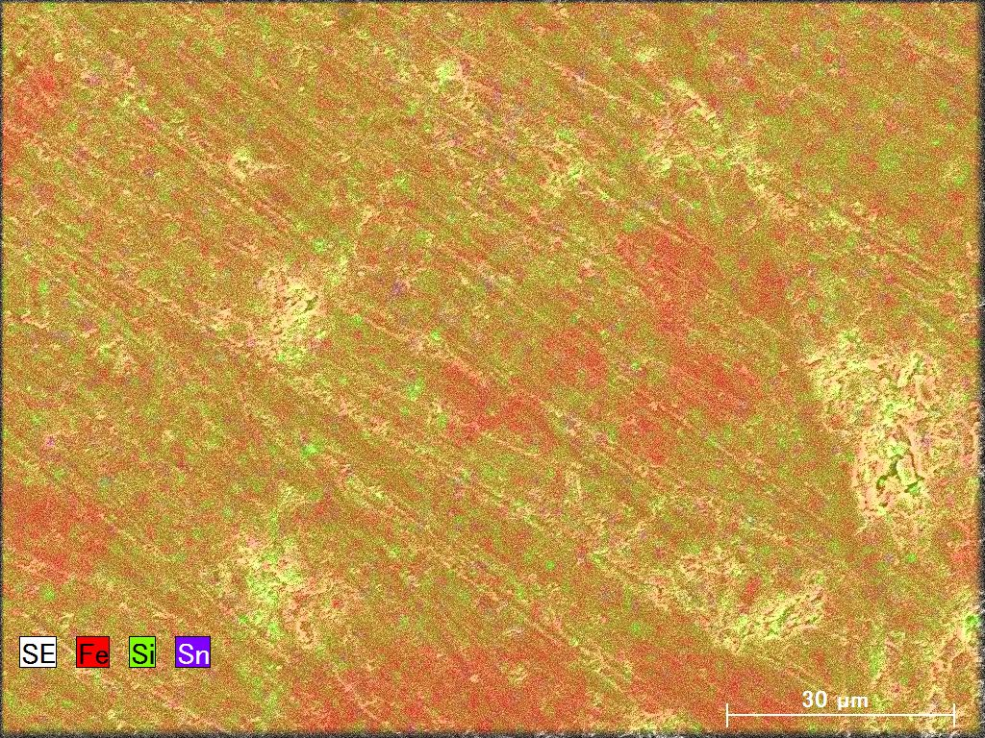
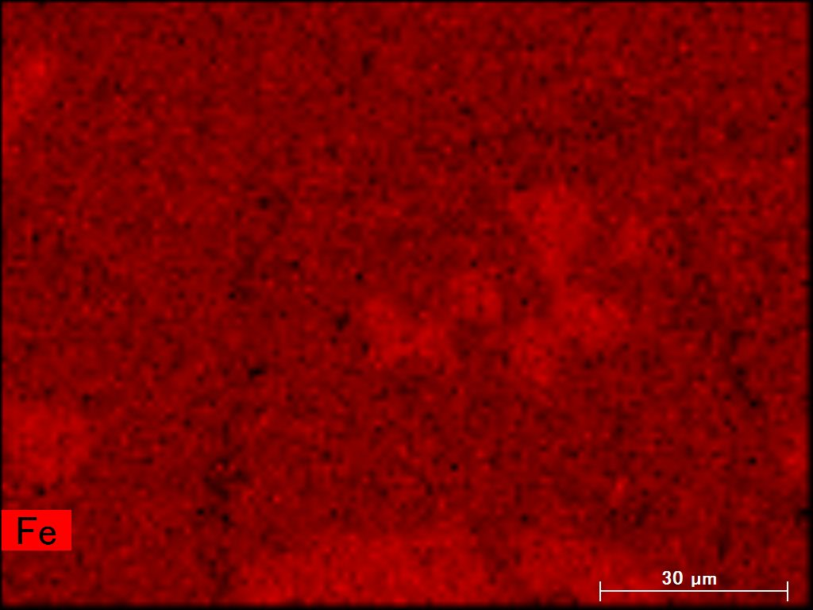
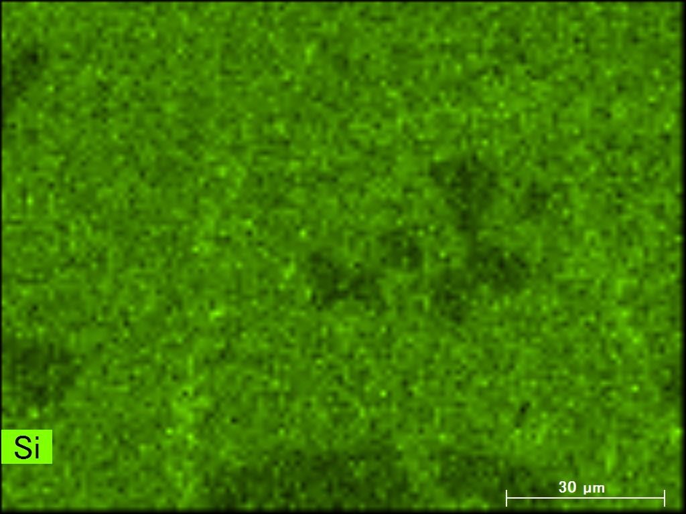
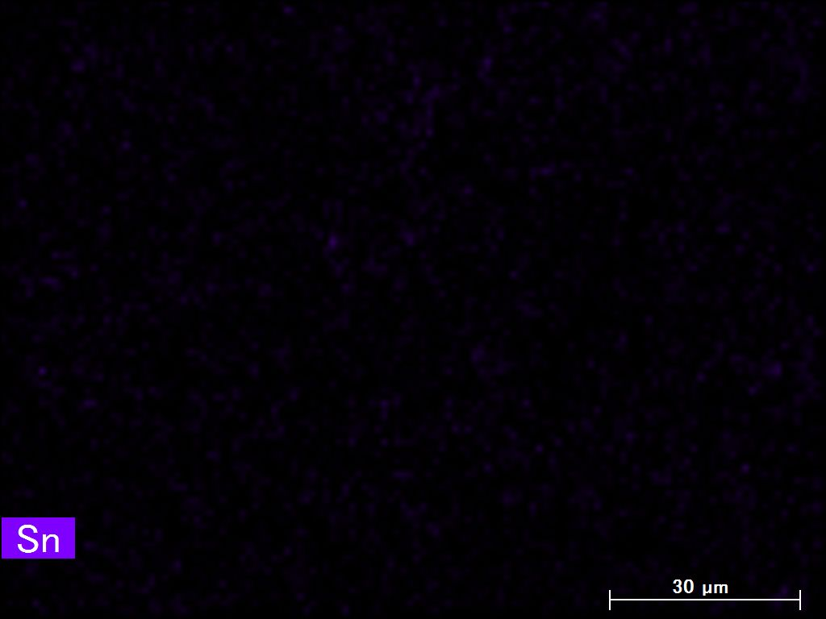
SEM-EDX Analysis
Initial composition | FeSi_{1.995}Sn_{0.005x1.01} | FeSi_{1.99}Sn_{0.01x1.01} | FeSi_{1.98}Sn_{0.02x1.01}
Composition by SEM-EDX analysis | FeSi_{1.958}Sn_{0.002} | FeSi_{1.868}Sn_{0.004} | FeSi_{2.057}Sn_{0.007}
The decrease amount of Sn doping maybe because of the evaporation during arc melting or the solubility limit at some doping levels.
SEM-EDX for FeSi_{1.99}Sn_{0.01x1.01}

Slide 12
Carrier concentration and mobility vs TE properties at room temperature
Sample Name | L [V²/K²] | n_{H} [ 1/cm³ ] | μ_{H}[ cm²/V*s ] | S[μV/K] | ρ[Ωcm] | κ[W/mK] | κ_{e}=LσT | κ_{L}=κ-κ_{e}
FeSi₂ | 1.793E-08 | 6.3(9)E+16 | 14(2) | -127.22 | 7.23 | 7.65 | 0.0000744 | 7.65
FeSi_{1.995}Sn_{0.005x1.01} | 1.749E-08 | 3.4(9)E+16 | 29(7) | -140.00 | 6.67 | 6.77 | 0.0000787 | 6.77
Fe_{0.995}Co_{0.005}Si₂ | 3.014E-08 | 1.0(0)E+19 | 6(5) | -371.33 | 0.232 | 9.71 | 0.0083038 | 9.70
Fe_{0.985}Co_{0.015}Si₂ | 2.932E-08 | 1.8(7)E+19 | 9(4) | -299.00 | 0.044 | 7.08 | 0.0201071 | 7.06
Low mobility because of carriers (electrons) are scattered more frequently than the Sn-dope sample.

Slide 13
Resistivity
At temperature below 500K, the electrical resistivity (ρ) of Sn doped samples was lower than standard sample.
The ρ of Co-doped sample was significantly lower than other samples. It is affected by the increase of carrier concentration because of doping with elements having different valence electrons.

Slide 14
Seebeck coefficient
T = 300K
〇
□
△
□
△
〇
〇
Co-dope sample is dominated by ionized impurity scattering (r=3/2) rather than acoustic phonon scattering or polar optical phonon scattering.
|S| of Co doped 0.005 samples ≥ 300μV.K⁻¹ and approximately stable at all temperature ranges below 700K. The carrier concentrations of this sample is maybe stable below this temperature. Or the electrons of this samples are scattered more frequently than the others.

Slide 15
Thermal conductivity
At room temperature, lattice thermal conductivity of Sn doped (x=0.005) was lower than other samples.

Slide 16
ZT
The highest ZT=0.062 was found in Co doped (y=0.01) sample at 700K. This enhancement was obtained from the high |S| and significant reduction of 𝛒.

Slide 17
Conclusions
The σ of Co-doped sample was significantly higher than Sn doped and standard samples and approximately stable at all temperature ranges. The increase of σ was affected by the increase of carrier concentration.
Doping with Co, |S| ≥ 300μV K⁻¹ and approximately stable at all temperature ranges. It is considered that the carrier scattering is stable by ionized scattering process.
Lattice thermal conductivity of Sn doped (x=0.005) was lower than other samples resulting in the reduction of total thermal conductivity at various temperature range.
The highest ZT=0.062 was found in Co doped (y=0.01) sample at 700K. This enhancement was obtained from the stability of |S| and significant reduction of 𝛒.

Slide 18
Thank you for your attentions!

