Slide 1

Investigation of p-type thermoelectric properties for Mn doped β-FeSi₂
Farooq Umar¹, Sopheap Sam², Rio Oshita¹, and Hiroshi Nakatsugawa ¹*
¹Yokohama National University,
²National Institute for Materials Science
*E-mail: nakatsugawa-hiroshi-dx@ynu.ac.jp
Notes:
----- 会議メモ (15/09/12 14:28) -----

Slide 2
Contents
Introduction
Experimental Methods
Results and Discussions
Conclusion

Slide 3
Introduction

Slide 4
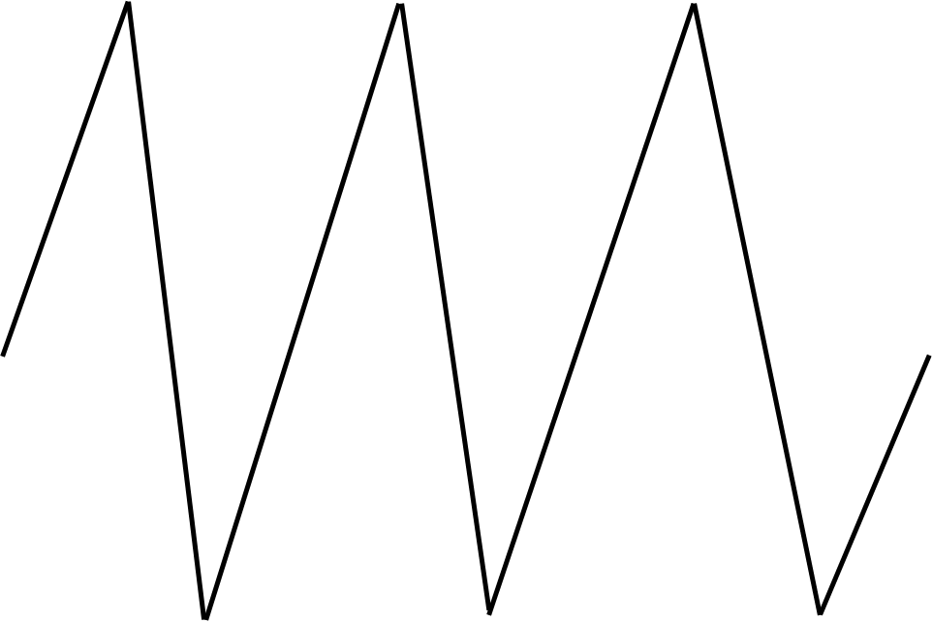
Introduction
Loss of 70% of global energy = waste heat released into the environment without utilization.
High Temp
Thermoelectricity phenomenon of transforming heat into electricity
h+
p
n
e-
Thermoelectric generators harvest electrical energy with the help of assembled thermoelectric elements
Low Temp
Driving force = heat flow by a Temp gradient
Based on n-type and p-type semiconductors
Notes:
Thermoelectricity is a physical phenomenon describing the direct transformation of heat into electricity without any moving parts.
Thermoelectric generators are devices to harvest electrical energy with the help of suitably assembled thermoelectric elements¹⁾.
The driving force behind thermoelectricity is a heat flow caused by a thermal gradient in a conductive material.
They are based on the pairs of n-type and p-type semiconductors connected to larger assemblies.
In practical thermoelectric generator or cooler, n-type and p-type thermoelectric elements are joined and arranged as a thermoelectric device.

Slide 5
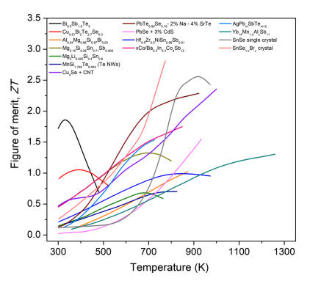

Introduction
Thermoelectric Materials
Nano Wires NWs
Carbon Nanotubes CNT
Selenides
Tellurides
Silicides
Mg_{2.15}Si_{0.28}Sn_{0.71}Sb_{0.006}
Magnesium Silicides
Iron Silicides
Mg_{2.15}Si_{0.28}Sn_{0.71}Sb_{0.006}
ZT of 1.3 at 700 K
Mechanically not reliable

Slide 6
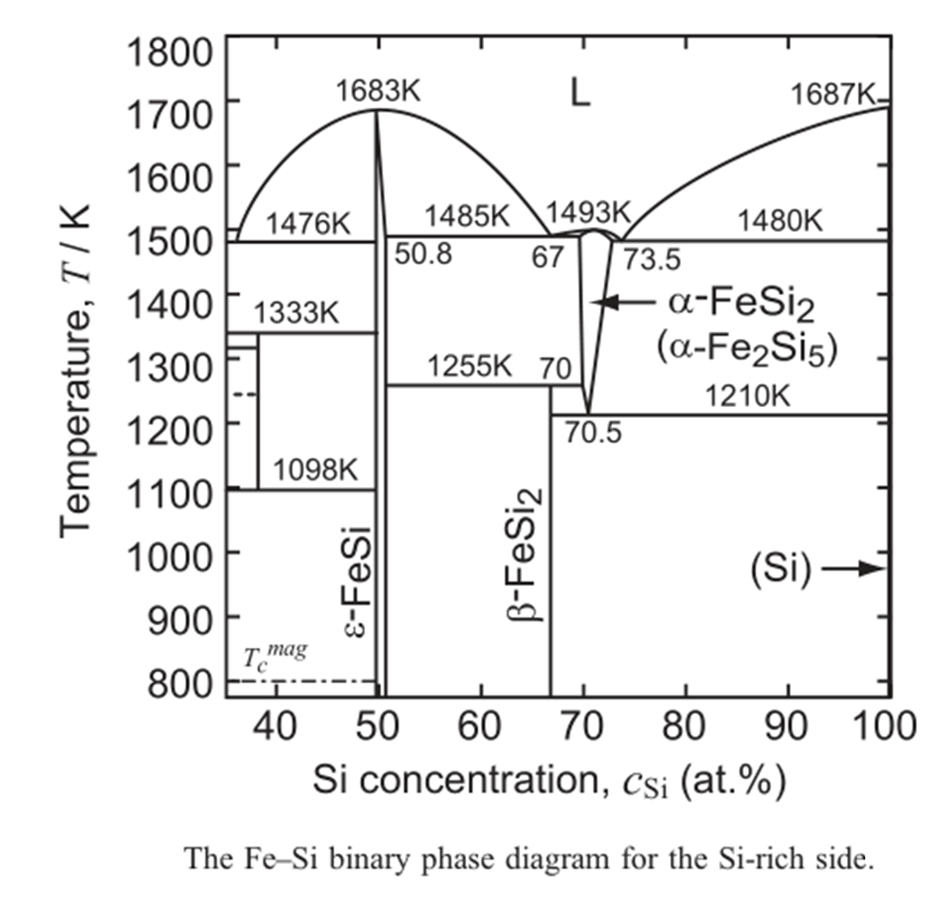
Phase Transition
Formation of β-FeSi₂
Peritectoid reaction
α-Fe₂Si₅ + ε-FeSi β-FeSi₂
Eutectoid decomposition of
α-Fe₂Si₅ β-FeSi₂ and Si

Slide 7
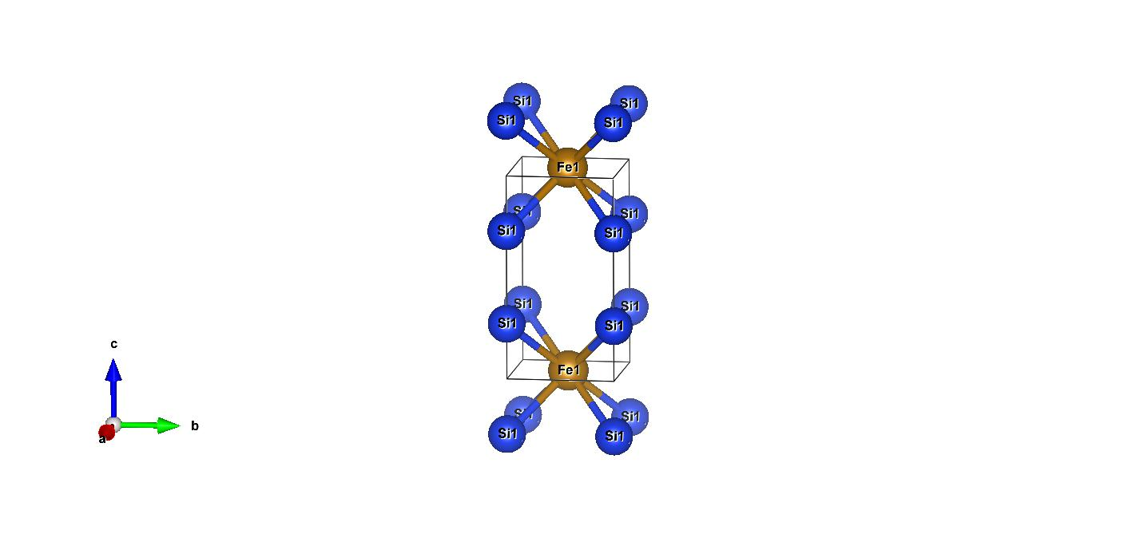
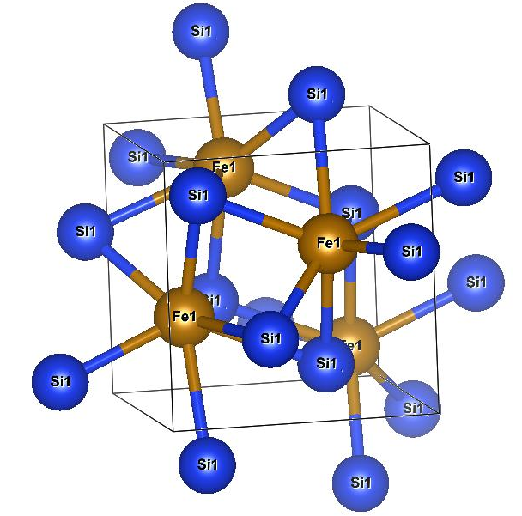
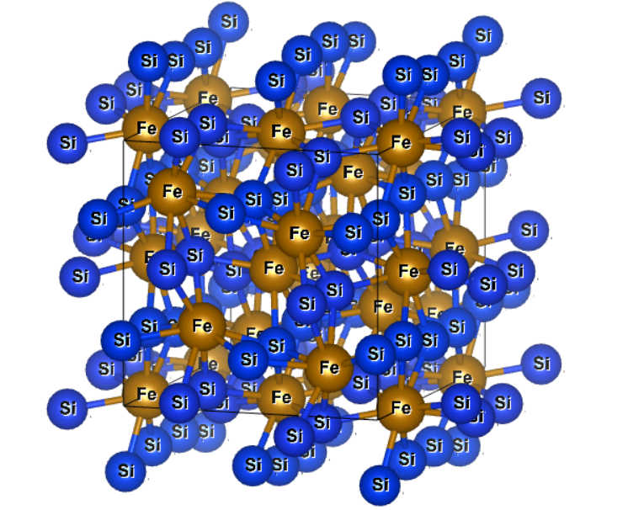
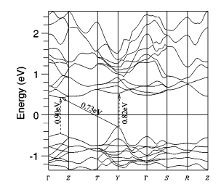
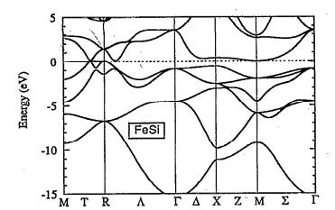
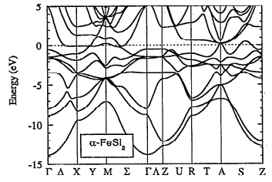
Crystal Structures
Iron Silicides phases
β-FeSi₂
ε-FeSi
α-Fe₂Si₅
Semiconducting
Metallic
Metallic

Slide 8
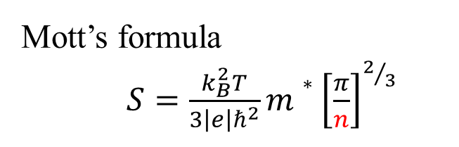

Objective of the Research
Investigating the effect of Mn doping for enhancing the ZT of
β-FeSi₂.
Achieving high ZT,
S ρ, κ
In the case of Mn doped β-FeSi₂
ρ ( $∝$ n ⁻¹) carrier mobility (μ)
($∝$ μ ⁻¹)
carrier concentration (n)
S ( $∝$ n ^{-2/3})
Optimizing the level of doping
ZT = S² T/ρ κ
}
Drude’s formula
ρ = 1/ |e| μ n
Mott’s formula
$S=\frac{k_{B}^{2}T}{3\left|e\right|ℏ^{2}}m∗{\left[\frac{π}{n}\right]}^{2/3}$
Notes:
The purpose of this study is to investigates the effect of Co and Ni doping for enhancing the ZT of β-FeSi₂.
To achieve high ZT, we need to increase the S of the material and decrease the ρ and κ.
But in the case of Co and Ni doped β-FeSi₂ while decreasing the ρ, the carrier concentration (n_{H}) increases which in turn reduces the S.
So, for this purpose, we are going to optimize the level of doping to achieve maximum S and lower ρ to achieve high ZT.

Slide 9
Experimental Methods

Slide 10
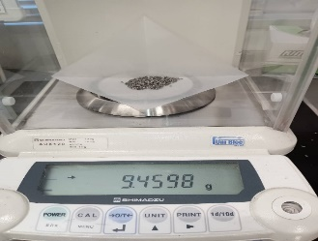
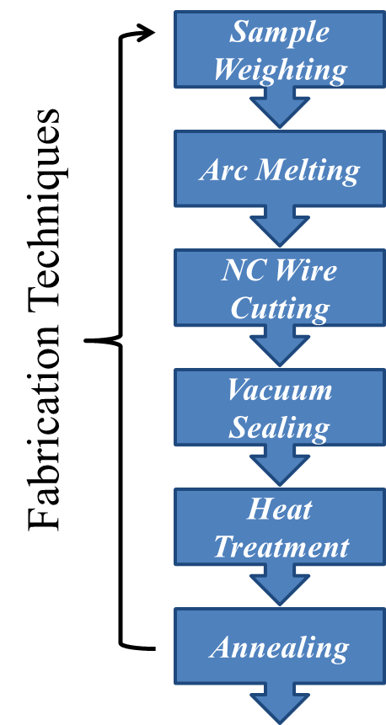
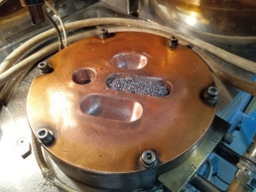
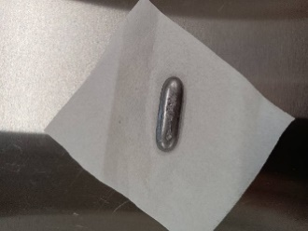
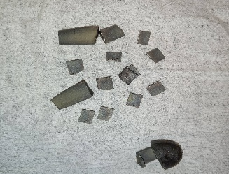
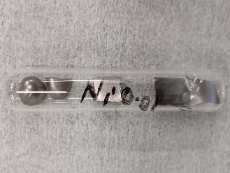
Experimental Methods
XRD
RIGAKU SmartLab
SEM
3D SEM VE 8800
SEM-EDS
Hitachi SU 8010
Seebeck Coefficient
Characterization Techniques
Resistivity
ResiTest 8300 up to 395 K
Hall Effect
At 300 K
HT Measurement
At 1423 K for 3 hr
Homebuilt Apparatus up to 800 K
Thermal Conductivity
At 1113 K for 20 hr
PEM-2 apparatus

Slide 11
Results and Discussions

Slide 12

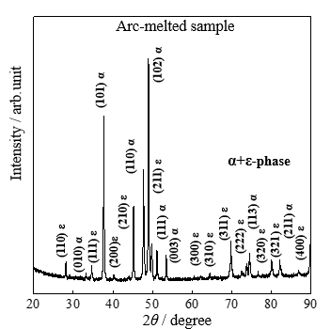
X-ray Diffraction for Fe_{1-x}Mn_{x}Si₂ (0 < x < 0.1)
SmartLab Rigaku with Cu Kα.
XRD data tallied ICSD database.
Metallic ε-phase at 2θ = 45.2º was observed along with β-phase.
Rietveld Analysis for the crystal parameters
(202)
(422)
(020)
(202)
(312)
(041)
(421)
(112)
(331)
(240
(023)
(024)
(242)
(602)
(515)
(533)

Slide 13
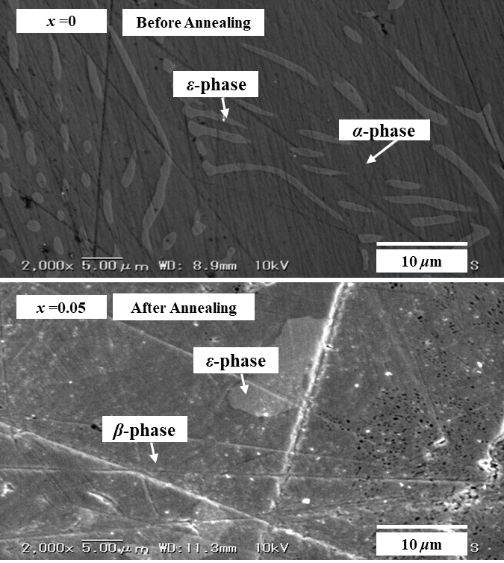
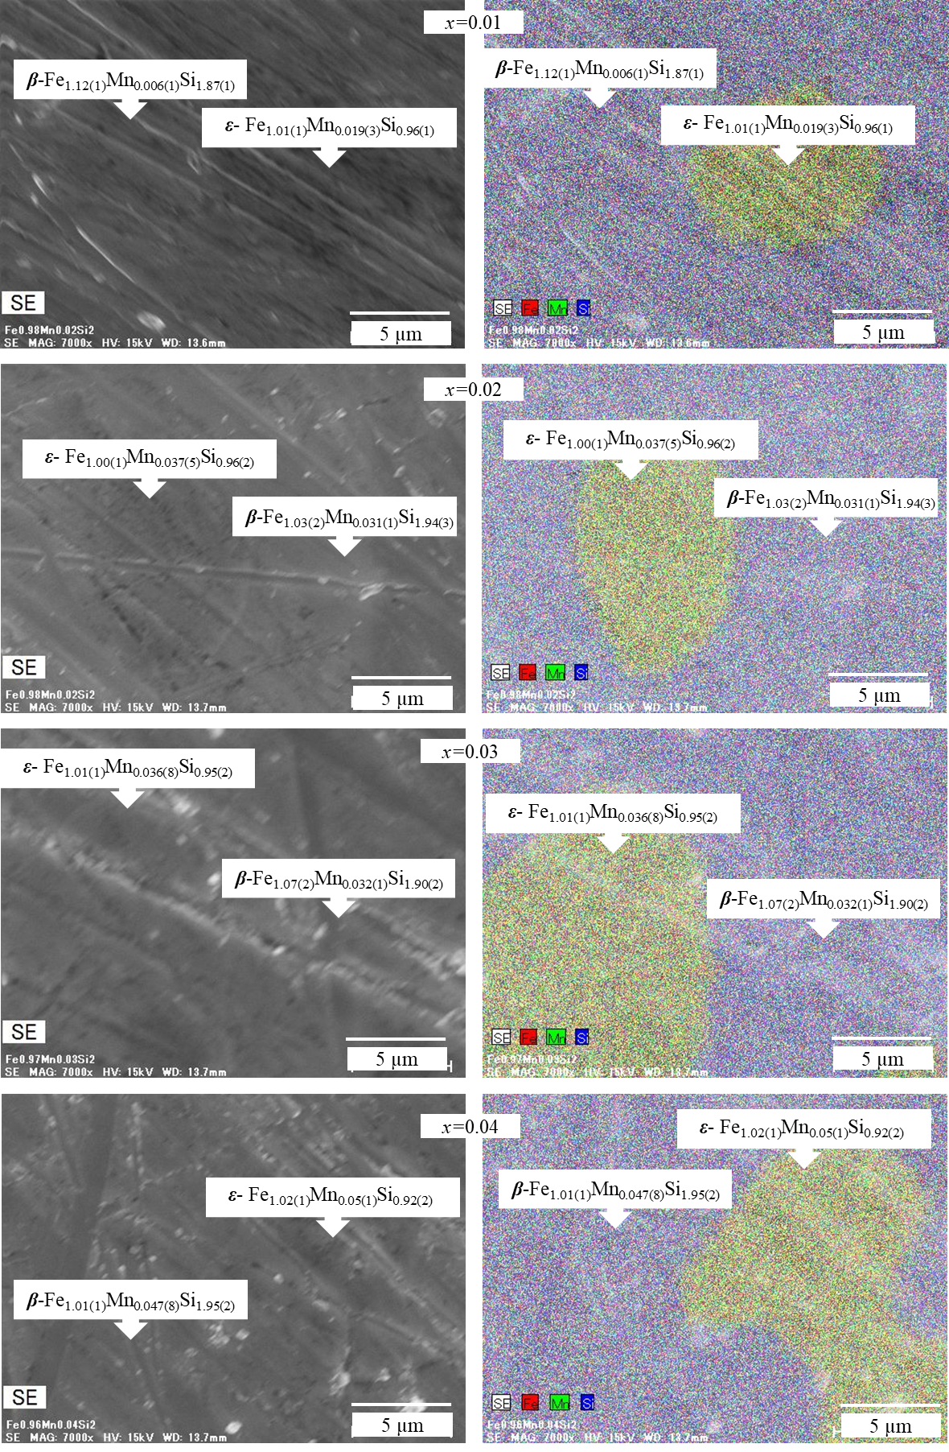
SEM-EDS
SEM, SU8010, Hitachi
EDS XFlash5060FQ,
Bruker
Non doped
Non-Annealed samples
Non doped
Annealed samples

Slide 14

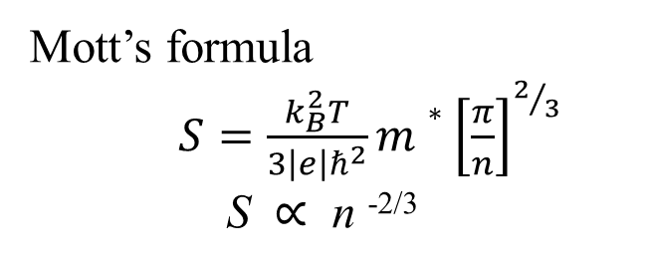
Seebeck Coefficient
Pisarenko Graph
Mott’s formula
$S=\frac{k_{B}^{2}T}{3\left|e\right|ℏ^{2}}m∗{\left[\frac{π}{n}\right]}^{2/3}$
S $∝$ n ^{-2/3}
Solid lines drawn by Mott’s formula
Circles and dots represents the experimental values
Good fitting occurs at m*= 0.5 ~ 2.5 m_{e}
Notes:
Seebeck Coefficient S was measured over the temperature range of 80-800K.
The original β-FeSi₂ showed S was positive at 80-195K which indicate it as a p-type semiconductor while changing to n-type after 200K up to 800K.
The graph can be explained by the Mott’s formula S $∝$ n_{H} ^{-2/3}
Resistivity ρ of the sample was measured over the temperature range of 80-800K.
Drude’s formula explains the correlation between ρ and n_{H}, ρ $∝$ n_{H} ⁻¹

Slide 15
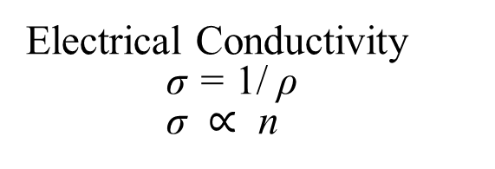
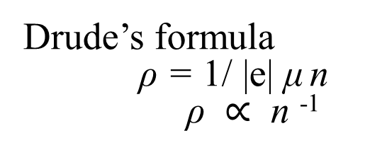
Electrical Resistivity
Electrical Conductivity
Drude’s formula
ρ = 1/ |e| μ n
ρ $∝$ n ⁻¹
Electrical Conductivity
σ = 1/ ρ
σ $∝$ n

Slide 16
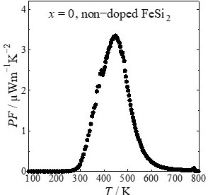
Power Factor PF
PF = S²/ ρ
PF of the doped samples increased compared to non -doped FeSi_{2.}
Maximum PF for non-doped β-FeSi₂ 3.4 μWm⁻¹K⁻² at 450 K
Maximum PF for doped β-Fe_{0.97}Mn_{0.03}Si₂ and 971 μWm⁻¹K⁻² at 800 K respectively.

Slide 17
Thermal Conductivity
Electrical Thermal Conductivity
Thermal Conductivity κ
κ= κ_{e} + κ_{l}
Increased
Reason
Formation of Metallic Phase
Increase in Electronic thermal Conductivity
Electronic Thermal Conductivity κ_{e}
κ_{e} = L₀ρ⁻¹T
Wiedemann Franz law

Slide 18
ZT Figure of Merit
ZT = S² ρ⁻¹ κ⁻¹ T
=PF κ⁻¹ T
For non-doped β-FeSi₂
ZT = 0.00024 at 450K
Maximum ZT = 0.12 at 800K
for β-Fe_{0.97}Mn_{0.03}Si₂
Notes:
The Power Factor (PF) of the samples was calculated over the temperature range of 80-800K.
The formula which explains the data is as, PF = S²/ ρ
It is very much clear from the data that the PF of the doped samples increased with increasing temperature as compared to non doped FeSi_{2.}
The dimensionless ZT figure merit for the samples was calculated over the temperature range of 80-800K.
The formula which explains the data is as,
ZT = S² ρ⁻¹ κ⁻¹ T
=PF κ⁻¹ T
It is very much clear from the data that the ZT of the doped samples increased with increasing temperature as compared to non doped β-FeSi₂.
The maximum ZT achieved was 0.31 for Fe_{0.96}Co_{0.02}Ni_{0.02}Si₂

Slide 19
Conclusion

Slide 20
Summary
Samples for β-Fe_{1-x}Mn_{x}Si₂ (0 < x < 0.10) were synthesized by Arc Melting method followed by Heat Treatment at 1423 K for 3 hr and Annealing at 1113 K for 20 hr.
All samples were grown in single β-phase but still some traces for ε-phase were found at 2θ = 45.2º, which was confirmed by SEM and SEM-EDS images.
Semiconducting phase increases for β-Fe_{1-x}Mn_{x}Si₂ (0.05 < x < 0.10) and is higher than 95 % for all samples and is maximum at Fe_{0.96}Mn_{0.04}Si₂ which is 98.86 %.
In samples of β-Fe_{1-x}Mn_{x}Si₂ (0 < x < 0.10) decrease in ρ occurred because of increase in carrier concentration while S was enhanced because of increase in effective mass.
Because of reduction in bipolar effect S becomes uniform at high temperature for β-Fe_{1-x}Mn_{x}Si₂ (0 < x < 0.10) samples as compared to β-FeSi₂
Thermal Conductivity for all doped samples slightly increases in comparison to non doped samples.
Throughout the study maximum Power factor was achieved for β-Fe_{0.97}Mn_{0.03}Si₂ which is 971 μ Wm⁻¹K⁻² while highest ZT was found to be 0.12 for β-Fe_{0.97}Mn_{0.03}Si₂ at 800 K.

Slide 21
Thank you
for your kind attention

