Slide 1


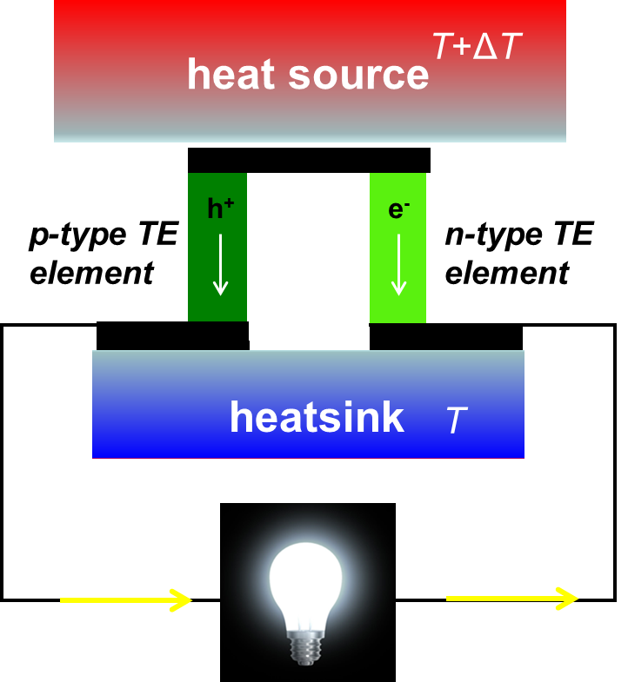
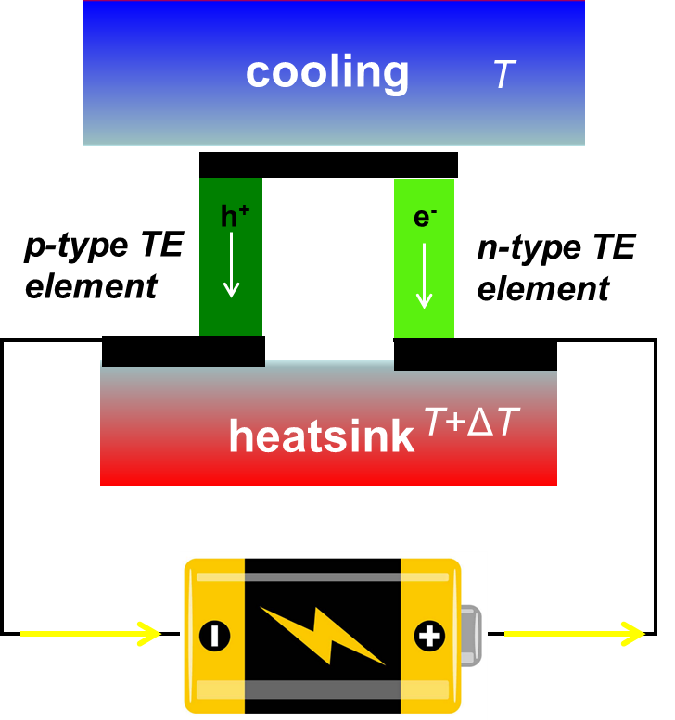
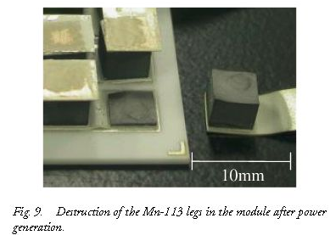
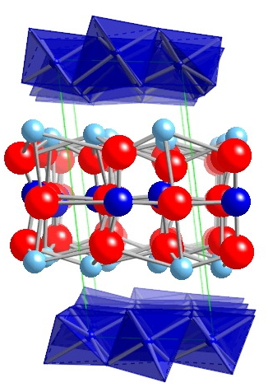
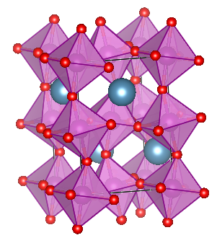
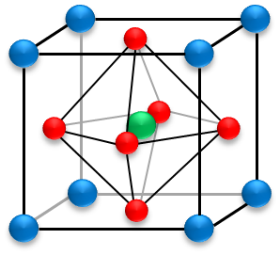
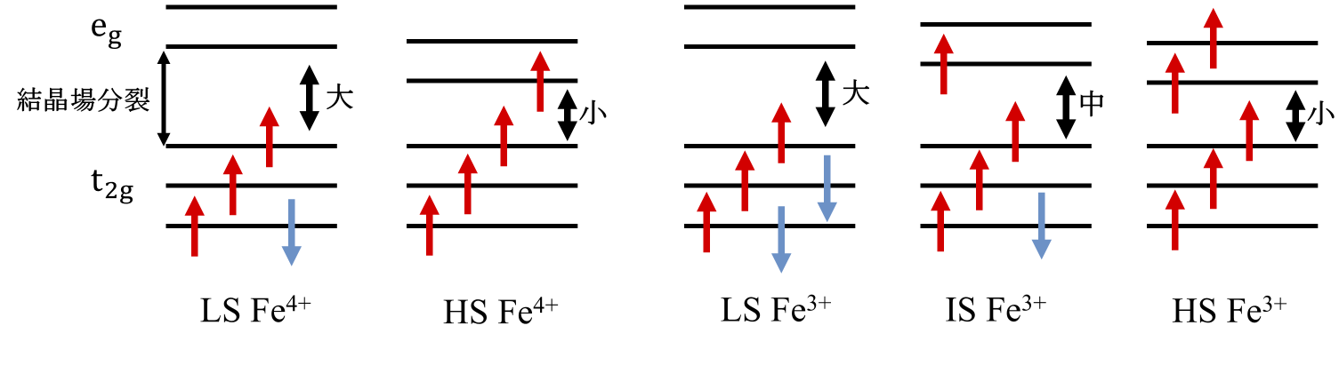
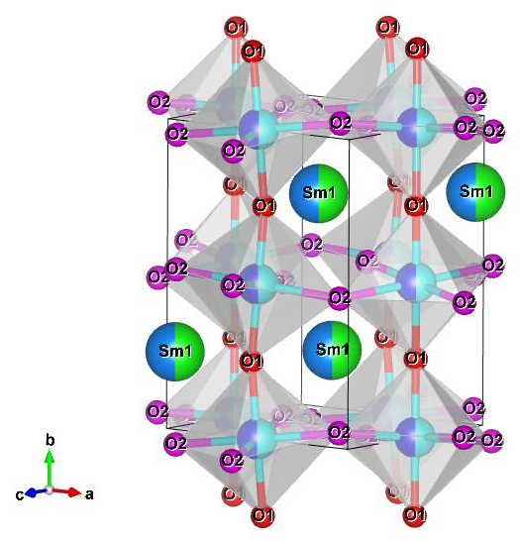
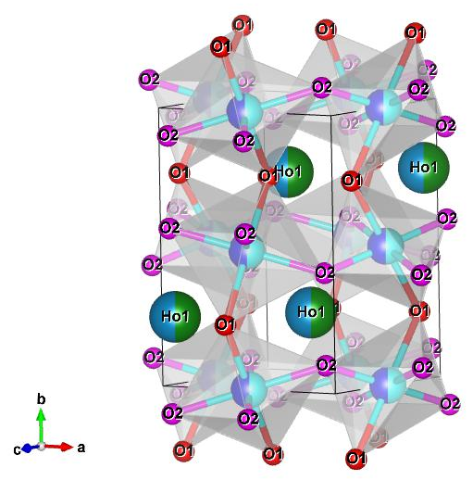
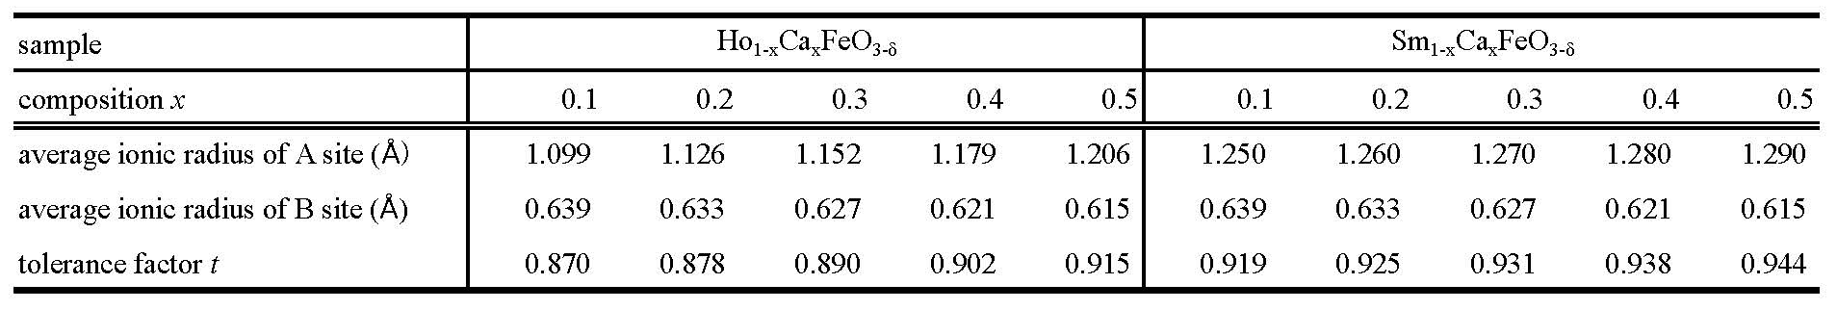
P-180
The 41st International and 7th Asian Conference on Thermoelectrics (ICT/ACT 2025) on June 15-19, Sendai, Japan
Thermoelectric properties of Sm_{1-x}Ca_{x}FeO_{3-δ} (0.1≦x≦0.8) and
Ho_{1-x}Ca_{x}FeO_{3-δ} (0.1≦x≦0.9) perovskite-type oxides
Hiroshi Nakatsugawa^{1※}, Muhammad Ibrar¹, Fumiya Konishi¹, Koichi Kitahara²
¹Yokohama National University (Yokohama 240-8501 Japan), ² National Defense Academy (Yokosuka 239-8686 Japan)
※E-mail : nakatsugawa-hiroshi-dx@ynu.ac.jp TEL : +81-45-339-3854
Introduction
Oxides thermoelectric materials
Heikes formula
S∞ for A_{1-x}Ca_{x}Fe³⁺_{1-x}Fe⁴⁺_{x}O_{3-δ} (δ = 0)
TE generation
TE cooling
●Advantages
η_{max} = 2%
LS Fe³⁺_{1-x} LS Fe⁴⁺_{x}
Chemically stable in oxidizing high-temperature
Composed of elements that are abundant on earth
Does not contain toxic elements
Maintenance-free and can be used for long time
Simple structure, resistant to vibration and impact
Int.Appl.Ceram.Tech. 4, 535 (2007)
●Disadvantages
IS Fe³⁺_{1-x} LS Fe⁴⁺_{x}
Oxide thermoelectric materials that exhibit excellent performance in both P-type and N-type configurations exist, but there are no oxide TE conversion materials that exhibit both P-type and N-type performance with the same composition.
●Research purpose
HS Fe³⁺_{1-x} HS Fe⁴⁺_{x}
energy conversion efficiency
coefficient of performance
Ca_{2.7}Bi_{0.3}Co₄O₉
(Ca349)
CaMn_{0.98}Mo_{0.02}O₃
(CaMnO₃)
Focusing on transition metal iron oxides with a perovskite structure, we aim to develop TE oxides that exhibit both P-type and N-type behavior with the same composition.
1.24Å
1.07Å
1.34Å
Experimental
A (Sm³⁺, Ho³⁺, Ca²⁺)
Small
Small
XRD ： space group Pnma (No.62, D_{2h}¹⁶)
1.40Å
Middle
Large
O²⁻
Large
O1
O1
tolerance factor：
B (LS Fe³⁺, IS Fe³⁺, HS Fe³⁺,
LS Fe⁴⁺, HS Fe⁴⁺)
crystal field splitting
O2
O2
perovskite structure : ABO₃ (t = 1)
Fe
Fe
crystal field splitting：Large
crystal field splitting：Small
Sm_{0.5}Ca_{0.5}
Ho_{0.5}Ca_{0.5}
Samples with x ≥ 0.6 show advanced oxygen deficiency and cannot maintain the Pnma perovskite structure.
Sm_{0.5}Ca_{0.5}FeO_{3-δ}
Samples with x ≥ 0.6 show increased octahedral distortion and cannot maintain the Pnma perovskite structure.
Ho_{0.5}Ca_{0.5}FeO_{3-δ}
(240)
crystal field splitting : Small or Middle
(123)
crystal field splitting :Large
(002)
(123)
(240)
(020)
(121)
(212)
(242)
(020)
(002)
(212)
(242)
(040)
(321)
(111)
(121)
(040)
(311)
(042)
(111)
(200)
(210)
(131)
(311)
(042)
(410)
(101)
(210)
(321)
(221)
(230)
(200)
(131)
(101)
(221)
(230)
(410)
Rietveld analyses
Electric resistivity ρ
Seebeck coefficient S
Thermal conductivity κ
Magnetic susceptibility χ
Evaluation of ZT
(202)
(202)
Weighing
mixing
pre-firing
crushing
mixing
press
forming
sintering
Powder
XRD
1000℃ 24h
in air
1200℃ 48h
in O₂
Results & Discussion
Curie-Weiss law：
Rietveld analyses for XRD data
magnetic susceptibility χ
s = 0.5
s = 1.0
LS Fe³⁺_{1-x} LS Fe⁴⁺_{x} or
IS Fe³⁺_{1-x} LS Fe⁴⁺_{x}
s = 1.5
s = 1.0
HS Fe³⁺_{1-x} HS Fe⁴⁺_{x}
s = 2.5
s = 2.0
electric resistivity ρ
Seebeck coefficient S
thermal conductivity κ
figure of merit ZT
熱伝導率
Conclusion
Sm_{1-x}Ca_{x}FeO_{3-δ} has a stable orthorhombic perovskite structure when x ≤ 0.5, but the perovskite structure is not maintained when x ≥ 0.6 due to oxygen deficiency. Since the distortion of the FeO₆ octahedra is small, the spin state of the Fe sites is LSFe³⁺_{1-x}LSFe⁴⁺_{x} or ISFe³⁺_{1-x}LSFe⁴⁺_{x}. As x increases, the Seebeck coefficient decreases, and consequently, ZT also decreases with increasing x, reaching a maximum ZT = 0.011 for x = 0.1 @ 600 K.
Ho_{1-x}Ca_{x}FeO_{3-δ} exhibits a stable orthorhombic perovskite structure at x ≤ 0.5, but at x ≥ 0.6, the perovskite structure is not maintained due to increased distortion of the FeO₆ octahedra. Due to the large distortion of the FeO₆ octahedra, the spin state of the Fe sites is HSFe³⁺_{1-x}HSFe⁴⁺_{x}. As x increases, the Seebeck coefficient remains constant, ZT also maintains a high value, reaching a maximum ZT = 0.014 for x = 0.1 @ 600K.
Finding an n-type Fe transition metal oxide that maintains the orthorhombic perovskite structure even at x ≥ 0.6 and exhibits ZT = 0.01 @ 600 K is a future challenge.
Acknowledgments : Part of this research experiment was conducted using equipments at the Institute for Solid State Physics, University of Tokyo,
National Defense Academy, and the Instrumental Analysis and Evaluation Center, Yokohama National University.

