Slide 1

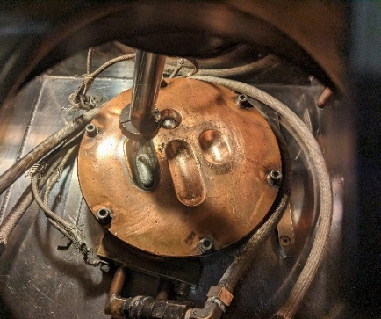
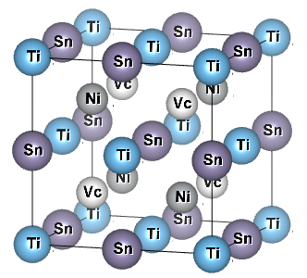
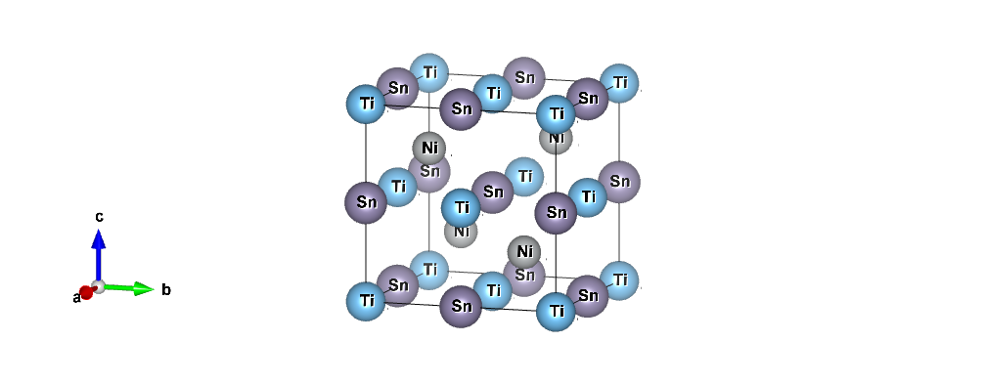
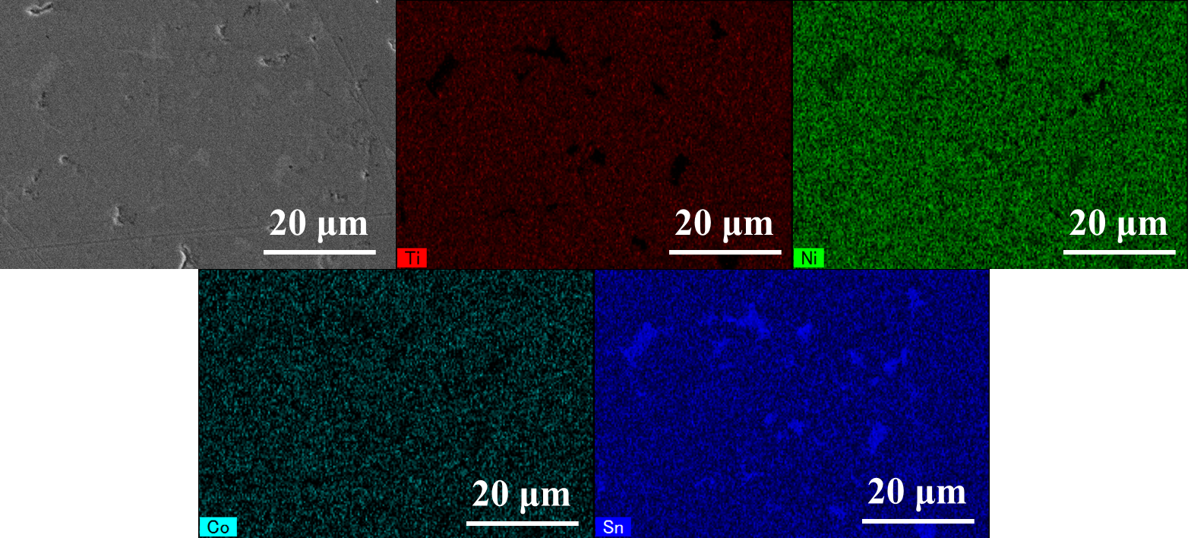
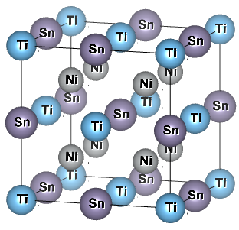

The 41st International and 7th Asian Conference on Thermoelectrics (ICT/ACT 2025)
June 15-19, 2025, Sendai, JAPAN
P-153
P-type thermoelectric properties of half-Heusler alloys TiNi_{1-x-y}Co_{y}Sn (0≤x≤0.1, 0≤y≤0.05) below 800 K
Kosuke Yamazaki¹, Sopheap Sam², Hiroshi Nakatsugawa^{1*} *E-mail : nakatsugawa-hiroshi-dx@ynu.ac.jp
1 Yokohama Natl. Univ., 79-5 Tokiwadai, Hodogaya, Yokohama, Kanagawa 240-8501, (Japan)
2 National Institute for Materials Science Namiki 1-1, Tsukuba, Ibaraki 305-0044, (Japan)
Introduction
Experimental method
Design for Thermoelectric (TE) Materials
  High dimensionless figure of merit (ZT)
  Low toxicity, Low cost, Practical
Characteristics of half-Heusler alloys TiNiSn
  N-type thermoelectric material
  High power factor (Wm⁻¹K⁻²)
  Chemically stable at high temperature (≤ 1273 K)
What we have found so far
  More than 3% Co substitution at Ni-site makes P-type*
  Low ZT compared to N-type (≈0.3)
  ⇒ Focus on intrinsic defects (interstitial Ni atoms)
What effect decreasing defects have on TE properties
Hole carrier density increases due to decrease of interstitial Ni atoms as donor impurity. As a result, electrical resistivity (ρ) decreases.
Sample preparation
Characterization method
ΔT
P-type
Weighing
_{x} ^{y} | 0.01 | 0.03 | 0.05
0 | ○ | ○ | ○
0.01 | - | - | ○
0.03 | - | - | ○
0.05 | ○ | ○ | ○
0.08 | - | - | ○
0.1 | ○ | ○ | ○
  Crystal structure
    XRD (Cu Kα : λ=1.5418 Å, SmartLab, Rigaku Holdings Co. )
    Rietveld analysis (RIETAN-FP)
  Chemical composition
    ICP-OES (ICPE-9000, SHIMADZU Co. )
    SEM-EDS (SU8010, Hitachi High-Tech Co.)
  Hall measurements
    300 K (ResiTest8300, TOYO Co. )
  Seebeck coefficient, Electrical resistivity
    80-395 K (ResiTest8300, TOYO Co. )
    395-800 K (Home-built apparatus)
  Thermal conductivity
    300-800 K (PEM-2, ULVAC, Inc. )
N-type
TiNi_{1-x-y}Co_{y}Sn
(0≤x≤0.1, 0≤y≤0.05)
S
ρ
κ
T
：Seebeck coefficient (VK⁻¹)
：Electrical resistivity (Ωm)
：Thermal conductivity (Wm⁻¹K⁻¹)
：Average Temperature (K)
Arc melting
Ti | 4a | (0, 0, 0)
Ni | 4c | (¼, ¼, ¼)
Sn | 4b | (½, ½, ½)
Vacancy (Vc) | 4d | (¾, ¾, ¾)
7 × 7 × 1 mm³ (ρ, S)
7 × 7 × 2 mm³ (κ)
Wire cutting
* Yamazaki, K. et al. Solid State Sci. 157, 107708(2024) .
Vacuum pump
Objective
Annealing
The effects of reducing interstitial Ni atoms on the crystal structure, thermoelectric properties, and the ZT values of TiNi_{1-x-y}Co_{y}Sn (0≤x≤0.1, 0≤y≤0.05) are clarified.
XRD pattern
1073 K, 168h
Rietveld analysis
Composition analysis
Sample composition | Actual Sample composition
TiNiSn | Ti_{1.01}Ni_{1.03}Sn_{0.96}
TiNi_{0.95}Co_{0.05}Sn | Ti_{1.00}Ni_{0.99}Co_{0.05}Sn_{0.96}
TiNi_{0.94}Co_{0.05}Sn | Ti_{1.02}Ni_{0.94}Co_{0.05}Sn_{0.98}
TiNi_{0.92}Co_{0.05}Sn | Ti_{1.02}Ni_{0.95}Co_{0.05}Sn_{0.96}
TiNi_{0.90}Co_{0.05}Sn | Ti_{1.02}Ni_{0.93}Co_{0.05}Sn_{0.95}
TiNi_{0.87}Co_{0.05}Sn | Ti_{1.01}Ni_{0.90}Co_{0.05}Sn_{0.97}
TiNi_{0.85}Co_{0.05}Sn | Ti_{1.02}Ni_{0.89}Co_{0.05}Sn_{0.95}
$F\overline{4}3m$ (No. 216)
R_{wp} | 2.570
R_{e} | 1.371
S | 1.874
R_{B} | 3.773
R_{F} | 1.943
All the samples exhibit compositions close to the nominal values, with the Ni content decreasing as x increases, as confirmed by ICP-OES.
TiNi_{0.85}Co_{0.05}Sn
The indexed peaks in the figure are the peaks of the HH structure. The peaks were observed in all samples, indicating that the prepared samples are composed of HH phase.
The lattice constants and 4d site occupancy (interstitial Ni atoms) decrease with the reduction in Ni composition, suggesting a decrease in resistivity.
For x > 0.05, the mass fraction of the main phase decreases while the impurity phase increases, suggesting a deterioration in the thermoelectric properties.
Regions exhibiting strong Sn intensity are attributed to the presence of Ti₆Sn₅ and Sn, as identified by XRD.
Thermoelectric properties & Electrical transport properties
【Why does ρ decrease, yet |S| remains unchanged?】
… ρ ∝ n⁻¹, µ⁻¹
Mott’s formula
… |S| ∝ m*, n^{-2/3}
e⁻
e⁻
e⁻
ZT_{max}=0.18 (T=700 K)
Interstitial Ni atoms decrease
h⁺
h⁺
h⁺
h⁺
e⁻
ZT increase because the resistivity decrease.
h⁺
h⁺
h⁺
h⁺
Sample composition | ZT | T (K)
HfNi_{0.85}Co_{0.15}Sn* | ~0.3 | 700
TiNi_{0.92}Co_{0.05}Sn | 0.18 | 700
ZrNi_{0.98}Co_{0.02}Sn** | ~0.08 | 700
* Ai, X. et al. Adv. Funct. Mater. 33, 2305582(2023) .
Increase in hole carrier density due to decrease in interstitial Ni atoms.
The reduction of interstitial Ni atoms modifies the electronic structure in a way that enhances the Seebeck coefficient.
** Xie, H.-H. et al. J. Electron. Mater. 41, 1826 (2012).
Conclusion
The crystal structure analysis shows that the interstitial Ni atoms decrease after the Ni composition ratio decrease. Thermoelectric properties show that the interstitial Ni atoms slightly decreasing is effective to improve ZT.
The maximum ZT (TiNi_{0.92}Co_{0.05}Sn) is attributed to the significant decrease of ρ and the maintenance of |S|. To further increase ZT, a reduction of κ is effective.
This results show that carrier density can be optimized by a simple method of reducing Ni composition, which is applicable to similar half-Heusler alloys.
In the future, we plan to reduce lattice thermal conductivity (κₗₐₜ) by doping with heavy elements to further increase ZT.
Acknowledgments: SmartLab, ICPE-9000 and SU8010 in this study were performed at the Instrumental Analysis Center, Yokohama National University. PEM-2 was performed at National Defense Academy of Japan.

